Slide 1
JLGF Gender Material - English

Slide 2
Gender Concepts

Slide 3
Gender Concepts
Gender Vs Sex
Gender Discrimination
Gender Roles and Gender Identity
Gender Equity, Equality and Empowerment
Development of Gender Policies (WID, WAD & GAD)
Gender Mainstreaming
Gender Planning
Gender Analysis
Productive and Reproductive Work
Gender Responsive Budgeting

Slide 4
Gender Vs Sex

Slide 5
Gender Vs Sex
Sex = male and female
refers to biological differences; chromosomes, hormonal profiles, internal and external sex organs.
Gender = masculine and feminine
describes the characteristics that a society or culture delineates as masculine or feminine.
Your sex as male or female is a biological fact that is the same in any culture, what that sex means in terms of your gender role as a 'man' or a 'woman' in society can be quite different cross culturally.
These 'gender roles' have an impact on the health of the individual.
In sociological terms 'gender role' refers to the characteristics and behaviors that different cultures attribute to the sexes.

Slide 6
Gender Vs Sex
 | Gender | Sex
About | An individual's or society's understanding of what it means to look, feel, and act feminine or masculine. Social constructs that affect one's personal gender identity and expression, and how that expression is perceived by others. | The physiological, biological characteristics of a person, with a focus on sexual reproductive traits, wherein males have male sexual traits (penis, testes, sperm) and females have female sexual traits (vagina, ovaries, eggs). Primary sex characteristics - a vagina or a penis and other organs related to reproduction. Secondary sex characteristics - physical distinctions between males and females not directly connected to reproduction.
What it Affects | Gender identity, gender expression, and gender roles. | The way someone looks, physiologically, and ability to procreate sexually. Affects chromosomes.
Types | Many possible and so sometimes known as a "non-binary" concept. Most common gender is cisgender. Other genders may include trans*, genderqueer, third gender, etc. | Male, female, or intersex. Sometimes called a "binary" concept because there are primarily two sex types (male or female).
Examples | Gender-based constructs: Blue for boys, pink for girls. Skirts for women, pants for men. Men as leaders, women as followers. | Male sex traits (penis, testes, sperm). Menstrual leave for females in parts of Asia.
Changeable? | Difficult, if not impossible to change, as it is a part of someone's psychological identity. Can be expressed contrary to how one feels, though (e.g., wearing men's clothing when wanting to wear women's). | To varying degrees with hormone replacement therapy and/or sex reassignment surgery.
http://www.diffen.com/difference/Gender_vs_Sex

Slide 7
Gender Vs Sex - Quiz
1. The penis and the vagina are examples of
a. primary sex characteristics
b. secondary sex characteristics
c. changing expectations
d. biological constructions of sexuality
2. At puberty, Suzan developed breasts and her hips grew larger. This is an example of
a. primary sex characteristics
b. secondary sex characteristics
c. sex
d. Gender
3. At puberty, Rami's voice became much lower and his thin arms began to show more muscle. This is an example of
a. primary sex characteristics
b. secondary sex characteristics
c. environmental factors bringing earlier maturation
d. boys' greater strength
https://quizlet.com/72375149/sex-and-gender-flash-cards/

Slide 8
Gender Vs Sex - Quiz
4. The term sex refers to characteristics that are
a. learned
b. inherited
c. demonstrated by some people, but not by others
d. banned in many countries
5. The term gender refers to characteristics that are
a. learned
b. inherited
c. demonstrated by some people, but not by others
d. banned in many countries
6. Suzy, age 8, likes to dress up in her mother's dress and carry her purse. This is an example of
a. sex
b. gender
c. primary sex characteristics
d. secondary sex characteristics
https://quizlet.com/72375149/sex-and-gender-flash-cards/

Slide 9
Gender Vs Sex - Quiz
7. Rami will play with his little sister at home, even putting her in her little stroller and pushing her around the living room. If his friends come over, he won't do this. This is an example of
a. sex
b. gender
c. primary sex characteristics
d. secondary sex characteristics
8. Suzy likes to jump rope with the girls. Joe likes to play soccer with the boys. This is an example of a. sex b. gender c. primary sex characteristics d. secondary sex characteristics
https://quizlet.com/72375149/sex-and-gender-flash-cards/

Slide 10
Gender Vs Sex - Answers
primary sex characteristics
secondary sex characteristics
secondary sex characteristics
Inherited
Learned
Gender
Gender
gender
https://quizlet.com/72375149/sex-and-gender-flash-cards/

Slide 11
Gender Vs Sex - Stereotyping - Careers
On a Flip Chart, create one column for each of the males and females and decide which of the following careers best suits them and why:
Teacher
Lawyer
Doctor
Nurse
Nanny
Chef
Secretary
Oil field worker
CEO, CFO
Waiters/waitress
Airhost/airhostess
Receptionist
Construction worker
Driver / Chauffer
Engineering
Sports coach
Artist

Slide 12
Gender Vs Sex – Personal Traits
On a Flip Chart, create one column for each of the males and females and decide which of the following attributes best describe them and why:
Caring
Rational/non emotional
Selfish
Emotional
Physically strong
Family oriented
Individualistic
Physically fragile
Aggressive
Careful
Sharing
Devotion
Dedication
Loyal

Slide 13
Gender Discrimination

Slide 14
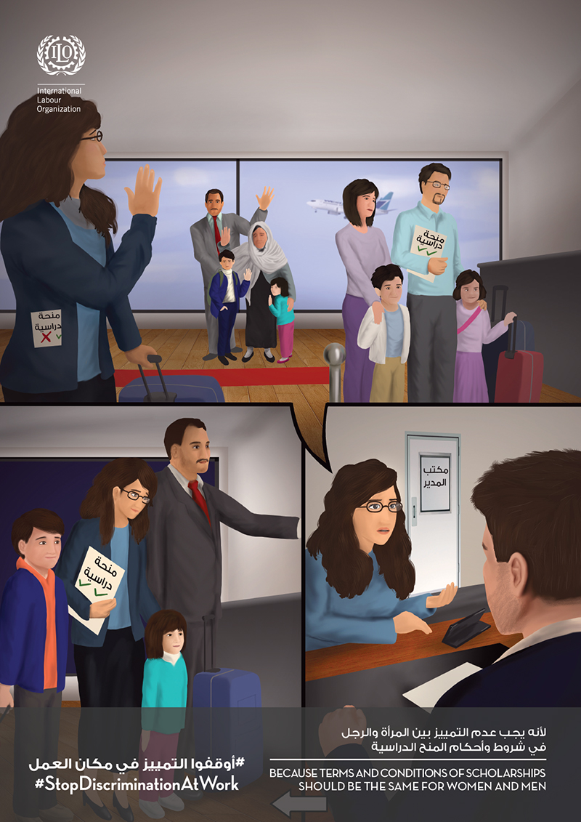
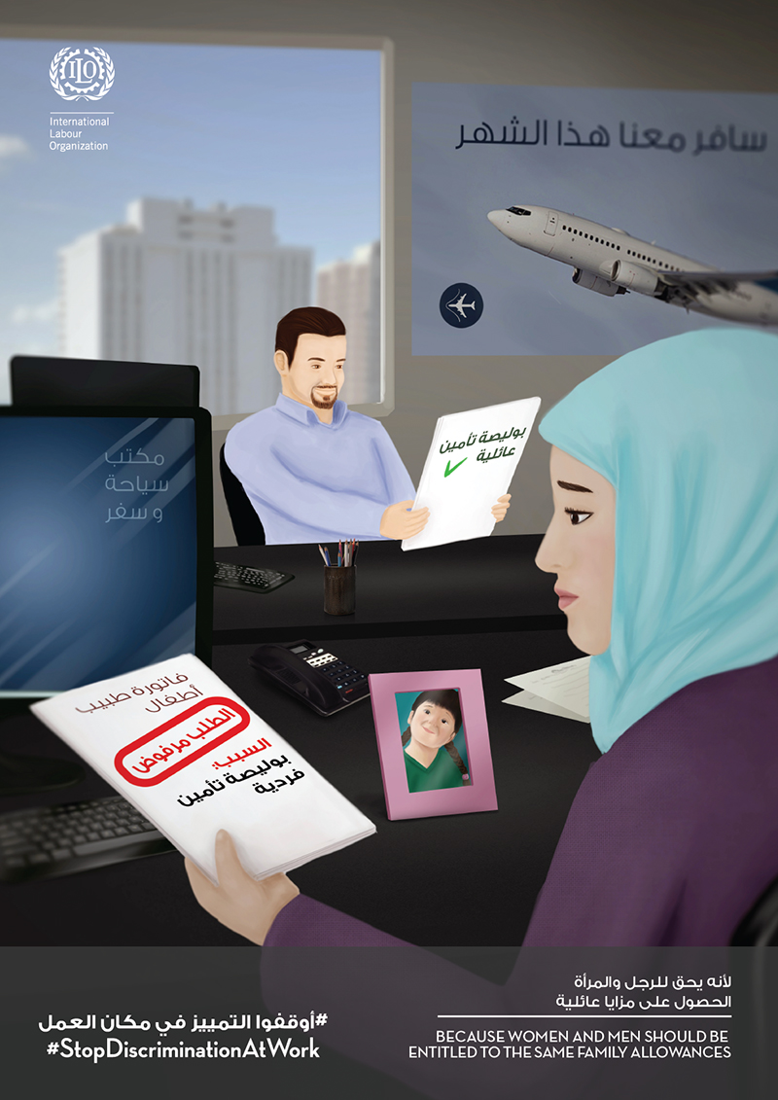
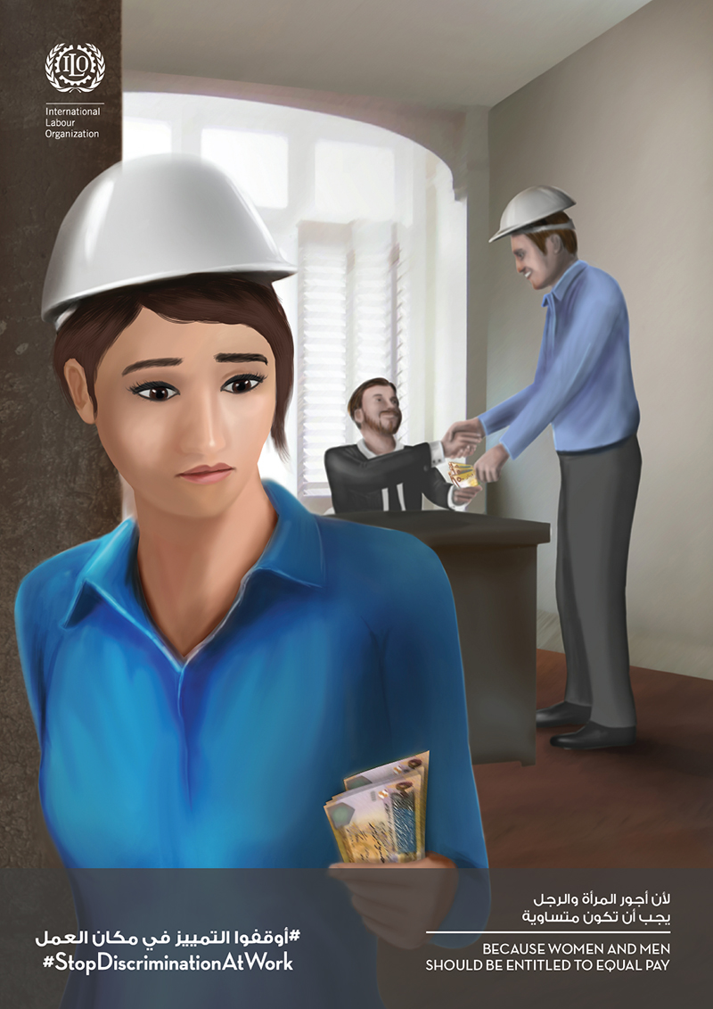
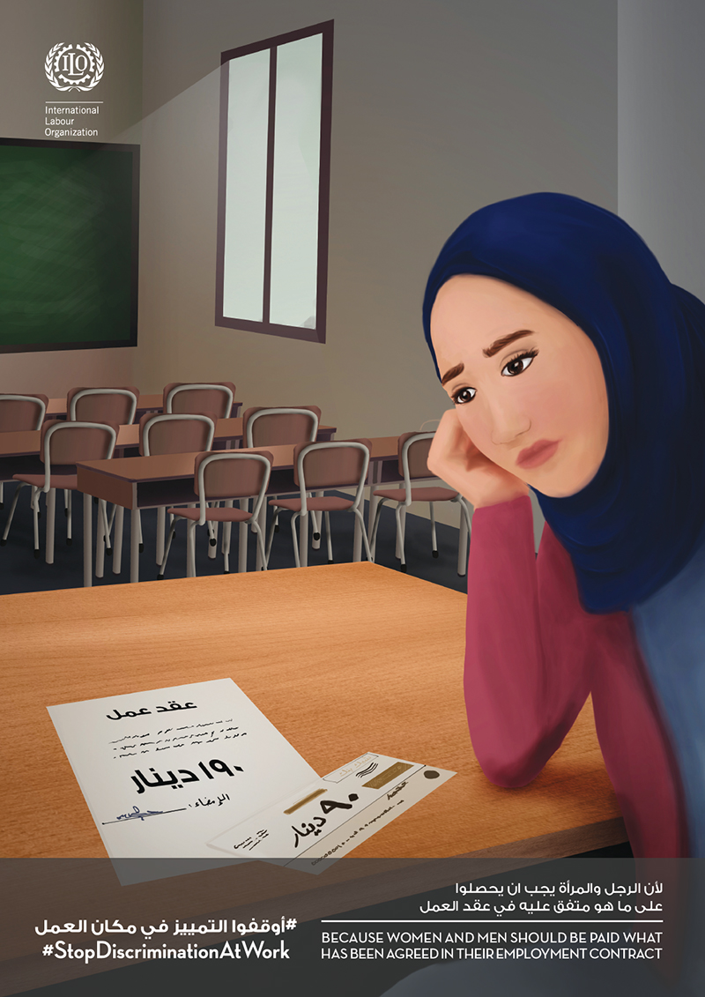
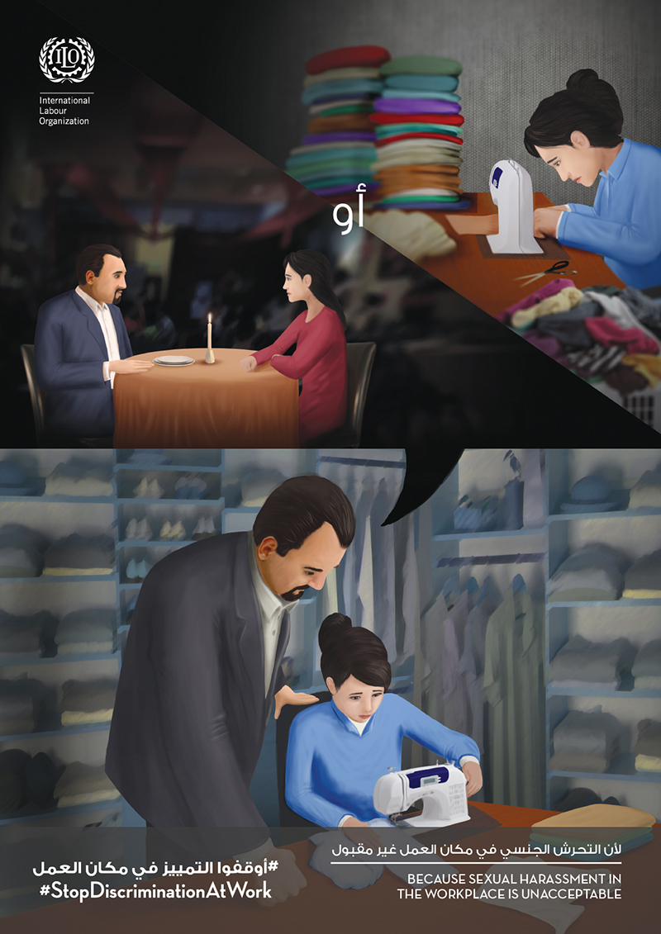
Gender Discrimination
Study Scholarships
Health Insurance Package
Pregnant Job Application
Same Job Different Pay
Unfair Salaries
Minor Work or Marriage
http://www.ilo.org/beirut/media-centre/multimedia/features/WCMS_411179_EN/lang--en/index.htm

Slide 15
Gender Roles and Gender Identity

Slide 16
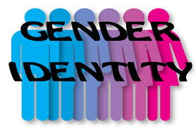
Gender Roles and Gender Identity
Gender identity: personal conception of oneself as male or female (or rarely, both or neither). This concept is intimately related to the concept of gender role, which is defined as the outward manifestations of personality that reflect the gender identity.
Gender identity, is self-identified, as a result of a combination of inherent and extrinsic or environmental factors; an individual's multifaceted sense of
belonging to the male or female sex; One’s awareness of being male or female; sex assignment
Gender role, is manifested within society by observable factors such as behavior and appearance. Expectations for how females and males
should think, act, and feel

Slide 17
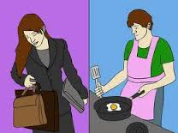
Gender Roles - Quiz
1. What were traditional gender roles like?
Men and women shared tasks of providing financially for the family
Men provided financially and women took care of household chores
Men took care of the children while the women took care of the home
All are correct
2. What are gender roles?
Socially acceptable rules of behavior for men and women
Characters that men and women play in the theater
Characters that have to be played by men or women
The physical differences between men and women

Slide 18
Gender Roles - Exercise
What do you as a wife, mother, sister (female) and your husband, father, or brother (male) do during the 24 hours per day?
Take 15-20 minutes to fill up the matrix in the following page

Slide 19
Hour/Day | He (husband, father, brother) | She (wife, mother, sister)
6 am
7 am
8 am
9 am
10 am
11 am
12 am
1 pm
2 pm
3 pm
4 pm
5 pm
6 pm
7 pm
8 pm
9 pm
10 pm
11 pm
12 pm
1 am
2 am
3 am
4 am
5 am

Slide 20
Gender Roles - Exercise
What does SHE do all day long?
What does HE do all day long?
How many hours does SHE work inside the house?
How many hours does HE work inside the house?
How many hours does SHE work outside the house?
How many hours does HE work outside the house?
Who works more? What do you think?

Slide 21
Gender Equity, Equality and Empowerment

Slide 22
Gender Equity, Equality and Empowerment
Gender equity is the process of being fair to women and men. To ensure fairness, strategies and measures must often be available to compensate for women’s historical and social disadvantages that prevent women and men from otherwise operating on a level playing field. Equity leads to equality.
Gender equality requires equal enjoyment by women and men of socially-valued goods, opportunities, resources and rewards. Where gender inequality exists, it is generally women who are excluded or disadvantaged in relation to decision-making and access to economic and social resources. It does not often result in equal outcomes for men and women.
Gender equality does not mean that men and women become the same; only that access to opportunities and life changes is neither dependent on, nor constrained by, their sex. Achieving gender equality requires women’s empowerment to ensure that decision-making at private and public levels, and access to resources are no longer weighted in men’s favor, so that both women and men can fully participate as equal partners in productive and reproductive life.
http://www.unfpa.org/resources/frequently-asked-questions-about-gender-equality

Slide 23
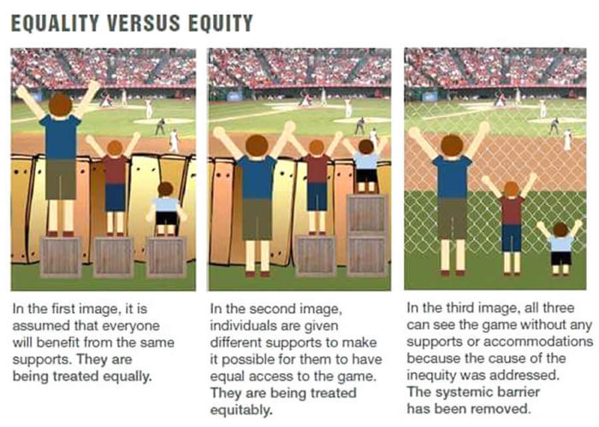
Equity vs Equality
https://www.reddit.com/r/LateStageCapitalism/comments/5meie1/equality_vs_equity/

Slide 24
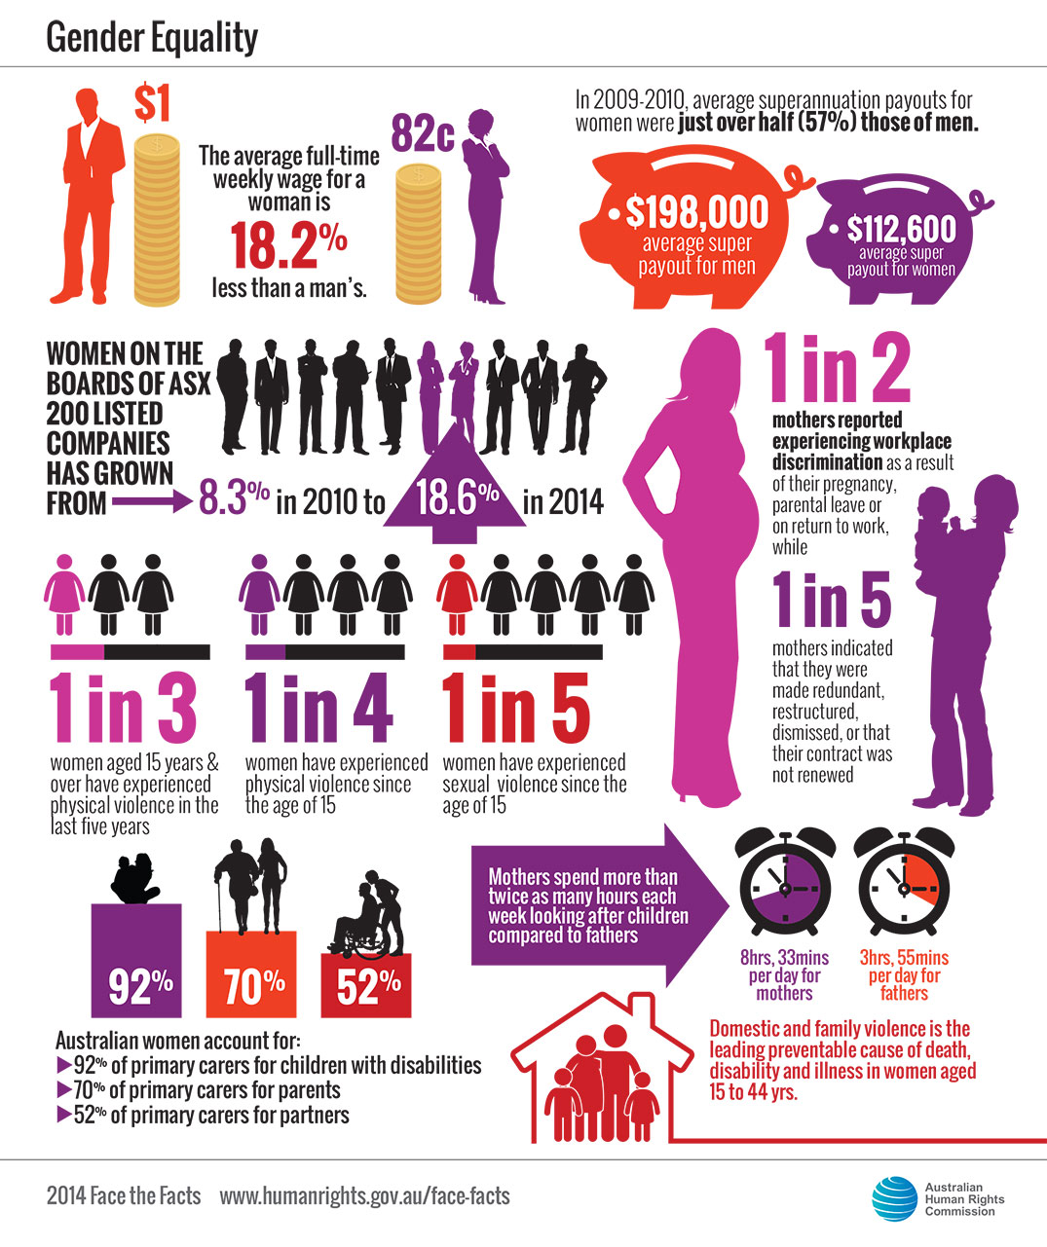
Gender Equality

Slide 25
Development of Gender Policies WID, WAD & GAD

Slide 26
Development of Gender Policies
 | WID Women in Development | WAD Women and Development | GAD Gender and Development
Origin | Early 1970s post WW II phenomena term articulated by American liberal Feminists | Mid 70s as a critique of modernization theory and WID | In the 1980s
Theoretical Base | Linked with Modernization Theory-Targets individuals as the catalyst for social change, no structural change | Dependency Theory | Socialist Feminist thinking
Approach | Seeks to integrate women into the development process | Seeks to involve women as active participation of development | Seeks to empower women and transform unequal relations between women and men
Focus | Women | Women | Men
The Problem | Exclusion of women from the mainstream development process | Women have always been part of development process but their contribution not recognized, development had negative impact on women | Unequal relations of power that prevent equitable development and women’s full participation
Strategies | Equality before law, education, increase women’s productivity and income, increase women’s ability to manage their households | Women focused development, women as economic actors in both public and private domain | Analysis of women’s contribution inside and outside household, looks at total social structure
Critique | Accepted existing social structure Didn’t question source of women’s oppression and subordination Treated women as homogeneous category | Focus only on women’s productive aspect ignoring the reproductive aspect Doesn’t question the relations between gender roles
http://slideplayer.com/slide/6100845/

Slide 27
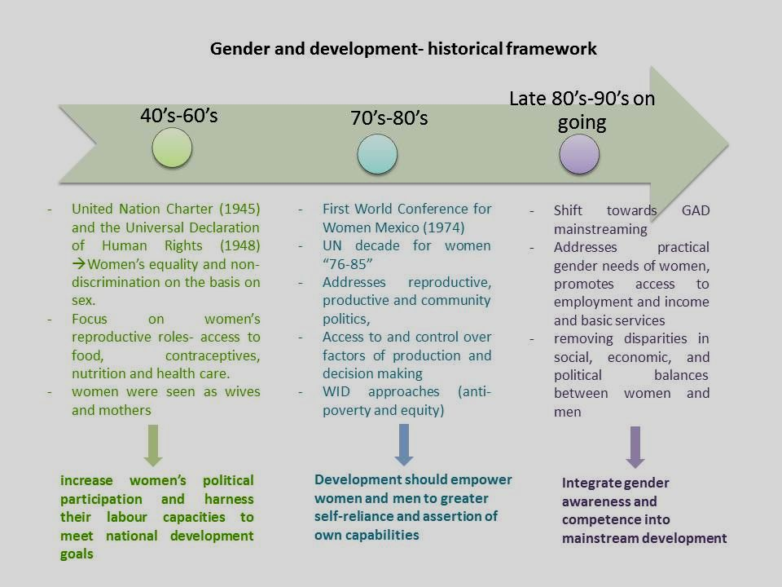
WID, WAD & GAD
http://slideplayer.com/slide/5265838/

Slide 28
Gender Mainstreaming, Planning, Analysis & Responsive Budgeting

Slide 29
Gender Mainstreaming
Gender mainstreaming is a strategy for integrating gender concerns in the analysis, formulation and monitoring of policies, programs and projects. It is therefore a means to an end, not an end in itself; a process, not a goal.
The purpose is to promote gender equality and the empowerment of women in population and development activities. This requires addressing both the condition, as well as the position, of women and men in society. Gender mainstreaming therefore aims to strengthen the legitimacy of gender equality values by addressing known gender disparities and gaps in such areas as the division of labour between men and women; access to and control over resources; access to services, information and opportunities; and distribution of power and decision-making.
http://www.unfpa.org/resources/frequently-asked-questions-about-gender-equality

Slide 30
Gender Planning
Gender planning is an active approach to planning which takes gender as a key variable and seeks to integrate an explicit gender dimension into policies or action. It consists of planning the implementation phase of policies or programs from a gender perspective.
Planning from a gender perspective requires the recognition of gender gaps and structural gender inequalities in each context. A gender diagnosis must always be the first phase of the gender planning methodology. Which is based on the rationale that women and men have different gender roles and different access to and control over resources which lead to structural gender inequalities.
http://eige.europa.eu/gender-mainstreaming/methods-tools/gender-planning

Slide 31
Gender Analysis
Gender Analysis highlights the differences between and among women, men, girls and boys in terms of their relative distribution of resources, opportunities, constraints
and power in a given context. Performing a gender analysis allows us to develop responses that are better suited to remedy gender-based inequalities and meet the needs of different population groups. Gender analysis is the starting point for gender mainstreaming. Before cooperation processes begin, any decisions are made and plans are outlined, the gender equality situation in a given context must be analyzed and expected results identified.
Gender analysis focuses on understanding and documenting the differences in gender roles, activities, needs, and opportunities in a given context. Gender analysis involves the disaggregation of quantitative data by gender.
file://192.168.1.200/sharing%20folders/Gender/ARTICLES/2016/gender-tool-analysis.pdf

Slide 32
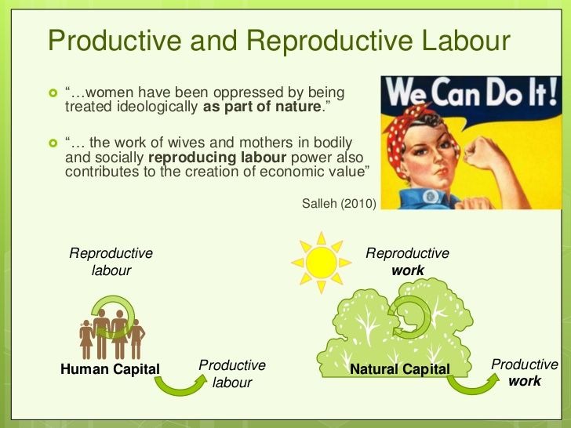
Productive and Reproductive Work
Productive work relates to any work that generates an income.
Men’s productive work commonly takes place outside the sphere of the household and more commonly generates monetary income.
Women’s productive work commonly occurs within the household sphere and is generally less valued, and often not even taken into account.
Reproductive work relates to work in the household, raising children, cooking and cleaning. It is commonly assumed to be the responsibility of women, yet men also often perform reproductive work, for instance, taking care of machines or washing the car. Reproductive work generally does not generate any income, yet has an impact on family (and societal) economy.
As it is associated with the women’s sphere, it is less valued than productive work and often not considered. Girls often have to take on the reproductive tasks if the mothers are to engage in productive work
http://www.sida.se/contentassets/3a820dbd152f4fca98bacde8a8101e15/gender-tool-analysis.pdf

Slide 33
Gender Responsive Budgeting
Gender responsive budgeting (GRB) is a tool that aims at integrating gender perspectives in the budgeting process. It should be viewed as an influential element of managerial activities related to development of budgets of different levels, which provides important information to specialists making decisions about allocation of
budget funds. It brings together two issues that are not commonly associated with one another: gender equality and public financial management. GRB argues that gender equality principles should be incorporated into all stages of the budget process.
https://www.youtube.com/watch?v=mquOclPJYPs
Gender Responsive Budgeting

Slide 34
Gender Gap

Slide 35
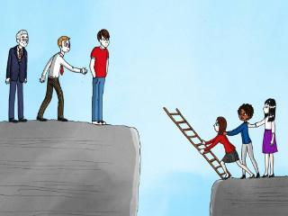
Gender Gap
Gender Gap the differences between women and men, especially as reflected in social, political, intellectual, cultural, or economic attainments or attitudes.
Differences are seen, for example, in the percentages of men and women in the labor force, the types of occupations they choose, and their relative incomes or hourly wages.

Slide 36
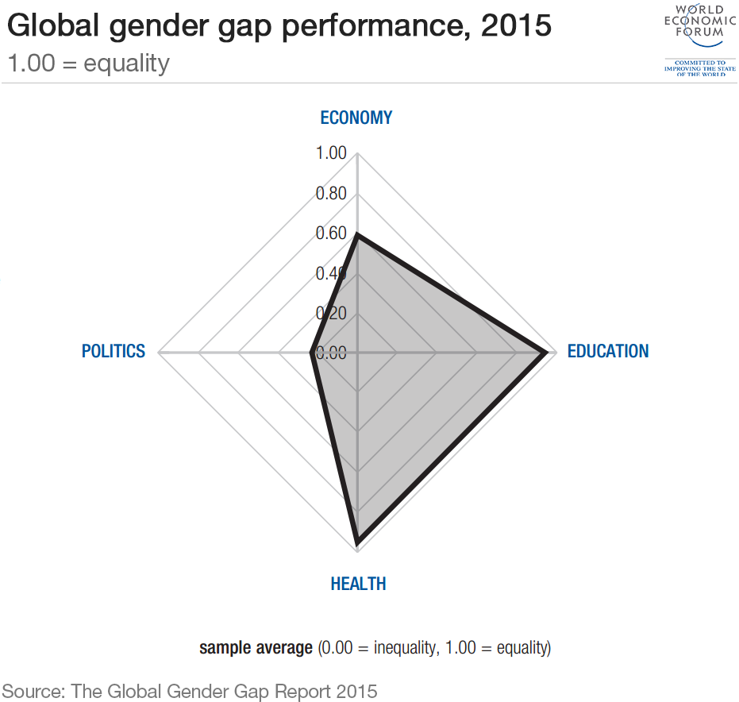
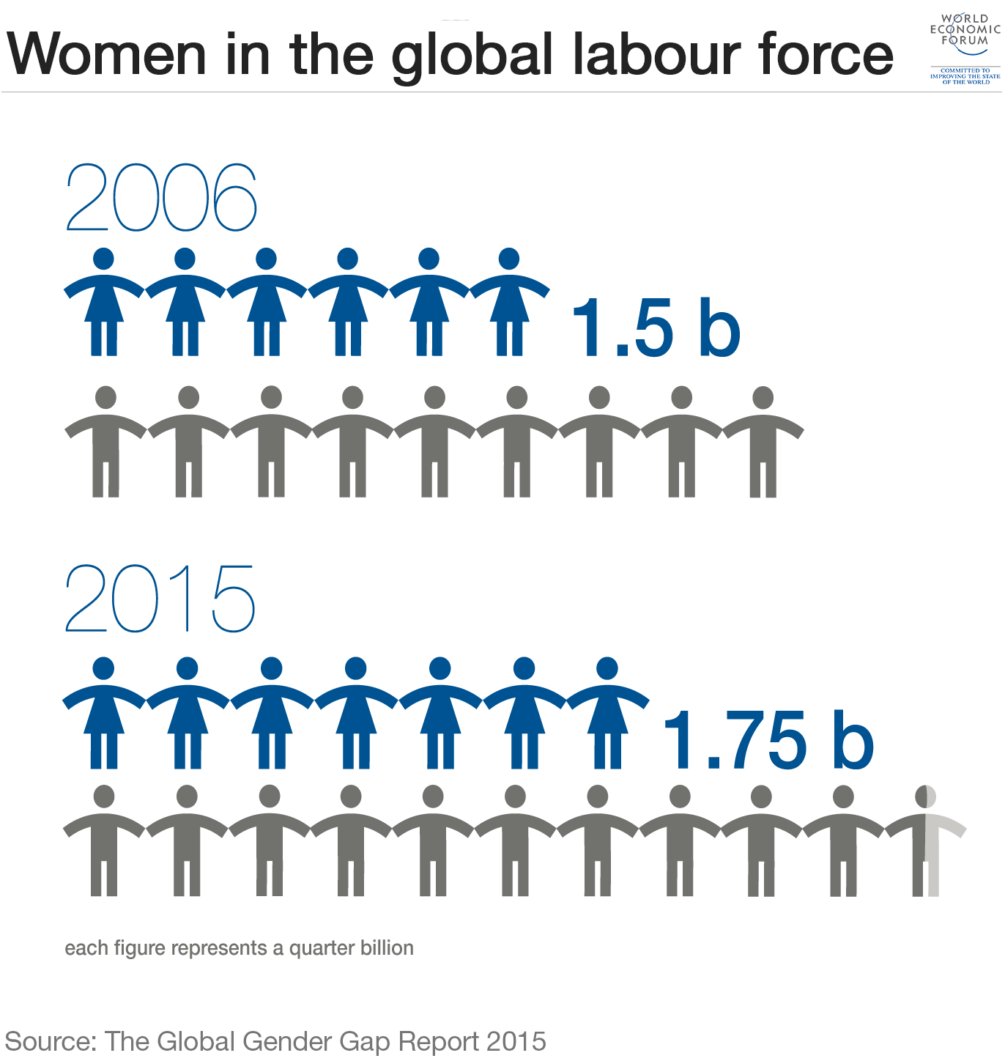
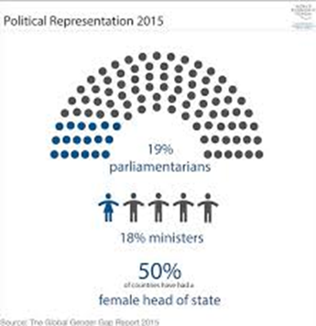
Gender Gap

Slide 37
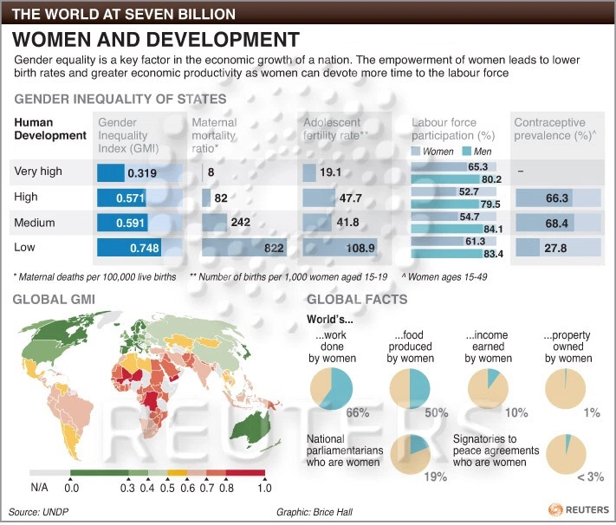
Gender Gap - Women and Development

Slide 38
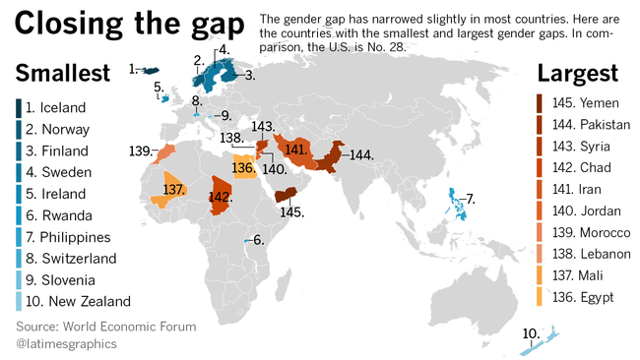
Gender Gap – Closing the Gap

Slide 39
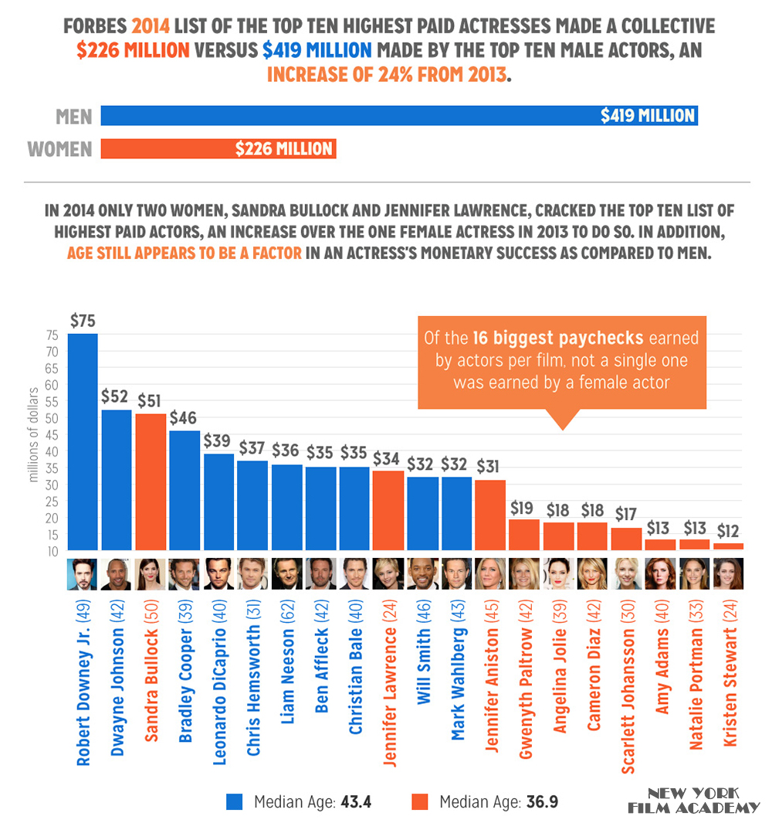
Gender Gap – Good to Know

Slide 40
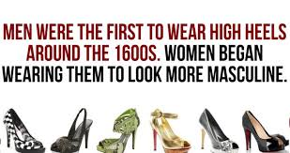
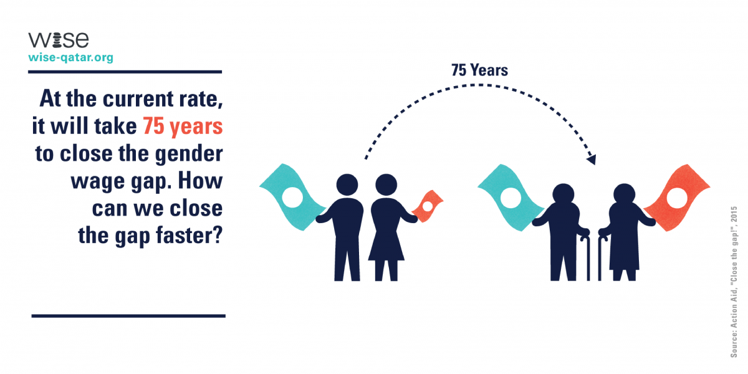
Gender Gap - Facts

Slide 41
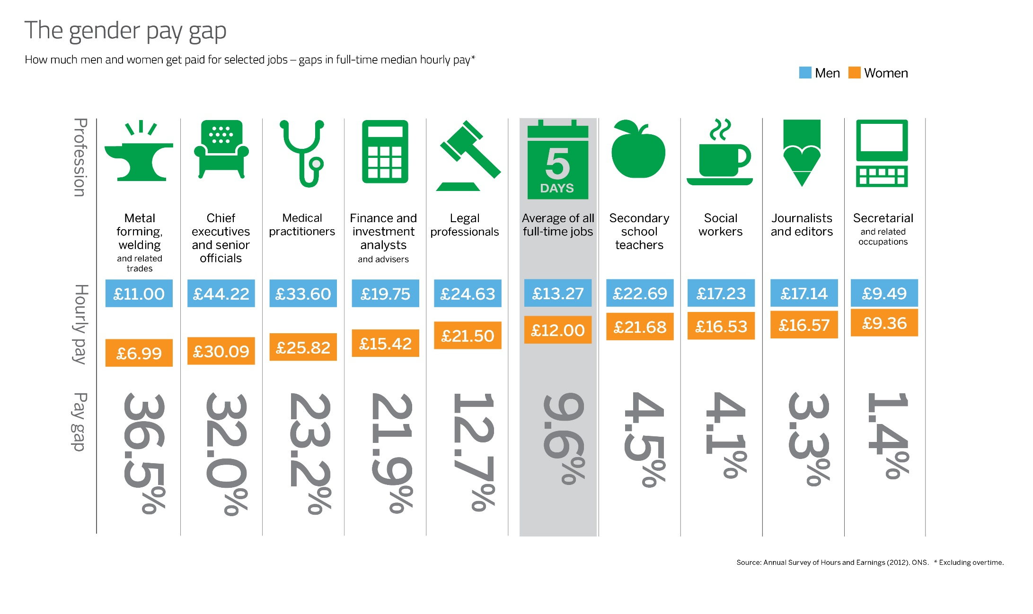
Gender Pay Gap Among Different Sectors

Slide 42
Entrepreneurs and Gender Performance Gap
Performance of Female Led Vs. Male Led Firms*
Lower entrepreneurs frequency rates among women ➔ necessity entrepreneurs
Women led firms are concentrated in low-technology, low-growth, and low-productivity sectors
Women owned businesses are considerably smaller
Women led firms achieve lower ROC and lower profitability
Performance gaps tends to be larger in lower income per capita levels
No gender differences in some performance indicators
In similar sectors, women led firms perform as peer firms led by men
Women led business have higher share of women employment
*Supporting Growth Oriented Women Entrepreneurs: A Review of the Evidence and Key Challenges – Sep 2014 – World Bank Group

Slide 43
What Explains Performance Gap?*
Constraint-driven factors
Female entrepreneurs start businesses with less capital, less access to credit, less experience, less schooling and less access to credit and lower level of management skills
Performance-driven factors
Perception of opportunity, self confidence and fear from failure. Women are more risk averse and unwilling to go thorough competitive situations
Gender differences in motivations; encouragements from peers to start new business and networks to success
Social norms, which forces women to choose socially acceptable sectors and based on their perception of what they are capable of achieving
Nature and nurture explains the difference
*Supporting Growth Oriented Women Entrepreneurs: A Review of the Evidence and Key Challenges – Sep 2014 – World Bank Group

Slide 44
Gender Related Challenges – Men Also Face Challenges
The Pad Man
1. Arunachalam Muruganantham: How I started a sanitary napkin revolution!
https://www.youtube.com/watch?v=zkQL7UJYDIY
2. Rags to Pads
https://www.youtube.com/watch?v=2aAWvEFehB8
3. India's Menstruation Man
https://www.youtube.com/watch?v=nvZsx3y69bs

Slide 45
Introduction to Gender Gap in Jordan

Slide 46
Jordan’s Global Gender Gap Index Rank’s 134 out of 144
Very low
Sources: WEF The Global Gender Gap Report 2016

Slide 47
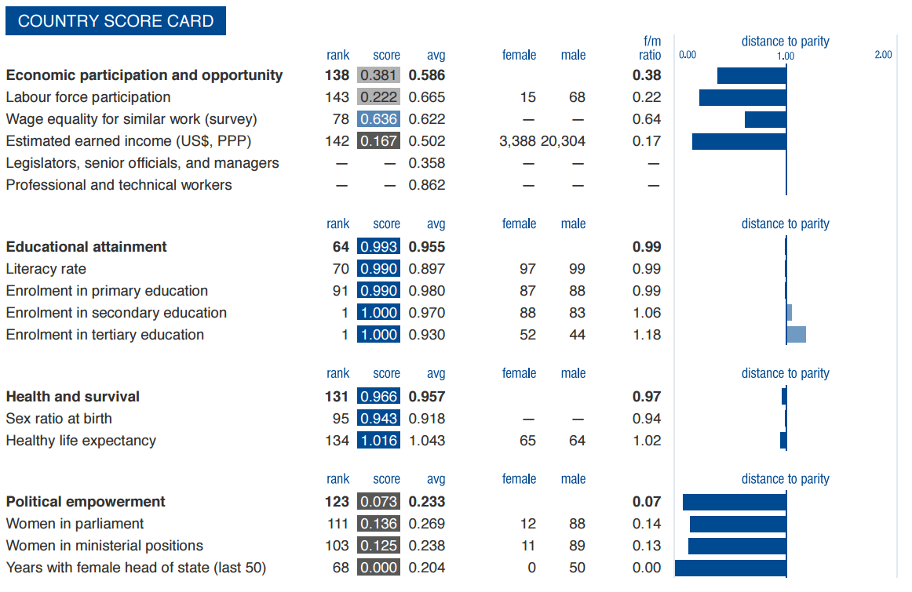
Economic Participation & Opportunity
Rank out of 144
Very low labour force participation
Average wage equality for similar work
Very low estimated earned income
Sources: WEF The Global Gender Gap Report 2016

Slide 48
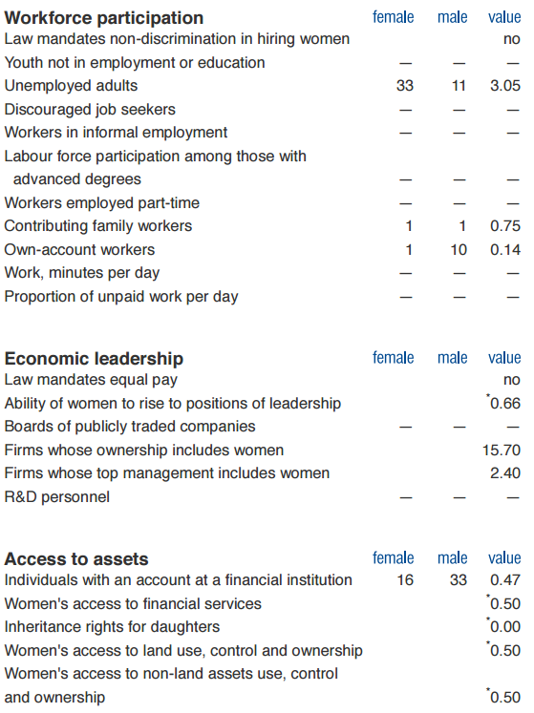
Economic Participation & Opportunity
Workforce Participation:
High unemployed women adults 3 to 1.
Both family male & female contributes to work.
Economic Leadership:
Ability of women to rise to positions of leadership is above average
Access to Assets:
16 females to 33 males who owns an account in financial institution
*Data on a scale from 0 to 1 (0 = worst score, 1 = best score)
Sources: WEF The Global Gender Gap Report 2016

Slide 49
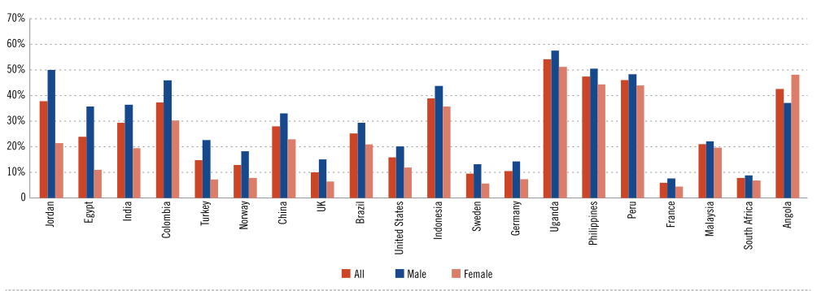
Entrepreneurship and the Gender Gap in performance
Entrepreneurship Prevalence Rate by Gender in Selected Countries Gender Gap Decreases From Left to Right
Highest Gender Gap is in Jordan
It measures female led firms growth in terms of employment and productivity gains vis-a-vis men led firms
Source: World Bank Group Trade & Competitiveness – Supporting Growth Oriented Women Entrepreneurs: A Review of the Evidence & Key Challenges - Sep 2015

Slide 50
Gender Diversity in Jordan - Exercise

Slide 51
Gender Diversity in Jordan
A research paper on the impact of Gender Diversity on the Economic Performance of Companies in Jordan was published in Sep 2015 by the IFC. Some quotations were taken from country leaders from both sexes regarding gender diversity in companies. Based on that, kindly follow the following instructions:
Trainees should be divided into 5 groups
Each group will be given one of the quotes presented in the following slide
Each group will briefly comment on the quotations by referring to:
Do you agree or disagree with the speaker’s opinion?
In your opinion, what are opportunities and threats facing women leaders in Jordan?
Each group should represent and share their comments
Group discussions

Slide 52
Gender Diversity in Jordan
“I have generally had good experience with women board members. Most women are better listeners than men and take more time in making and weighing decisions. Some women feel that they need to be more macho and they tend to be abrasive, erratic and often wrong. Also, I have witnessed poor cooperation between women on board, which was destructive and alarming”
Source: Laith Al Qasem – Owner and chair of Arabian Business Consultation
“Diversity Leads to good corporate governance because it brings more ideas, as men might be concerned with maintaining strong internal control, while women might be concerned with succession and developing senior staff, which will lead to better corporate governance”
Source: Suhail al Ali – Former minster of industry
“It was good to see women reaching such positions with their qualifications and professionalism. The dynamics certainly change, as male domination seemed to decrease, which enhances the implementation of decisions”
Source: Suhail Jouaneh – member of advisory educational board of Baptist Schools Jordan
“Women need to work on strengthening their weaknesses and reinforcing their strengths. They also need to increase their capabilities, and build networks. They need to step up and take action, be creative, and stop accepting their inferior status.”
Source: Lina Hundaileh – president of YEA & Owner and founder of chocolate factory
“ there are opportunities, but I believe women need to be seen as more active in their fields to become future leaders and board members”
Source: Ghassan Nuqul – Vice Chair of Nuqul Group
Sources: IFC Jordan Gender Report Sep 2015

Slide 53
Challenges Facing Women ➔Unpaid Care Work

Slide 54
Unpaid Care Work
In groups, comment on the quotations presented in the following slide by addressing the following questions:
What is Unpaid Care Work ?
Does Unpaid Care Work have a positive or negative impact on women’s career, weather employment or entrepreneurship?
Is Unpaid Care Work always a challenge to women’s progress? If so, how can we turn it into a positive catalyst?
How can we address and integrate unpaid care work within market systems?

Slide 55
Unpaid Care Work
Time spent on unpaid care work by women is more than twice that for men, while men spend more time on paid work
Society, power relations, and social norms identifies care as a ‘natural’ role of women, it is an activity that doesn’t requires training or skills or
that produces value, it cannot ‘not’ be done.
Women are working 1.4 hours for every 1 hour worked by men
Unpaid care responsibility is a barrier to women’s greater involvement in the labor market, affecting productivity, economic growth and poverty reduction.
Source: https://beamexchange.org/uploads/filer_public/c4/e0/c4e03654-107f-48cb-8e2c-9115c8c9175c/carework.pdf

Slide 56
Unpaid Care Work
Unpaid ➔ it arises out of social or contractual obligations, such as marriage or less formal societal relationships;
Care ➔ it is a group of activities that serves people in their well-being;
Work ➔ it is an activity that has costs ‒ time and energy.
Challenges: Some market systems practitioners and actors, see unpaid care work as irrelevant to their core business. Including unpaid care as part of their intervention design will move them beyond their core competencies or weaken their focus on improving market productivity and incomes. Or, when recognized, they may not know how to facilitate sustainable, long-term solutions to it.
Source: https://beamexchange.org/uploads/filer_public/c4/e0/c4e03654-107f-48cb-8e2c-9115c8c9175c/carework.pdf

Slide 57
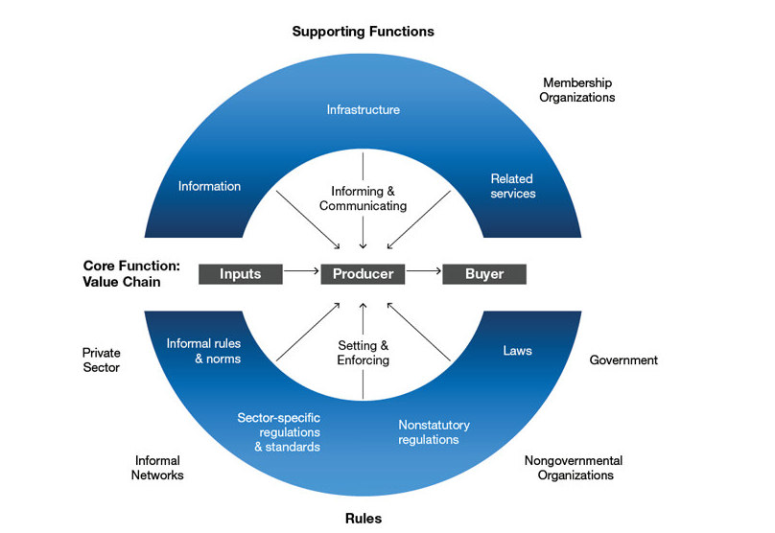
Unpaid Care Work
A core market where goods or services are exchanged – often through a chain of transactions (value chain)
Supporting services, resources and infrastructure (e.g. roads, inputs, transport, credit)
Formal and informal rules that influence how market exchanges take place (e.g. gender norms affecting women’s access to certain type of jobs).
Source: https://beamexchange.org/uploads/filer_public/c4/e0/c4e03654-107f-48cb-8e2c-9115c8c9175c/carework.pdf

Slide 58
Addressing unpaid care work within market systems
Adapting program delivery to take account of unpaid care work (mainstreaming).
Recognize unpaid care, market activities should be designed to be more accessible to women, and understanding of social norms. Market systems should incorporate an understanding of care work into market analysis, to avoid unintended consequences and ensure that women as well as men benefit from interventions.
Source: https://beamexchange.org/uploads/filer_public/c4/e0/c4e03654-107f-48cb-8e2c-9115c8c9175c/carework.pdf

Slide 59
Addressing unpaid care work within market systems
Designing interventions to address specific constraints.
These could include unequal childcare responsibility, low decision-making power in the household or community around services, technologies and infrastructure, or restrictive social norms. Assessments and interventions that are inclusive and participatory, where men are involved and women are supported to speak up about their priorities, have been successful, and have avoided conflicts in households and communities.
Source: https://beamexchange.org/uploads/filer_public/c4/e0/c4e03654-107f-48cb-8e2c-9115c8c9175c/carework.pdf

Slide 60
Addressing unpaid care work within market systems
Focusing on unpaid care as a strategic market sector.
Specific services related to care provision, such as childcare, or meal preparation, are systems themselves, in which different actors including households, communities, governments and markets provide relevant products, services, infrastructure, rules and norms, subsidies and incentives. Interventions would address constraints in the supporting functions such as information, finance, equipment, policies and regulations and household norms around energy and energy use.
Source: https://beamexchange.org/uploads/filer_public/c4/e0/c4e03654-107f-48cb-8e2c-9115c8c9175c/carework.pdf

Slide 61
Integrating unpaid care into market systems programs
Recognition
Reduction
Redistribution
Redistribution, so that the total unpaid care work to be done is more fairly distributed among households, communities, state and the private sector. For example, factories may be supported to develop childcare facilities.
Recognition of unpaid care work so that it is “seen” and acknowledged as being “work” and “production.” Programs may then adapt interventions in light of a better understanding of care work, or include compensation for the work.
Reduction of unpaid care work so that the burden of certain tasks is reduced. Interventions can support markets to better deliver a specific service (healthcare) or product (fuel efficient stoves). For example, if healthcare services are closer, women’s time accessing facilities is reduced.
Representation, by increasing women’s voice in their household and community, or their access to leadership positions. Often cooperative or community leaders are male, with decisions taken often failing to reflect women’s specific needs. By increasing women’s voice and providing them with spaces to discuss their issues and raise them to the community, some unpaid care work constraints can improve.
Representation
Source: https://beamexchange.org/uploads/filer_public/c4/e0/c4e03654-107f-48cb-8e2c-9115c8c9175c/carework.pdf

Slide 62
Most Powerful Jordanian Business Women

Slide 63
The Most Powerful Jordanian Women 2015 : 100 Most Powerful Arab Business
Source: http://www.forbesmiddleeast.com/en/list/the-most-powerful-arab-women-2015/

Slide 64
Most Powerful Arab Women 2015
Nisreen Shocair took over the helm of Virgin Megastores, Middle East in 2006 and has overseen the brand’s transformation from a CD and DVD store to a one-stop shop for music, video and multimedia entertainment. Shocair, who grew up in Nigeria, started her entertainment career working at a local Blockbuster store in Texas before finishing her degree and joining Sony in the early 1990s. In addition to her role at Virgin, Shocair also sits on the advisory board of several digital and environmental start-ups.
https://www.youtube.com/watch?v=9Aa9W9LlcmY
Nadia Al Saeed joined Bank al Etihad over 10 years ago, and has been serving as General Manager of the bank since 2007. Throughout her career, Mrs. Al Saeed held different key roles in the private and public sectors; most notably, she served as Minister of Communications and Information Technology from 2004 to 2006, and before that as Economic Advisor to the Minister of Communication and Information Technology. Nadia is also a member of the board in various organizations and associations related to banking and finance, alongside supporting local initiatives such as EDAMA, INJAZ and Endeavor Jordan.

Slide 65
Most Powerful Arab Women 2015
Deema Sukhtian, CEO of Munir Sukhtian Group, a family business that works internationally. They produce and sell cleaning supplies, cosmetics, confectionary, paints, etc.
Randa S. Ayoubi, Founder and CEO, Rubicon, a global company headquartered in Amman, Jordan. Trustee: King's Academy; Royal Commission for Education Reform in Jordan; Children's Museum, Amman. Founding Member: Jordan Chapter, Int'l Women Forum (IWF); Information Technology Association of Jordan “Intaj”; Young Presidents' Organization (YPO). Former Chairperson, Red Sea Institute for Cinematic Art “RSICA”. Recipient of awards: Entrepreneur of the Year Award, YEA; regional Entrepreneur Award (2004), Arabian Business; Businesswoman of the Year Award, CEO Middle East Awards 2010; Ernst and Young Entrepreneur of The Year Award (2011).

Slide 66
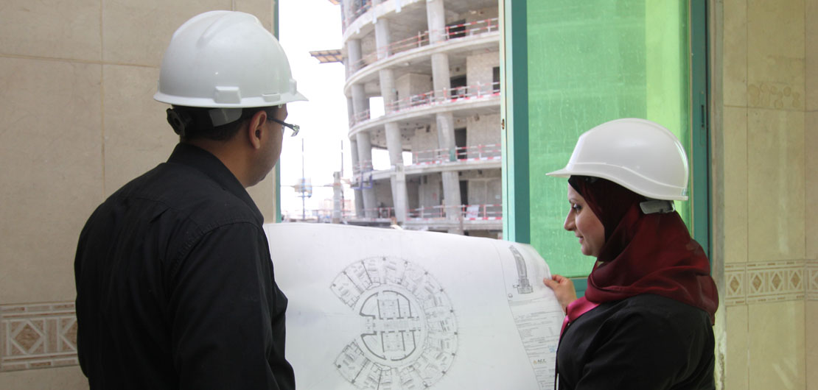
Most Powerful Arab Women 2015
Mary Nazzal is living proof that women can multitask. The 35-year-old is the deputy chairperson at the Landmark Hotel, a barrister, a political activist, and serves on several boards, including al Shabaka, the Palestinian Policy Network, and the Royal Film Commission. On top of that, she is a dedicated mother.
https://www.youtube.com/watch?v=m4UMnKlps4E
Nermin Fawzi Saad the founder of Handasiyat.net, a virtual engineering company with a built-in meeting room setup by a team of Jordanian freelance engineers, who offer engineering services for Saudi & Jordanian Engineering Companies. Many engineering tasks don't require the presence at the office, and there are many countries -such as KSA- that suffer from a huge lack of qualified local engineers compared to their market size, and consequently the employment issue is considered as a financial/social burden on those countries. This technique will reduce employment need and cost in such countries adding that it will solve the employment complexity in crisis areas. This is an opportunity for hundreds of Female Engineers in the Arab world, where the man is dominant in the engineering field, and females are restricted with different kind of social rules.

Slide 67
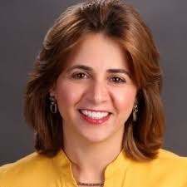
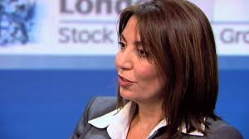
Most Powerful Arab Women 2015
Dr. Rand Abu-Ghanimeh: commercial lead in the Middle East for the American Multinational Agrochemical and Agricultural Biotechnology Corporation Monsanto.
Ghada Mohammed Farhan Hallosh: is Independent Director at Jordan Mortgage Refinance Co. and Deputy GM-Operations & Support at Jordan Commercial Bank.
She received her undergraduate degree from the American University of Beirut and a graduate degree from the University of East London.
Rana Sami Sunna: Deputy General Manager for Credit And Treasury Services
Holds Masters in Business Administration and Bachelor in Accounting
Professional Experience:
Deputy General Manager for Banking Operations since December 2009
Experience in the field of risk management through her work and the Manager of Risk Management Department in the Bank since 1998.
Worked as the Head of local facilities department in the Central Bank of Jordan
Board member in the Jordan Mortgage Refinancing Company

Slide 68
The Most Powerful Jordanian Women 2016 : 100 Most Powerful Arab Business
Source: http://www.forbesmiddleeast.com/en/list/the-100-most-powerful-arab-businesswomen/

Slide 69
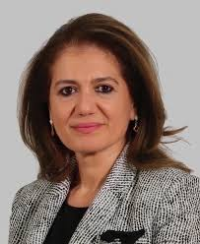
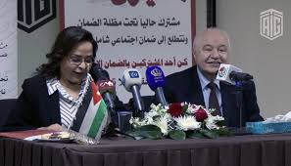
Most Powerful Arab Women 2016
Randa Sadik: Deputy Chief Executive Officer of Arab Bank since July 2010, and has broad international Banking experience built over 25 years. Before joining Arab Bank, she served as Group General Manager for National Bank of Kuwait, responsible for the bank’s international and regional network of branches and subsidiaries. She is also Chairman of Arab Tunisian Bank in Tunis, a Board member of Oman Arab Bank, Vice Chairman of Arab Bank Australia ltd, a board member of Arab Investment Bank S.A.L.-Lebanon, Chairman of Al Arabi for Finance (Holding co.) S.A.L.-Lebanon and Chairman of the Management Committee of Al-Arabi Investment Group.
Nadia Al Rawabdeh: director general of the Social Security Corporation (SSC). She is now serving in a new board position at Kingdom Electricity Co. PSC

Slide 70
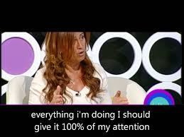
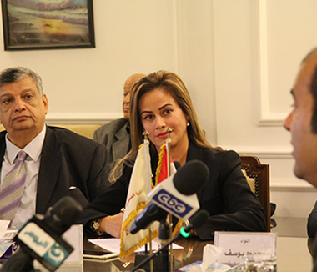
Most Powerful Arab Women 2016
Iman Mutlaq is a Jordanian entrepreneur, financier and social activist and the Founder/CEO of the Sigma Investments. Forbes magazine's Middle East edition, published in 2016 and 2017, ranked Iman Mutlaq 32nd and 41st positions respectively in a list of "The 100 Most Powerful Arab Businesswomen.
She established her export-import business at the age of 18 and then entered in the financial industry at the age of 27 covering the regions of Middle East and North Africa. She is currently managing Jordan based Sigma Investments as its Chief Executive Officer on international financial issues. She is a director of Australia based INGOT Brokers. She is involved in angel investment encouraging projects which enhance women's creativity and ideas. She is also targeting applications for mobile devices through her startup, Dreamtech.
Achievements:
Best Woman in the Corporate Sector at the AmCham MENA Council Women in Business Awards in 2016
Global Alliance Partners, a network of financial entities has elected Iman as a director at its Conference in New York City in 2016; the first female director for the institution.
Iman received the award "Middle - East Woman of the Year" at the 3rd Global Official of Dignity Awards held in the United Nations Headquarters in New York on August 5–7, 2015; she also received there “Certificate of Special Congressional Recognition”
Iman has been appointed "Goodwill Ambassador for Human Rights and Peace" in Jordan in 2014
Jordan's Top Businesswomen in 2015

Slide 71
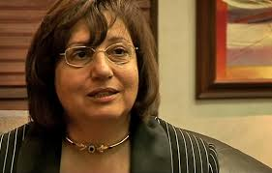
Most Powerful Arab Women 2016
Manal Jarrar: National Insurance Company General Manager. She has been in the business since 1990, working with four different insurance companies.
She has been with the National Insurance Company since 2012, devising insurance policies and developing the company’s resources.
Simona Sabella Bishouty is the Chief Executive Officer/General Manager of Arab Banking Corporation (Jordan), which is one of the leading Jordanian universal banks.
Simona is an accomplished and seasoned banker with a long-standing successful track record that extends for more than 30 years. She started her banking career at Chase Manhattan Bank in Amman and London. After which she moved to Bank of Jordan and Cairo Amman Bank where she assumed a number of leadership positions and her responsibilities covered various areas including: risk and compliance, internal audit, consumer banking and retail credit, corporate banking, treasury and financial institutions.
She serves as the chairman of ABC Investments (ABCI), and is a member of the Board of Amlak Finance (Jordan) and Visa Jordan Card Service Company.
Simona is a member in the International Women’s Forum (Jordan Chapter). She is also a member of the Jordanian Equestrian Endurance Society and is a disciplinary committee’s official of the European Arabian Horse Show.

Slide 72
The Opportunity

Slide 73
The female economy is large and growing
Women are starting and growing businesses at significant rates.
25% to 33% of private businesses are owned or operated by women.
There are approximately 126 million women across 67 economies who are starting or running a new business.
There are 98 million women around the world running established businesses.
According to GEM, 69% of women in LAC and Sub-Saharan Africa believe there is strong opportunity for entrepreneurship.
Women around the world are gaining control over financial decisions as their accumulation of wealth continues to rise.
Women’s earned income is growing at a rate of 8.1%, compared to 5.8% for men.
42% of women derive their wealth from their own salaries.
Women will inherit US$28.7 trillion in intergenerational wealth over the next 40 years.
Women make or influence a majority of purchasing decisions, including where to bank and where to invest.
Source: http://www.gbaforwomen.org/the-opportunity

Slide 74
Maleeka Zakarneh
In a male-dominated field and a male-dominated country, Maleeka Zakarneh is making a name for herself and her company, Jadara Electronics.
https://www.bankaletihad.com/content/malika-zakarneh

Slide 75
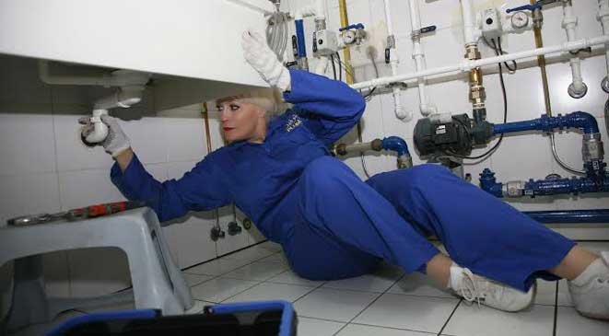
Khawla Al Shaikh
"Plumbing" women are breaking taboos in Jordan
https://www.youtube.com/watch?v=k15FI8peQhk

Slide 76
Challenges Facing Women Entrepreneurs

Slide 77
Main Obstacles in the Way of Women’s Advancement in Jordan
Individual | Cultural | Workplace | Structure/ policy
Educational Choices | Perception of female commitment | Staff rather than line role promotions | lack of childcare assistance
Sector Choices | Double standards | Promotions rates | Differentiated taxation
Pipeline available | Spousal role and support | Face time and flexibility | Lack of shared parental leave
Risk aversion disparity | Work-life balance priorities | Mentoring for women rather than sponsorship | Organizations were designed for men and manufacturing
Sources: Credit Suisse 2014 - IFC Jordan Gender Report Sep 2015

Slide 78
Exercise
What are the obstacle facing you as a women entrepreneur in Jordan?
Write your answer based on the perspectives mentioned in the table bellow:
 | Obstacle
Individual
Cultural
Workplace
Structure/Policy

Slide 79
Exercise
Think of solutions to your obstacles
 | Solution
Individual
Cultural
Workplace
Structure/Policy

Slide 80
Important Business Concerns & Challenges for Women in Jordan
Business Management | Business Climate | Business Laws and Practices
Access to Capital for your business | Competition from other countries | Laws & regulations that hamper business growth
Finding & keeping good employees | High cost of public services | Business payoffs & bribes
Low efficiency & productivity | Gaining access to technology for business | Access to property & land
Access to new markets | High labor cost | Access to training & technical assistance
 |  | Learning business financial management skills
Sources: IFC - Women Business Owners in Jordan: Characteristics, Contributions and Challenges – June 2007

Slide 81
Challenges associated with Women Entrepreneurs
Challenges
Challenging social expectations
Limited access to funding
Playing with the boys
Building a support network
Balancing business and family life
Owning your accomplishments
Coping with a fear of failure

Slide 82
Challenges associated with Women Entrepreneurs
1. Challenging social expectations:
Women may feel as though they need to adopt a stereotypically "male" attitude toward business: competitive, aggressive and sometimes overly harsh. But successful female CEOs believe that remaining true to yourself and finding your own voice are the keys to rising above preconceived expectations.
“Don't conform yourself to a man's idea of what a leader should look like. You made it to where you are through hard work and perseverance. Don't conform yourself to a man's idea of what a leader should look like.” Hilary Genga, founder and CEO of women's swimwear company Trunkettes
“I eventually learned that, woman or not, my business would fail if I refused to defend or fight for it," Pierson said. "Since then, I no longer worry about being seen as aggressive.” Alexandra Pierson, founder and CEO of social media app springpop

Slide 83
Challenges associated with Women Entrepreneurs
2. Limited access to funding
Raising capital is even more difficult for women-owned firms. Less than 3% of venture-capital-funded companies had female CEOs by Babson College report
“Venture capitalists tend to invest in startups run by people of their own "tribe" — for instance, a Stanford-educated investor will want to back a Stanford alum's business. Women looking for business investors should build confidence through a great team and business plan. Investors look for businesses that can grow their valuation to over $1 billion. If you have experts on your team that can execute the business operations well, investors will have confidence in those people. You also need a good product market fit. Bonnie Crater, president and CEO of sales and marketing analytics company Full Circle Insights
“Working to get more female investors involved in supporting one another is another way to overcome this challenge. Such groups are "looking to not only inspire and encourage female investors, but to grow and support other female entrepreneurs through both funding and strategic educational workshops." Felena Hanson, founder of Hera Fund

Slide 84
Challenges associated with Women Entrepreneurs
3. Playing with the boys
As a female entrepreneur in a male-dominated industry, earning respect has been a struggle.
“I was more than willing to put in the work to create my own reputation for being a hardworking, honorable businessperson in my own right. To overcome this, I have had to learn to build my confidence and overcome my negative self-talk. They’re stopping you from reaching your full potential. One of the best things I’ve done to help me in this area is joining a variety of women entrepreneur groups. These groups have provided me mentors and peers to inspire me, hit me with reality checks on my capabilities and successes and help me grow and learn from their outside perspectives and experiences.”
Solution: hardworking and strive for success regardless of others perception

Slide 85
Challenges associated with Women Entrepreneurs
4. Owning your accomplishments
The common, consensus-building qualities encouraged in young girls can leave women unintentionally downplaying their own worth.
Difficult to convey own worth as a leader: “When I talk about the company … I always find myself saying 'we' instead of 'I,‘. I know I have fallen into this pattern because: Using the first person to discuss successes feels to me as if I'm bragging, and I cannot shake the idea that if someone knows it's just me in control, the value of what we do will go down. As I grow the business, I am making an effort to own what I've accomplished."
Molly MacDonald, founder and CEO of The Mobile Locker Co.
Recognize the value of your creative ideas: “Confidence is the key to success, even when you're up against a boardroom full of men. When I was a newly appointed CEO, I often felt my ideas received more scrutiny than those from my male colleagues. However, this didn't discourage me from being a great business leader.”
Shilonda Downing, founder of Virtual Work Team

Slide 86
Challenges associated with Women Entrepreneurs
5. Building a support network
48% of female founders report that a lack of available advisers and mentors limits their professional growth.
“With the majority of the high-level business world still being dominated by men, it can be hard to blaze your own path and facilitate the introductions and connections into some of the more elite business networks. As most of business today still rings true with the philosophy that 'It's not what you know; it's who you know,' this can be a huge factor in your ultimate success.
Knowing where to find the right support network isn't always easy. A few good places to start include women-focused networking events as well as online forums and groups created specifically for women in business.” Hanson, founder of Hera Hub co-working hub for female entrepreneurs.

Slide 87
Challenges associated with Women Entrepreneurs
6. Balancing business and family life
“Mompreneurs" have dual responsibilities to their businesses and to their families, and finding ways to devote time to both is key to truly achieving that elusive work-life balance.
“Being a mother while running a business is very challenging. There are ways to balance your time, but the perception is that you could be more effective running your business if you didn't have to deal with kids.”

Slide 88
Challenges associated with Women Entrepreneurs
7. Coping with a fear of failure:
The fear of failure is the top concern of women who launch startups.
“You need to have massive failure to have massive success. You may need 100 'noes' to get one 'yes,' but that one 'yes' will make you more successful tomorrow than you were today. I have stopped worrying if people will treat me differently in business because of my gender … and have stopped comparing myself to others, including men. The bottom line is, if you're successful, no one cares whether you are man or a woman." Delia Passi, CEO of WomenCertified and founder of the Women's Choice Award

