Slide 1
An introduction to SME Lending

Slide 2
Lending to SMEs - Opportunities

Slide 3
SMEs are core of Jordanian economy
There are more than 100,000 SMEs in Jordan, > 95% of all registered companies.
Contribute around 50% or more to GDP;
Provide employment to an estimated 60% of the Jordanian workforce;
Create up to 70% of new job opportunities in the economy;
Account for 45% of exports.
Sources: Oxford Business Group / OECD / Jordan Department of Statistics

Slide 4
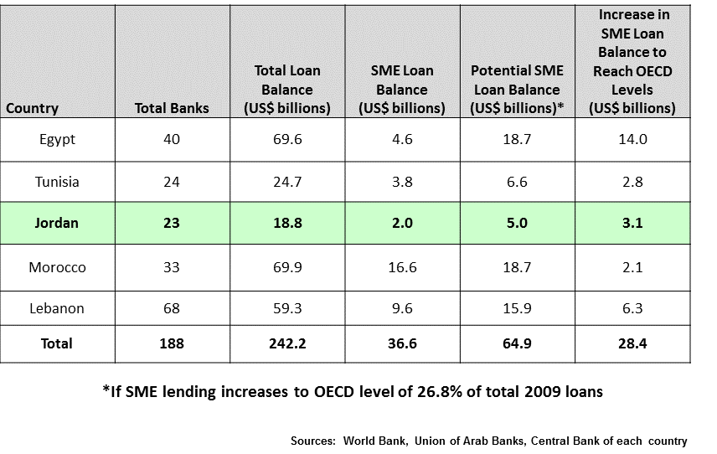
Jordan’s SME financing gap

Slide 5
Opportunity
Jordanian banks that learn how to make loans to SMEs without requiring excessive collateral can significantly increase their market share and profits.
Many SMEs do not have access to credit.

Slide 6
Opportunity
Loan Size
Banks
3.1 Billion USD
MFIs
Company Size

Slide 7
The most valuable bank in the world specializes in SMEs
Wells Fargo Bank
World's most valuable bank with a market value of $260 billion.
Fourth largest bank is U.S. in terms of total assets.
Number #1 small business (SME) bank in the U.S.

Slide 8
Conditions for Loan Repayment
Repayment
Willingness to repay
Ability to repay

Slide 9
Conditions for Loan Repayment
Repayment
Willingness to repay

Slide 10
Business Profile
Description | Item
Manufacturer, wholesaler, trader, distributor, seller? What products / services do you offer and what are their main advantages? | Product / Service
Who are your customers and what are their needs? Demographic and geographic distribution of the target market. | Customer / target market
Who are your competitors and what are the competitive products / services for your that compete with your products / services in the same target market? | Competition
What are the reasons customers will pay for your products / services? How can you differentiate between competitors and competing products / services? | Competitive Advantage
How are your products / services priced? | Price
How can customers get your products / services? | Distribution
How customers know about your products / services. | Promotion
What are the main inputs for your products / services? Which are your most important suppliers? | Inputs & Suppliers
How is the final product accessed? | Production
Experience and qualifications possessed by the Department and enable them to run the business successfully? | Management
What is the financial situation and financial performance of your business, and how is your business funded? | Finance

Slide 11
Conditions for Loan Repayment
Repayment
Ability to repay

Slide 12
Loan purpose and sources of repayment
Loan purpose | Primary Sources of Repayment | Secondary Sources of Repayment
Seasonal Permanent current assets Fixed assets Refinance existing debt Cover losses | Conversion of current assets Operating cash flow | Collateral - sale of assets Guarantor Owner’s contribution Refinancing
Notes:
Must understand loan purpose because it tells you how the loan should be repaid.
This, in turn, tells you how to structure the loan.
Banks cause bad loans by using incorrect structures.

Slide 13
Difference Between Purpose & Opportunity
Purpose:
The underlying reason an applicant is seeking a loan ➔ used by the lender to make decisions on the risk and may even impact the interest rate that is offered, terms and conditions of the loan
Example: Hani wants JD 500K to buy inventory
Opportunity:
Exploitable set of circumstances with uncertain outcome, requiring commitment of resources and involving exposure to risk.
Describe the opportunity to increase sales and/or to decrease costs.
Example: the newly purchases inventory will result in increase in sales by 10% over six months

Slide 14
Common lending mistakes
Not defining borrowing cause
Improper loan structure
No cash flow analysis
Over reliance on collateral
Inadequate monitoring

Slide 15
What is the purpose of the loan?
ABC Bakery is a bakery that produces many varieties of bread and cakes.
The owner says:
“I need 5,000 JD to purchase flour and other baking supplies each month.”

Slide 16
What is the purpose of the loan?
Green Farm grows vegetables and sells them to wholesalers.
The owner says:
“I need 16,000 JD to purchase seeds and fertilizer to plant this year’s crop.”

Slide 17
What is the purpose of the loan?
The Book Shop is a manufacturer and binder of books, magazines, brochures and other type of publications.
The owner says:
“I need 60,000 JD to purchase a new binding machine.”

Slide 18
What is the purpose of the loan?
Fitness center with exercise equipment and aerobics classes.
The owner says:
“My business needs $7,000.”

Slide 19
What is the purpose of the loan?
Computer Services is a proposed internet start up company seeking to serve clients with different types of computer internet and consumer hardware.
The owner says:
“I am starting my business and I need $15,000 to purchase computers, printers, copier and office furniture.”

Slide 20
Why businesses borrow – loan purpose
Inventory:
Raw materials
Components
Semi finished goods
Finished goods
Fixed assets:
Equipment
Buildings
Land
Seasonal Fluctuation in Current Assets
Permanent Current Assets
Fixed Assets

Slide 21
Loan Covenants

Slide 22
Loan Covenants
A loan covenant is a condition in a commercial loan that requires the borrower to fulfill certain conditions or which forbids the borrower from undertaking certain actions, or which possibly restricts certain activities to circumstances when other conditions are met.
Their purpose is to help the bank ensure that the risk attached to the loan does not unexpectedly deteriorate prior to maturity.

Slide 23
Affirmative Covenants
Examples:
Maintain existence
Maintain financial targets
Provide information on time
Maintain insurance
Pay taxes on time
Allow inspections

Slide 24
Negative Covenants
Examples:
Will not sell or dispose of assets
Will not change ownership
Will not change management
Will not pay dividends
Will not assume additional debt
Will not change business
Will not merge

Slide 25
Feasibility Study Plan
Executive Summary
Overview
Introduction
the letter
Objectives
Products / Services
Competitive features
the key of success
Property
Legal structure
Analysis of opportunities
Market analysis
Internal analysis
Marketing Strategy
Marketing mix
Market division
Target Market
Market positioning
Operations
Locations and facilities
Suppliers
Capacity
Availability of resources
Executive Plan
Administration
Finance
Financial Plan
Key assumptions
Expected income statement
Expected cash flow statement
Expected balance sheet
Break-even point analysis (profit threshold)
Ratio analysis

