Slide 1
WOMEN’S ECONOMIC PARTICIPATION ASSESSMENT Final Presentation
March 23, 2021
Notes:
The objectives of the Women’s Economic Participation Assessment are to better understand why women’s economic participation in Jordan has stagnated between 2010 and 2020 by reviewing the literature on the topic and elaborating a country profile that identifies the challenges the Government of Jordan (GOJ) has faced in promoting women’s economic participation. The desk review distinguishes the social, political, and economic factors that have directly and indirectly inhibited women’s economic participation in Jordan over the past decade.
The study’s ultimate aim is to find out and discuss what can be done to inform longer-term programming efforts to increase women’s economic participation in Jordan by comparing it to similarly situated countries in the MENA region. The comparative analysis used seven country case profiles of countries that share various dimensions with Jordan but exhibit greater degrees of women’s economic participation. The comparative analysis considered the factors that have directly and indirectly inhibited women’s economic participation in those countries and identified what insights can be applied to the case of Jordan.

Slide 2
MEETING AGENDA
The goal of today’s meeting is to share findings of the Women’s Economic Participation Assessment
Introductions
Assessment
Overview
Methodology
Comparative
Data Analysis
Key Findings and Lessons Learned
Recommendations
for Jordan
Question
and Answer
Appendix

Slide 3
PROJECT TEAM
Team Lead
Qualitative Analyst
Subject Matter Expert - Gender Specialist
Leading Point Team
Data Visualization Expert
Researchers

Slide 4
Assessment Overview

Slide 5
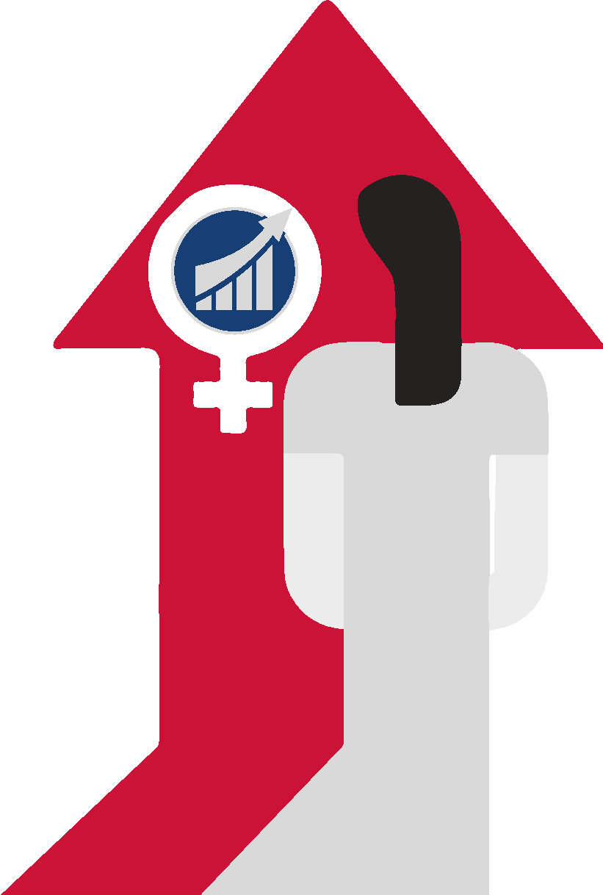
ASSESSMENT PURPOSE
A desk review of women’s economic participation in Jordan and other Middle East and North Africa (MENA) countries was conducted:
To better understand why women’s economic participation in Jordan has stagnated for the past decade; and
To find out what can be done to inform longer-term programming efforts to increase women’s economic participation in Jordan.
Notes:
This assessment is an in-depth review on the status of Female Labor Force Participation (FLFP) across eight different countries in the MENA region, over the course of the past decade (2009-2019). The countries examined included: Algeria, Jordan, Lebanon, Morocco, Saudi Arabia (KSA), Tunisia, Turkey, and the West Bank and Gaza.
At the center of this research is Jordan; with the purpose of informing future interventions and strategies, as well as policy recommendations that would help Jordan enhance its low levels of FLFP. The seven additional countries were examined to extract lessons learned that could be applied in Jordan. Essentially, this assignment looks at what worked across seven countries in MENA, what didn’t work, and how it can be utilized for Jordan to better enhance FLFP.

Slide 6
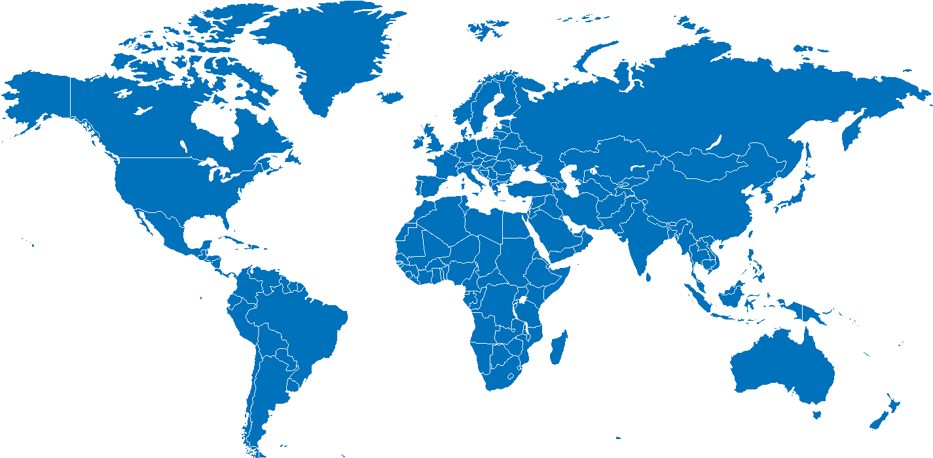
RESEARCH QUESTIONS
What countries in the MENA area have seen an increase in women’s economic participation in the last decade?
What has supported this increase in participation (e.g., political, social, economic)?
What are the sectors (formal and informal) that have seen an increase in participation?
What key factors from other countries would support a strengthened women’s economic participation in Jordan?
What are the formal and informal sectors in Jordan that have potential for better women participation?
What are lessons learned from other regional countries’ women economic participation that should be considered in Jordan?
What hinders the increase in women’s economic participation in Jordan?
Notes:
The research questions are as follows:
What countries in the MENA area have seen an increase in women’s economic participation in the last decade?
What has supported this increase in participation (e.g., political, social, economic)?
What are the sectors (formal and informal) that have seen an increase in participation?
What key factors from other countries would support a strengthened women’s economic participation in Jordan?
What are lessons learned from other regional countries’ women economic participation that should be considered in Jordan?
What hinders the increase in women’s economic participation in Jordan?
Did any of the other identified countries face the same challenge before and overcome it? If yes, how was it addressed? (ex. social norms, transportation, childcare, etc.).
What are the formal and informal sectors in Jordan that have potential for better women participation?

Slide 7
Methodology

Slide 8
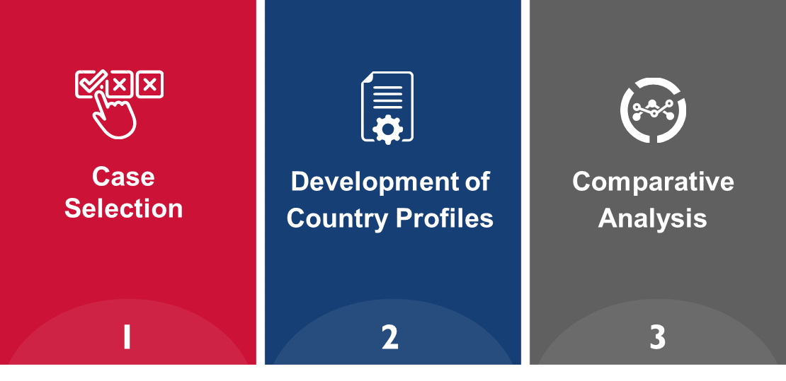
METHODOLOGY OVERVIEW
Notes:
The study began with a review of MENA countries that have seen an increase in women’s economic participation between 2010 and 2020 and the proposed case selection countries that are most comparable to Jordan or offer learning opportunities for Jordan. Our primary selection criteria was focused on selecting countries with higher rates of women’s economic participation than Jordan and countries that experienced an increase in women's economic participation over the past decade. In evaluating countries for selection for more in-depth research, we also considered countries that are comparable to Jordan in terms of economic situation and population characteristics. Finally, we looked at overall improvement on gender indices in order to include countries with lessons learned that can be applied to the case of Jordan. See Appendix (Slides 90-92) for more details on case selection.
The study then focused on a more in-depth review of the selected countries to inform the comparative analysis with Jordan.

Slide 9
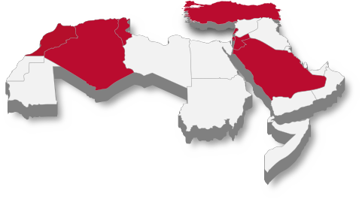
METHODOLOGY CASES SELECTED
JORDAN
LEBANON
TUNISIA
GAZA AND WEST BANK
TURKEY
ALGERIA
MOROCCO
SAUDI ARABIA
Notes:
The countries selected for in-depth analysis and comparison to Jordan include Morocco, Algeria, Tunisia, Lebanon, Turkey, Saudi Arabia, and the West Bank and Gaza. All of these countries, with the exception of Morocco, experienced a rise in FLFP over the course of the previous decade. See Appendix (Slides 90-92) for more details on case selection.

Slide 10
METHODOLOGY ANALYTICAL FRAMEWORK (1/2)
1. Description of the current level of women’s economic participation and its developments over the last decade
2. Economy and Economic Factors
Female labor force participation rate (FLFP)
Change in female labor force participation rate (2010-2019)
Informal labor force participation
World Economic Forum (WEF) Global Gender Gap
Overview of economy, including economy type and GDP
What’s happened economically over the past ten years
Labor market conditions
Women business owners
Notes:
The analytical framework is based on current research around conditions and determinants of female labor force participation (FLFP). Whether women have access to labor force participation is affected by how “structural determinants of world-system location, class location, state legal policy, and development strategy intersect to shape the pace and rhythm of women’s integration into the labor force and their access to economic resources” (Moghadam, 2013). Considering this myriad of factors, we take a holistic approach to understanding the diverse social, economic, and political factors that create enabling environments for women’s economic participation in countries across the MENA region.
From an economic perspective, as a country’s economy develops and grows, FLFP is expected to increase, and stronger economies tend to have higher levels of FLFP (Haghighat, 2012). While this has been the case in much of the developed world, MENA economies still face lower ratios of women to men in nonagricultural-wage employment than in other developing regions.
Sources:
Haghighat, E. (2012). Debunking the Assumed Connection between Educational Attainment, Reduced Fertility and Mortality, Labor Force Inclusion and Political Participation for Women in the Middle East. Middle East Critique, 21(3), 309-332.
Moghadam, V. (2013). Modernizing women: Gender and social change in the Middle East (Third ed.). Boulder: Lynne Rienner. pg. 2

Slide 11
METHODOLOGY ANALYTICAL FRAMEWORK (2/2)
3. Legal, Regulatory, and Policy Frameworks
4. Social Factors
5. Interventions
Regulatory structure considering how policies and regulations are formulated, implemented, and enforced
Legal, regulatory, and policy frameworks
Actual implementation of such laws/frameworks
Support services for women
Education
Social and cultural norms
Government interventions, such as measures that affect the economy, the vision of the country, campaigns to increase FLFP, changes in labor law, incentives to increase employment
Civil society or private sector interventions
Notes:
From a social and demographic perspective, age, marital status, religion, education level, literacy, family income level, the area of residence (urban or rural), and the number of children all affect an individual’s labor force involvement (Heath & Jayachandran, 2017). Of these, education is assumed to have the largest impact on women’s economic participation because of its effect on other determinants. Increased educational attainment is usually marked by a delay in marriage age, lower fertility rates, and higher levels of employment (Heath & Jayachandran, 2017; Solati, 2017), though at lower rates in MENA than in other developing regions.
Sources:
Heath, R., & Jayachandran, S. (2017). The causes and consequences of increased female education and labor force participation in developing countries. In The Oxford Handbook of Women and the Economy (pp. 345-367). Oxford University Press.
Solati, F. (2017). Women, work, and patriarchy in the Middle East and North Africa (Palgrave pivot). Cham, Switzerland: Palgrave Macmillan.

Slide 12
Comparative Data Analysis
Notes:
This comparative analysis draws labor market indicators from different sources. Wherever possible and to allow for comparisons across countries, data was drawn from World Development Indicators from the World Bank database, the Global Gender Gap Index by the World Economic Forum, and the World Bank’s Women, Business, and the Law reports. For analysis on more disaggregated statistics such as female employment by levels of education and marital status, the report uses survey data from each of the countries at focus.
One limitation is that country level data from survey data sources is not consistent across the years in terms of availability as well as definition of indicators. Additionally, country level analysis also varies, impacting the level of analysis conducted for each country and the comparability across country profiles.

Slide 13
Female Labor
Force Participation (FLFP)

Slide 14
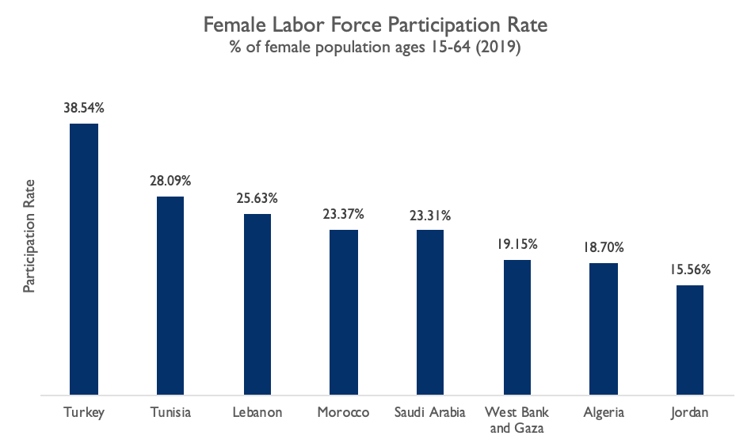
FEMALE LABOR FORCE PARTICIPATION CURRENT RATES (2019)
Of the selected countries, Turkey had highest FLFP while Jordan had the lowest.
Notes:
The different countries had varied rates of FLFP. Of the selected countries, Turkey had the highest FLFP rate while Jordan had the lowest.
Definition: Labor force participation rate is the proportion of the population ages 15-64 that is economically active: all people who supply labor for the production of goods and services during a specified period. Including the employed, unemployed, and persons actively searching for employment.
Data: Presented here are modeled ILO estimates for the female labor force participation rate in 2019.
Series: Labor force participation rate, female (% of female population ages 15-64) (modeled ILO estimate)
Source: World Bank. (2022). World Bank Development Indicators. https://databank.worldbank.org/source/world-development-indicators

Slide 15
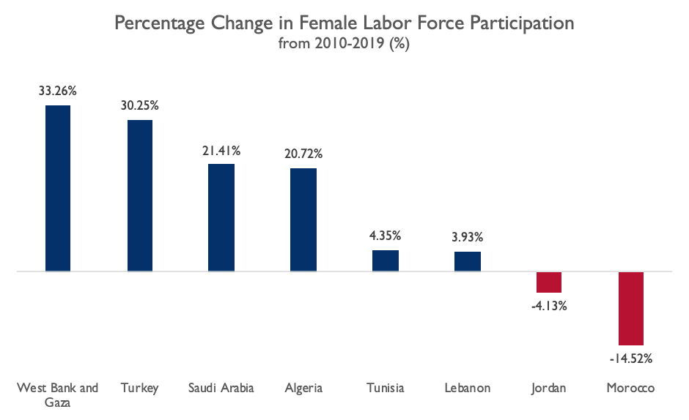
FEMALE LABOR FORCE PARTICIPATION RELATIVE CHANGE IN SPAN OF DECADE (2010-2019)
West Bank and Gaza and Turkey saw the largest percent change in FLFP over the last decade, relative to their 2010 FLFP rate.
Notes:
The different countries exhibited various levels of increased or decreased FLFP over the course of the past decade, with the most significant increase found in West Bank and Gaza, Turkey, and Saudi Arabia. However, the West Bank and Gaza FLFP rate masks the reality of skyrocketing female unemployment (~40%).
Over the last decade the West Bank and Gaza has seen a steady and volatile increase in FLFP with the rate increasing by 4.78 percentage points from the 2010 rate of 14.37%. The change represents an increase of 33.26% over the decade with an average yearly increase of 3.33% (World Bank, 2022). The volatile nature of the participation rate for women is evident when analyzing the yearly percent change, with some years showing increases of around 10% relative to the previous year, while other years show decreases of around 2%, suggesting women’s participation in the West Bank and Gaza is susceptible to external factors such as political shock, Israeli restrictions and the Gaza War in 2014.
Despite increases in FLFP, West Bank and Gaza faces a reality of skyrocketing female unemployment, with the unemployment rate for women having increased by 49.62% from a rate of 26.8% in 2010 to 40.2% in 2020 (PCBS, 2022), making it the highest female unemployment rate in the world. Moreover, the unemployment rate for females reached 43% in 2021 (PCBS, 2022a)
Note: To calculate the percent change we used the formula ((new value - old value)/old value)*100), with the new value being the 2019 FLFP rate and the old value being the 2010 FLFP rate.
Data: Presented here are the percent change between the 2010 and the 2019 FLFP rates from the modeled ILO estimates for the female labor force participation (Labor force participation rate, female (% of female population ages 15-64) (modeled ILO estimate)).
Sources:
PCBS. (2022). Unemployment Rate of Persons Aged 15 Years and above in Palestine by Governorate and Sex, 2020 https://pcbs.gov.ps/Portals/_Rainbow/Documents/unemployment-2020-02e.html
PCBS. (2022a). Press Release: The Reality of the Palestinian Women on the Eve of International Women's Day, 08/03/2022. https://pcbs.gov.ps/portals/_pcbs/PressRelease/Press_En_7-3-2022-woman-en.pdf
World Bank. (2022). World Bank Development Indicators. https://databank.worldbank.org/source/world-development-indicators

Slide 16
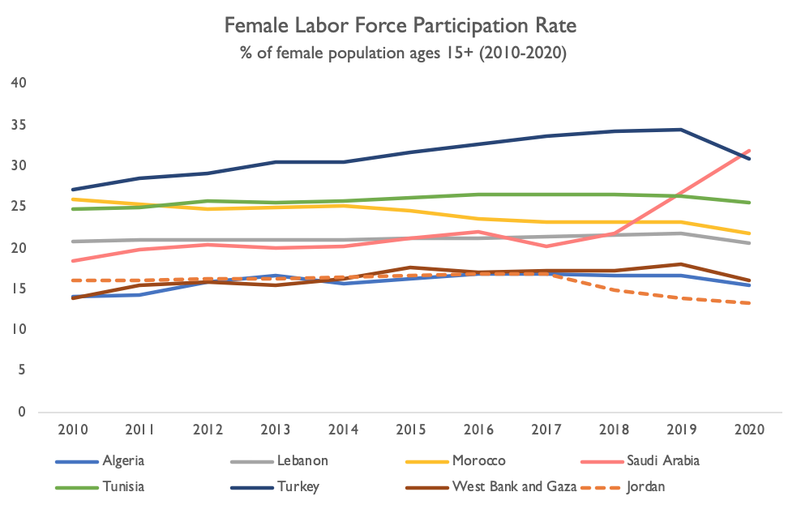
FEMALE LABOR FORCE PARTICIPATION OVER SPAN OF DECADE (2010-2020)
Between 2010-2019, most countries saw modest increases in FLFP, while Jordan and Morocco experienced a decline.
Most countries had slight decreases due to the COVID-19 pandemic.
Notes:
Each of the countries experienced a variety of distinct social, economic, and legislative/political factors that caused them to either improve or hinder their FLFP rates, and the degree to which such changes took place. Four out of the seven countries (not counting Jordan) have experienced substantial growth in FLFP, between 3.1% and 12.9% (Saudi Arabia, Turkey, West Bank and Gaza, and Algeria). Tunisia experienced minor-modest growth, around 1%. One country exhibited substantial decrease over the past decade (Morocco) and Lebanon experienced a very slight decline, below 1%. The West Bank and Gaza is starting from a very low rate. Finally, Jordan’s rate decreased by 2.76%.
Figures differ between FLFP for the 15-64 or 15+. Saudi Arabia has one of the largest increases in FLFP over the decade when using 15+ FLFP, especially from 2017 to 2020, and even surpasses Turkey in 2020 with a 29.51% FLFP. For the bulk of our study, we use the 15-64 FLFP figures following the OECD definition of the working age population as those aged 15 to 64.
FLFP in Jordan has been persistently low. In 2020, only 14.2% of Jordanian women were economically active (among those, 9.8% were employed and 4.4% were unemployed but actively seeking work). The majority of economically active women are in the public sector, in fields that are considered feminized (39.9% in education and 15% in health and social work).
All countries appear to dip in FLFP between 2019 and 2020 and this is largely due to the Covid-19 pandemic. The pandemic had dampening effects on FLFP around the world. In the MENA region, which already had low levels of FLFP and high rates of youth female unemployment, school closures during the pandemic hit working women in three key ways: loss of jobs for lower-paid or unskilled women, increased household labor during lockdowns, and labor market exit due to increased care work (Moghadam, 2021). While women in the public sector have been largely protected from job loss, women in the private or informal sectors, agriculture, and in small and mid-size enterprises (SMEs) have been greatly affected by job and income loss during the pandemic (Ibid).
Definition: Labor force participation rate is the proportion of the population ages 15 and older that is economically active: all people who supply labor for the production of goods and services during a specified period. Including the employed, unemployed, and persons actively searching for employment.
Data: Presented here are modeled ILO estimates for the FLFP rate from 2010 to 2020.
Sources:
Jordan Department of Statistics, Employment and Unemployment Data (2020). Available from: http://www.dos.gov.jo/owa-user/owa/emp_unemp_y.show_tables1_y?lang=E&year1=2020&t_no=18
Moghadam, V. (2021). Covid-19 and Female Labor in the MENA Region. Middle East Institute, 8 June 2021. https://www.mei.edu/publications/covid-19-and-female-labor-mena-region.
World Bank. (2022). World Bank Development Indicators. https://databank.worldbank.org/source/world-development-indicators

Slide 17
FEMALE LABOR FORCE PARTICIPATION FEMALE TO MALE RATIO
Turkey, with the highest FLFP, was also the closest to gender parity in labor force participation in 2019.
In Jordan, a ratio of 22.83% means that only 1 female is employed for every 5 men.
Notes:
The female to male ratio in labor force participation shows the extent of the gender gap in the labor force. Jordan has the largest gap among the selected countries, reflecting the significantly low FLFP it had in 2019. Meanwhile Turkey had both the highest FLFP and the highest ratio, meaning it was the closest to gender parity in labor force participation in 2019.
Definition: The ratio of female to male labor force participation rate is calculated by dividing female labor force participation rate by male labor force participation rate and multiplying by 100.
*Series: Ratio of female to male labor force participation rate (%) (modeled ILO estimate)
Source: World Bank. (2022). World Bank Development Indicators. https://data.worldbank.org/indicator/SL.TLF.CACT.FM.ZS

Slide 18
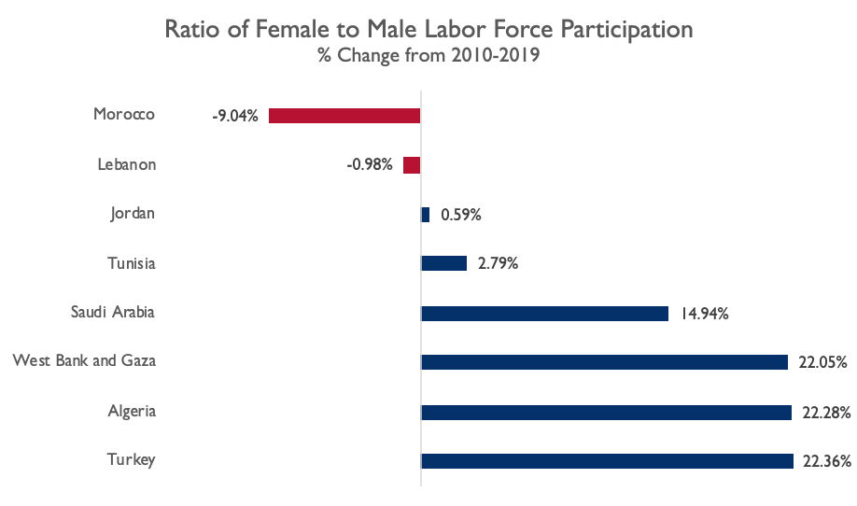
FEMALE LABOR FORCE PARTICIPATION CHANGE IN FEMALE TO MALE RATIO (2010-2019)
Several countries that increased FLFP also observed a closing of the gender gap in the labor force.
Morocco’s ratio of female to male labor force participation decreased the most over the decade, as female economic participation declined.
The ratio of women to men in the labor market has been stagnant in Jordan.
Notes:
The change in female to male ratio demonstrates how the gender gap in labor force participation has changed over the course of the decade. It is a useful metric because it shows whether women have become more represented in the labor force in comparison to men. The greatest decrease in the female to male ratio took place in Morocco, which follows its significant decrease in FLFP.
Tunisia, Saudi Arabia, the West Bank and Gaza, Algeria, and Turkey all witnessed a closing gender gap in the labor force between 2010 and 2019. The ratio of women to men in the labor market was relatively stagnant in both Lebanon and Jordan.
Note: To calculate the percent change, we used the formula ((new value - old value)/old value)*100)
Definition: The ratio of female to male labor force participation rate is calculated by dividing female labor force participation rate by male labor force participation rate and multiplying by 100.
*Series: Ratio of female to male labor force participation rate (%) (modeled ILO estimate)
Source: World Bank. (2022). World Bank Development Indicators. https://data.worldbank.org/indicator/SL.TLF.CACT.FM.ZS

Slide 19
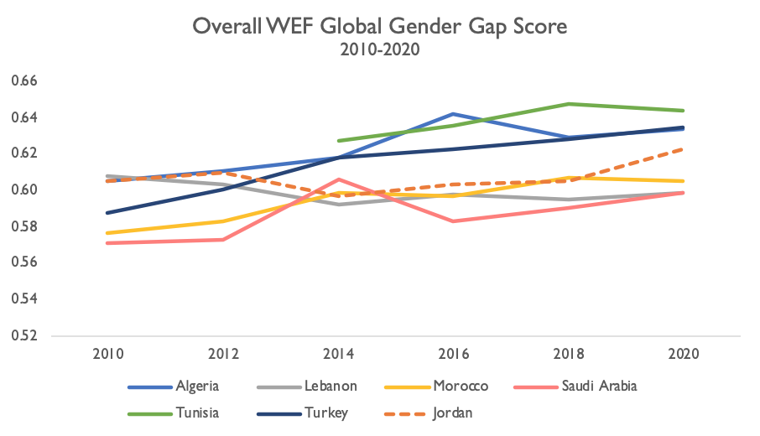
FEMALE LABOR FORCE PARTICIPATION WORLD ECONOMIC FORUM (WEF) GLOBAL GENDER GAP INDEX
Turkey had the largest increase in the overall score (0.047) between 2010 and 2020.
Jordan experienced an 0.018 increase in overall score in the same period.
*West Bank and Gaza is not included in the WEF Global Gender Gap report.
Notes:
The Middle East and North Africa region remains the area with the largest gender gap (60.9%) according to the Global Gender Gap Index. The Global Gender Gap Index benchmarks the progress of gender-based gaps among four key components (Economic Participation and Opportunity, Educational Attainment, Health and Survival, and Political Empowerment). Looking at each of the four dimensions within the MENA, Health and Survival has seen the most substantial regional progress, followed by Educational Attainment, which is relatively advanced, yet still below par compared to other regions.
Definition: The Global Gender Gap Index was first introduced by the World Economic Forum in 2006 to benchmark progress towards gender parity and compare countries’ gender gaps across four dimensions: economic opportunities, education, health, and political leadership. By providing country rankings, the report incentivizes comparisons across regions and countries and stimulates learning on the drivers of gender gaps and policies to close them.
Source: World Economic Forum, Global Gender Gap Reports, available at https://www.weforum.org/reports/

Slide 20
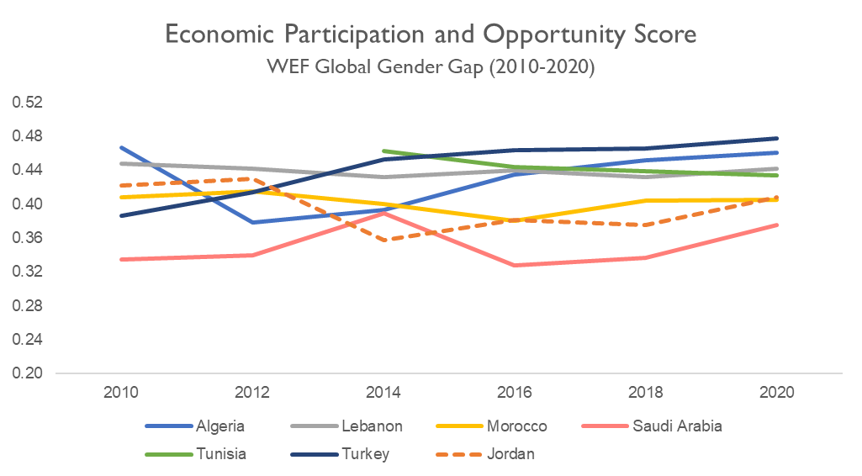
FEMALE LABOR FORCE PARTICIPATION WORLD ECONOMIC FORUM GLOBAL GENDER GAP INDEX
Turkey, which saw high FLFP growth, also increased its score on the Economic Participation and Opportunity indicator.
*West Bank and Gaza is not included in the WEF Global Gender Gap report.
Notes:
When it comes to Economic Participation and Opportunity, the average regional score is 40.9%, which is the second-lowest among all regions (however, this is primarily driven by the three lowest global performers on this dimension—Iraq, Syria and Yemen, countries which have been affected by war in the past decade). Of all the selected countries, only Turkey had a consistently increasing score in the Economic Participation and Opportunity Score over the decade.
Source: World Economic Forum, Global Gender Gap Reports, available at https://www.weforum.org/reports/

Slide 21
Economy and
Economic Factors

Slide 22
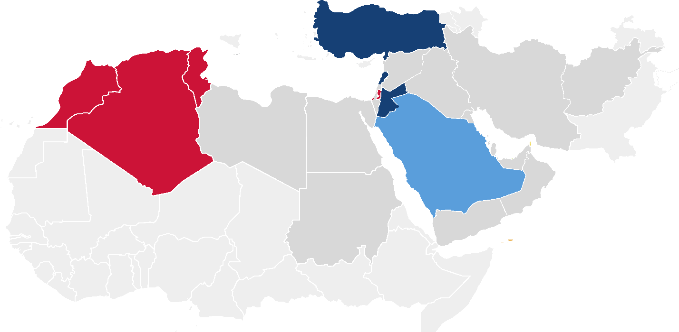
ECONOMY AND ECONOMIC FACTORS ECONOMIC GROUP
Jordan experiences lower female labor force participation than economically similar countries.
3
3
2
2
4
1
1
1
Lower-Middle
Upper-Middle
High
Algeria
Morocco
Tunisia
West Bank and Gaza
Jordan
Lebanon
Turkey
Saudi Arabia
1
1
1
2
2
3
3
4
Notes:
The selected countries in this study span across three income groups- Lower-Middle, Upper-Middle, and High. Jordan is categorized as an Upper-Middle economy, but its FLFP is significantly lower than its income group peers. The countries in the Lower-Middle income group, except for Morocco, all saw modest increases in FLFP, while the largest increases in FLFP took place in Turkey and Saudi Arabia. Although Saudi Arabia does not share many economic similarities with Jordan, the Mission specifically requested its inclusion in this study.
Definition: The World Bank classifies economies for analytical purposes into four income groups: low, lower-middle, upper-middle, and high income. For this purpose, it uses gross national income (GNI) per capita data in U.S. dollars, converted from local currency using the World Bank Atlas method, which is applied to smooth exchange rate fluctuations. Estimates of GNI are obtained from economists in World Bank country units who rely primarily on official data published by the countries; the size of the population is estimated by World Bank demographers from a variety of sources, including the UN’s biennial World Population Prospects.
Source: World Bank. (2022). World Bank Development Indicators. https://databank.worldbank.org/source/world-development-indicators

Slide 23
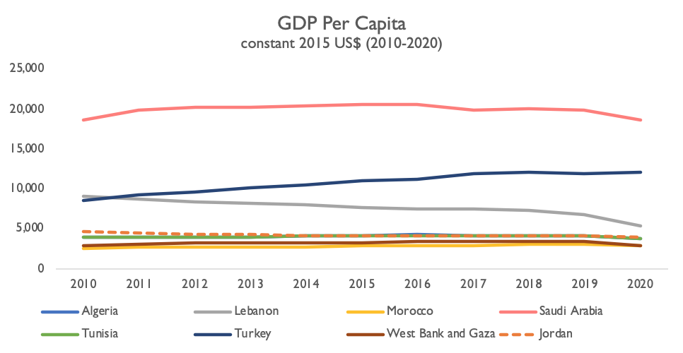
ECONOMY AND ECONOMIC FACTORS GDP PER CAPITA 2010-2020
Several countries exhibiting the most FLFP improvement were countries with the highest GDP/capita (Saudi Arabia, Turkey).
While West Bank & Gaza saw increased FLFP, it has resulted in high women’s unemployment, partially as a result of their economic situation.
Notes:
The countries exhibiting the most FLFP improvement were also the countries with the highest GDP. Saudi Arabia and Turkey’s large economy played a major role, in part at least, in their ability to expand women’s participation in the labor force. While government programming and legislative reforms played a key role in further integrating women into previously female-underrepresented sectors, they also provided financial stimuli, and incentive components which countries with lower economies wouldn’t be able to finance on such a scale.
Jordan has experienced steady economic growth since 2010, with a current GDP in 2020 of US$41 billion (constant 2015 prices), compared to US$31 billion in 2010. GDP growth has been positive each year throughout the decade, although declining, but turned negative in 2020 to -1.6% compared with the previous year. Despite Jordan’s overall GDP increase over the decade, GDP per capita shows an opposite trend and has declined significantly throughout the decade due to the large increases in population. In 2012 GDP per capita growth was -3%, and growth has been increasing each year since and just about turned positive in 2018 and 2019 at 0.1% and 0.6% respectively. The current GDP per capita in 2020 is US$4,029 (constant 2015 prices), compared to US$4,644 in 2010.
Definition: GDP per capita is gross domestic product divided by midyear population. GDP is the sum of gross value added by all resident producers in the economy plus any product taxes and minus any subsidies not included in the value of the products. It is calculated without making deductions for depreciation of fabricated assets or for depletion and degradation of natural resources. Data are in constant 2015 U.S. dollars.
Source: World Bank. (2022). World Bank Development Indicators. https://data.worldbank.org/indicator/NY.GDP.PCAP.KD

Slide 24
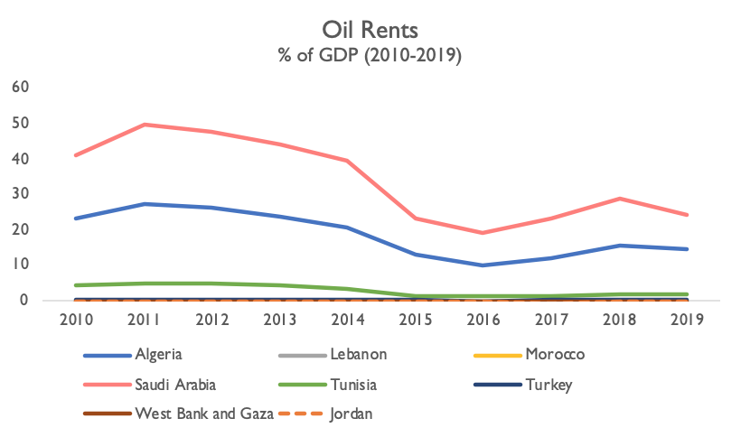
ECONOMY AND ECONOMIC FACTORS OIL REVENUES
Saudi Arabia and Algeria were the only two countries studied with sizable oil revenues and are examples of how countries experienced increasing FLFP rates as they diversified their economies throughout the decade.
Notes:
Diversification in sectors and the setting of explicit objectives to include women in new sectors were factors which helped increase FLFP. Saudi Arabia and Algeria have been making strides to wean themselves off their dependence on oil revenues. Algeria has relied heavily on oil production as a main source of revenue since its independence in 1962, and with the sharp decline of oil prices in the 1980s, which was followed by a deep recession, the country became aware of the need to diversify its sources of revenue. Economic growth in Algeria was driven by increased hydrocarbon production and increased activity in services, construction, and public works (Begga and Merghit 2014).
Similarly, Saudi Arabia has a primarily oil-based economy, but the Saudi government has begun to make strides to diversify its economy away from petroleum and expand its private sector (Young 2022). Saudi Arabia also made an explicit objective to make space for women employment in newly expanded sectors, taking into consideration the barriers that may prevent them from accessing the labor market, and putting in place measures and incentives to counter such barriers. Furthermore, as women are highly underrepresented in the oil industry, economic diversification provides them greater opportunity for employment in both countries.
Definition: Oil rents are the difference between the value of crude oil production at regional prices and total costs of production.
Sources:
World Bank. (2022). World Bank Development Indicators. https://databank.worldbank.org/source/world-development-indicators
Begga, C., & Merghit, A. (2014). Attempts to Industrial Reforms in Algeria: Do they fit the Logic of Globalization?. Topics in Middle Eastern and African Economies, 16(1), 4.
Young, K. E. (2022, January 27). The MBS Economy. Foreign Affairs. Retrieved February 11, 2022, from https://www.foreignaffairs.com/articles/saudi-arabia/2022-01-27/mbs-economy

Slide 25
Economy and Economic Factors
Labor Market Conditions

Slide 26
LABOR MARKET CONDITIONS WOMEN’S EMPLOYMENT IN THE SERVICES SECTOR
Several countries exhibiting increased women’s labor force participation have a growing services sector.
Jordan’s value added to GDP by the services sector was fairly stagnant over the decade.
Notes:
Several countries exhibiting increased women’s labor force participation have a growing services sector, including Saudi Arabia, Lebanon, and Algeria. Jordan’s value added by the services sector was fairly stagnant over the decade. One of the reasons Algeria’s FLFP rate surpassed Jordan’s over the decade, despite being lower than Jordan’s in 2010, was the expansion of the services sector. The services sector added value close to 50% of GDP in 2020 compared to close to 40% in 2010 (World Bank, 2022).
Definition: The ILO divides employment into three broad groupings of economic activity: agriculture, industry, and services. The services sector consists of wholesale and retail trade; restaurants and hotels; transport, storage, and communications; financing, insurance, real estate, and business services; and, community, social, and personal services.
Source: World Bank. (2022). World Bank Development Indicators. https://databank.worldbank.org/source/world-development-indicators

Slide 27
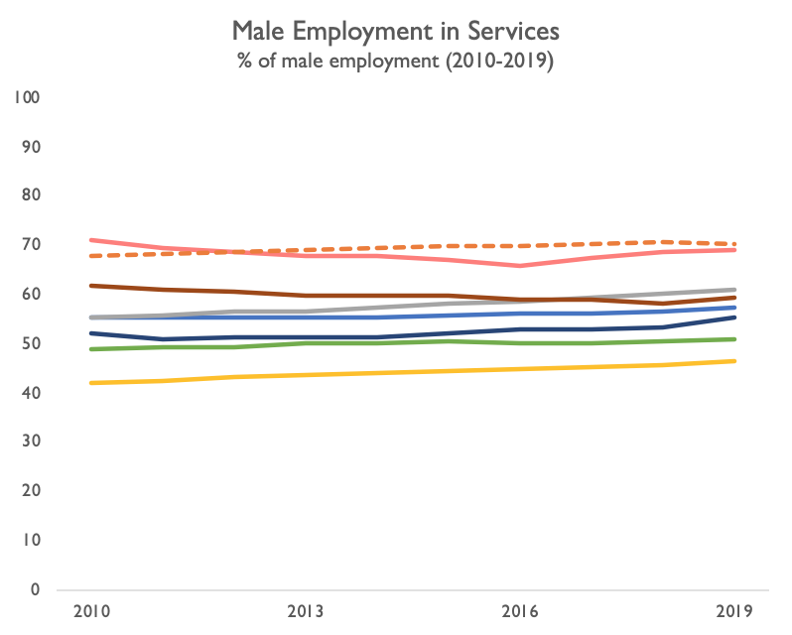
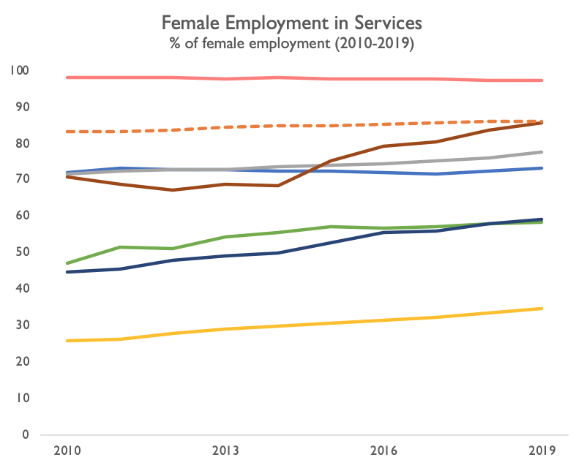
LABOR MARKET CONDITIONS WOMEN’S EMPLOYMENT IN THE SERVICES SECTOR
The services sector is absorbing female labor in several countries with the most significant increases in FLFP.
Female employment in services in Jordan was relatively stagnant over the decade.
Notes:
In most of the selected countries, women’s employment in the services sector was either higher than male employment in the sector (Saudi Arabia, Jordan, Algeria, Lebanon and West Bank and Gaza), or women’s employment in the services sector increased more than men’s employment in the sector. This suggests that women in the labor market are being absorbed by new jobs in the services sector more than men and suggest job roles in the services sector are a promising avenue for women’s employment.
Definition: The ILO divides employment into three broad groupings of economic activity: agriculture, industry, and services. The services sector consists of wholesale and retail trade; restaurants and hotels; transport, storage, and communications; financing, insurance, real estate, and business services; and, community, social, and personal services. Industry comprises mining, manufacturing, construction, electricity, water, and gas. Agriculture, forestry, and fishing corresponds to ISIC divisions 1-3 and includes forestry, hunting, and fishing, as well as cultivation of crops and livestock production (World Bank, 2022).
Source: World Bank. (2022). World Bank Development Indicators. https://databank.worldbank.org/source/world-development-indicators

Slide 28
LABOR MARKET CONDITIONS ALGERIA SERVICES SECTOR
The services sector increased in Algeria and female employment in the sector remained high and increased slightly.
Notes:
In Algeria, the services sector saw the highest growth over the decade, with the sector increasing by 9.5% of GDP. The services sector added value of 48.7% of GDP in 2020, compared to 39.2% in 2010. The industry and manufacturing sectors declined dramatically by around 50% over the decade, representing 40% and 39% of GDP respectively in 2010, compared to 20.3% and 18.8% respectively in 2020. The agriculture sector increased by 67% over the decade from 8.5% of GDP in 2010, to 14.1% in 2020 (World Bank, 2022).
When assessing women’s employment in different economic sectors, we find women in Algeria are disproportionately employed in the services sector. Women’s employment in each sector has remained relatively flat over the decade, with the services sector representing an average of 72.5% of employed women each year from 2010-2019 and increasing by 1% of GDP. This is compared to an average of 24% of women employed in the industry sector each year and an average of 3.5% of women employed in agriculture (World Bank, 2022). Moreover, a breakdown of women’s employment in 2019 by sector of activity shows that the largest majority of women are employed in health and social work at 45%, followed by the manufacturing industry at 18.9% and 13.9% in public administration (ONS, 2019). A breakdown of women’s employment by occupational group in 2019 shows that the largest majorities of women are employed in intellectual professions, as administrative employees, in skilled trades in industry and crafts, and in teaching, at 31.1%, 19.8%, 15.3% and 10.3% respectively. These occupational groups also employ a higher percentage of women than men, apart from skilled trades in industry and crafts. When assessing the percentage of female employment out of the total employment for a sector, we find that women make up 56.9% of total employment in the administrative employees' group, and 54.8% of total employment in the intellectual professions group. Women also make up a fair percentage of total employment in teaching at 37.5%. All other vocations have a low share of women at under 10%, except for skilled trades in industry and crafts with 16.3% being women (ONS, 2019).
Definition: The ILO divides employment into three broad groupings of economic activity: agriculture, industry, and services. The services sector consists of wholesale and retail trade; restaurants and hotels; transport, storage, and communications; financing, insurance, real estate, and business services; and, community, social, and personal services. Industry comprises mining, manufacturing, construction, electricity, water, and gas. Agriculture, forestry, and fishing corresponds to ISIC divisions 1-3 and includes forestry, hunting, and fishing, as well as cultivation of crops and livestock production (World Bank, 2022).
Sources:
World Bank. (2022). World Bank Development Indicators. https://databank.worldbank.org/source/world-development-indicators
ONS. (2019). Activity, Employment and Unemployment, May 2019 (Emploi, Chom, Mai 2019). Office National des Statistiques Algerie. Available from https://www.ons.dz/spip.php?rubrique3
International Labour Organization, ILOSTAT database. Available at https://ilostat.ilo.org/data/

Slide 29
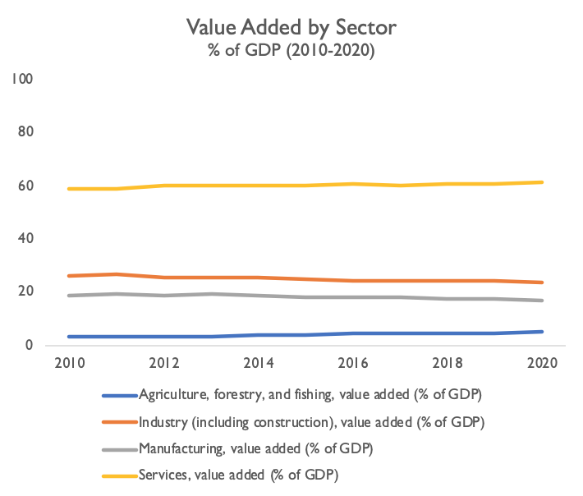
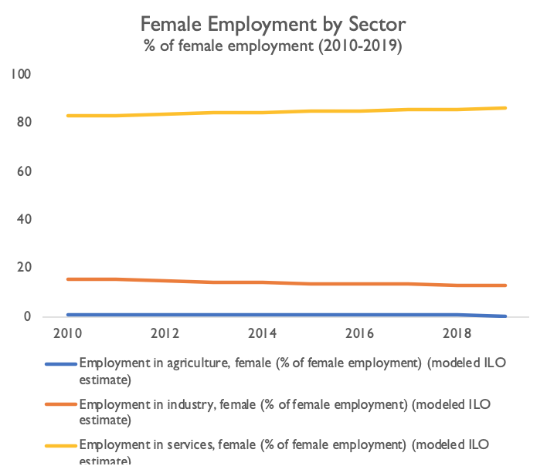
LABOR MARKET CONDITIONS JORDAN SERVICES SECTOR
Sectoral growth in Jordan has remained stagnant throughout the decade. The services sector is the largest and a high percentage of women are employed in the sector.
Notes:
The different sectors in Jordan have remained fairly stagnant in terms of GDP added over the 2010-2020 decade. Among the agriculture, industry, and services sectors, the services sector is the largest and has the highest percentage of female employment. The large public sector in Jordan accounts for an important share of the services sector, representing 40% of employment in services (Winkler and Gonzalez, 2019).
Although it makes a large portion of the labor market, the public sector is limited in terms of its capacity to absorb the large number of those interested in working within it. Women in Jordan are also highly concentrated in “feminized” sectors, including education (39.9%) and social work and health (15%).
Definition: The ILO divides employment into three broad groupings of economic activity: agriculture, industry, and services. The services sector consists of wholesale and retail trade; restaurants and hotels; transport, storage, and communications; financing, insurance, real estate, and business services; and, community, social, and personal services. Industry comprises mining, manufacturing, construction, electricity, water, and gas. Agriculture, forestry, and fishing corresponds to ISIC divisions 1-3 and includes forestry, hunting, and fishing, as well as cultivation of crops and livestock production (World Bank, 2022).
Sources:
World Bank. (2022). World Bank Development Indicators. https://databank.worldbank.org/source/world-development-indicators
Winkler, H. and Gonzalez, A. (2019). Jordan Jobs Diagnostic. Jobs Series; No. 18. World Bank, Washington, DC. Available from https://openknowledge.worldbank.org/handle/10986/32751
Jordan Department of Statistics, Employment and Unemployment Data. http://www.dos.gov.jo/dos_home_e/main/linked-html/Emp&Un.htm

Slide 30
LABOR MARKET CONDITIONS SAUDI ARABIA SERVICES SECTOR
Nearly all women in Saudi Arabia work in the services sector and its recent growth provides new opportunities for employment.
Notes:
Women’s employment in Saudi Arabia is particularly unique as nearly 100% of female employment is in the services sector. The percentage of women employed in the sector remained exceptionally high and stagnant over the decade, with an average of 97.9% of women employed in the sector. This is compared to an average of 68.4% of men. The sector also expanded by 17% of GDP over the decade, adding value worth 39.2% of GDP in 2010, and value worth 56.2% of GDP in 2020 (World Bank, 2022). The expansion of the sector and an exceptionally high percentage of women employed in the sector suggest new opportunities for women in the sector and allowed for increase in FLFP.
The Saudi government made efforts to expand the privatization of certain social services like health, and education where there exists a concentration of women employment. This shift has contributed to an expansion of the private sector, which witnessed a 7.5% growth in 2021 (Young, 2022). The government is also now allowing the development of new sectors that were once banned, like the entertainment sector, which opens new avenues for women to join the labor force. Industries including automotive, aviation, banking, and retail have expanded as more women have begun working (Kamel, 2021). The government has begun to limit certain jobs, like retail, only to Saudi nationals as well as limiting employment in specific sectors, such as cosmetic and lingerie stores, for only women (Peter, Alem, and Knabe, 2018).
Note: These figures include data regarding both Saudi and non-Saudi women.
Definition: The ILO divides employment into three broad groupings of economic activity: agriculture, industry, and services. The services sector consists of wholesale and retail trade; restaurants and hotels; transport, storage, and communications; financing, insurance, real estate, and business services; and, community, social, and personal services. Industry comprises mining, manufacturing, construction, electricity, water, and gas. Agriculture, forestry, and fishing corresponds to ISIC divisions 1-3 and includes forestry, hunting, and fishing, as well as cultivation of crops and livestock production (World Bank, 2022).
Sources:
World Bank. (2022). World Bank Development Indicators. https://databank.worldbank.org/source/world-development-indicators
Young, K. E. (2022, January 27). The MBS Economy. Foreign Affairs. Retrieved February 11, 2022, from https://www.foreignaffairs.com/articles/saudi-arabia/2022-01-27/mbs-economy
Kamel, D. (2021, June 8). How Saudi Arabia's women are pushing into the workforce and transforming the economy​​​​​​​​​​​​​​​​​​​​​​​​​​​​​​​​​​​​​​​​​​​​​​​​​​​​​​​​​​​​​​​​​​​​​​​​​​​​​​​​​​​​​​​​​​​​​​​​​​​​​​​​​​​​​​​​​​​​​​​​​​​​​​​​​​​​​​​​​​​​​​​​​​​​​​​​​​​​​​​​​​​​​​​​​​​​​​​​​​​​​​​​​​​​​​​​​​​​​​​​​​​​​​​​​​​​​​​​​​​​​​​​​​​​​​​​​​​​​​. N Business. Retrieved February 11, 2022, from https://www.thenationalnews.com/business/economy/how-saudi-arabia-s-women-are-pushing-into-the-workforce-and-transforming-the-economy-1.1236956
Peter, D. J., Alem, S., & Knabe, B. (2018). Reassessing cultural capital: access to employment for women with disabilities in Saudi Arabia. Equality, Diversity and Inclusion: An International Journal.

Slide 31
LABOR MARKET CONDITIONS TUNISIA SERVICES SECTOR
In addition to the services sector, a large percent of women in Tunisia are also employed in industry (46.19%).
Notes:
Like the other countries studied, a majority of female employment in Tunisia takes places in the services sector. However, industry also makes a sizable contribution to GDP in Tunisia. The agricultural sector remains significant in rural areas with a contribution of about 11% to GDP (African Development Bank, 2017).
Definition: The ILO divides employment into three broad groupings of economic activity: agriculture, industry, and services. The services sector consists of wholesale and retail trade; restaurants and hotels; transport, storage, and communications; financing, insurance, real estate, and business services; and, community, social, and personal services. Industry comprises mining, manufacturing, construction, electricity, water, and gas. Agriculture, forestry, and fishing corresponds to ISIC divisions 1-3 and includes forestry, hunting, and fishing, as well as cultivation of crops and livestock production (World Bank, 2022).
Sources:
World Bank. (2022). World Bank Development Indicators. https://databank.worldbank.org/source/world-development-indicators
African Development Bank. (2017). African Development Bank Group Annual Report.

Slide 32
LABOR MARKET CONDITIONS TURKEY SERVICES SECTOR
The services sector did not expand significantly in terms of Turkey’s GDP, but female employment grew substantially in this sector.
Notes:
Like Saudi Arabia, Turkey was successful in diversifying their sources of national revenue. Turkey started placing more emphasis on the services sector instead of the agriculture and industry sectors.
Definition: The ILO divides employment into three broad groupings of economic activity: agriculture, industry, and services. The services sector consists of wholesale and retail trade; restaurants and hotels; transport, storage, and communications; financing, insurance, real estate, and business services; and, community, social, and personal services. Industry comprises mining, manufacturing, construction, electricity, water, and gas. Agriculture, forestry, and fishing corresponds to ISIC divisions 1-3 and includes forestry, hunting, and fishing, as well as cultivation of crops and livestock production (World Bank, 2022).
Source: World Bank. (2022). World Bank Development Indicators. https://databank.worldbank.org/source/world-development-indicators

Slide 33
LABOR MARKET CONDITIONS WEST BANK & GAZA SERVICES SECTOR
While the services sector did not grow significantly as a percent of GDP, women’s involvement in the sector grew as agriculture declined.
Notes:
Women’s employment in the services sector in West Bank and Gaza increased by 14.78% over the decade from 70.82% in 2010 to 85.60% in 2019, whereas men’s employment in the services sector decreased over the same period by 2.51% from 61.99% in 2010 to 59.48% in 2019 (World Bank, 2022). Given the services sector grew by 3.4% as percentage of GDP over the same period, we found that women are absorbed by growth in the services sector in West Bank and Gaza (Ibid).
Restrictions by the Israeli Occupation on access to raw material inputs, land and other natural resources, compounded by impediments to movement and trade, had severely curtailed the contribution of the manufacturing and agriculture sectors over the past two decades (ILO, 2020). The manufacturing sector accounted for 12.2% of GDP in 2010, 11.2% in 2019 and reached a high of 13.1% in 2012 and a low of 9.3% in 2015. The agriculture sector saw a steady decline from 9% of GDP in 2010, to a mere 7.1% in 2019 (World Bank, 2022).
Definition: The ILO divides employment into three broad groupings of economic activity: agriculture, industry, and services. The services sector consists of wholesale and retail trade; restaurants and hotels; transport, storage, and communications; financing, insurance, real estate, and business services; and, community, social, and personal services. Industry comprises mining, manufacturing, construction, electricity, water, and gas. Agriculture, forestry, and fishing corresponds to ISIC divisions 1-3 and includes forestry, hunting, and fishing, as well as cultivation of crops and livestock production (World Bank, 2022).
Sources:
World Bank. (2022). World Bank Development Indicators. https://databank.worldbank.org/source/world-development-indicators
International Labour Organization (ILO). (2020). The situation of workers of the occupied Arab territories Report of the Director-General, Appendix 2020. International Labour Office, Geneva. http://search.ilo.org/wcmsp5/groups/public/---ed_norm/---relconf/documents/meetingdocument/wcms_745966.pdf
PCBS. (2021). Labor Force Survey 2020. Palestinian Central Bureau of Statistics. https://www.pcbs.gov.ps/Downloads/book2562.pdf

Slide 34
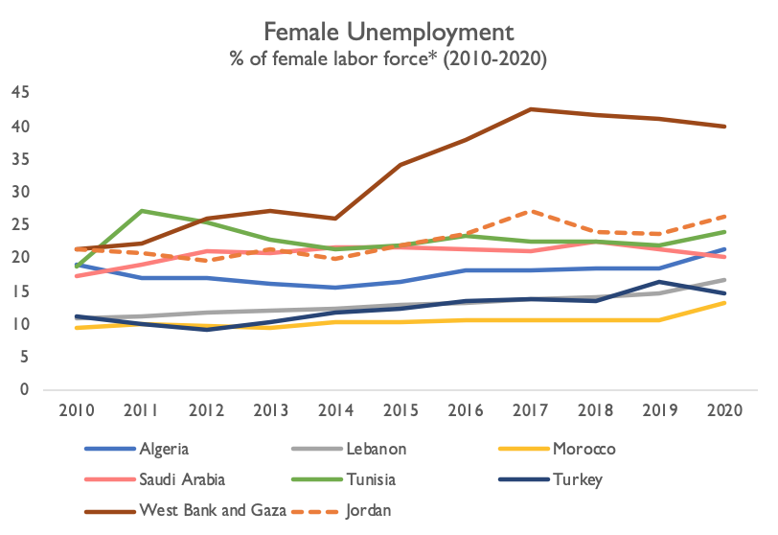
LABOR MARKET CONDITIONS UNEMPLOYMENT
Although West Bank and Gaza had one the biggest increases to female labor force participation, the participation translates into exceptionally high unemployment for women at 40.02% in 2020, compared to 22.45% of males.
Jordan also experiences high levels of female unemployment at 26.54% in 2020.
Notes:
While the unemployment rate for both men and women is high in Jordan, more women than men are unemployed at 26.54% in 2020, compared to 17.43% of men in 2020 (World Bank, 2022). Evidence shows that highly educated women still struggle to secure employment, as 9 out of 10 unemployed women have a university degree. In countries with high unemployment, initiatives to promote entrepreneurship have proven successful, including Algeria and West Bank and Gaza.
Data: Presented here are modeled ILO estimates for the female unemployment rates from 2010-2019.
*Series: Unemployment, female (% of female labor force) (modeled ILO estimate) We showed the ILO modelled estimates for unemployment as it more effective when comparing across countries.
Sources:
World Bank. (2022). World Development Indicators. https://data.worldbank.org/indicator/SL.UEM.TOTL.FE.ZS
Winkler, H. and Gonzalez, A. (2019). Jordan Jobs Diagnostic. Jobs Series; No. 18. World Bank, Washington, DC. Available from https://openknowledge.worldbank.org/handle/10986/32751

Slide 35
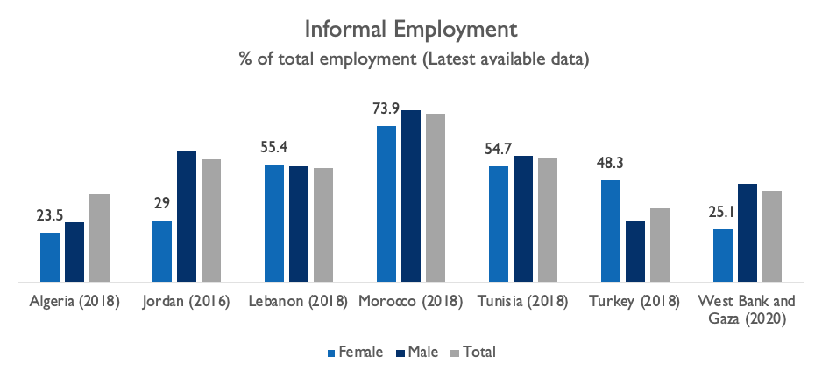
LABOR MARKET CONDITIONS INFORMAL EMPLOYMENT
While there is limited data available on the informal labor force, the informal female labor force participation in Jordan is approximately 30%.
Notes:
In Turkey and Morocco, a high percent of women work informally or as unpaid family laborers in the agricultural sector.
In Lebanon, women’s employment in elementary occupations, service and sales, and craft work tends to be predominantly informal.
Although still high, representing close to half of total employment in Algeria, informal employment has declined over the decade with 50.1% of total employment being informal in 2010, compared with 41.9% in 2019. Informal employment reached its lowest point during 2016 where it was 37.8% of total employment (ONS, 2019). Gender disaggregated informal employment data is not available but when assessing women and men’s vulnerable employment we find that 23.5% of women’s employment is vulnerable compared to 28.4% of men’s (World Bank, 2022). Vulnerable employment is contributing family workers and own-account workers and women and men in vulnerable employment are the least likely to have formal work arrangements, are the least likely to have social protection and safety nets to guard against economic shocks, and often are incapable of generating sufficient savings to offset these shocks (World Bank, 2022). An action plan was adopted by the Algerian government in 2008 in order to promote employment and combat unemployment and employment informality, which Souag and Assaad (2017) found in fact did reduce the probability that workers are employed informally. The study also finds that employers are not ready to offer formal jobs immediately but are willing to formalize employees once they have observed their job performance for some time.
In Jordan, 58% of workers are informal according to the legal definition in 2016. They are not covered by social insurance and thus are not protected against risks such as unemployment, disability, illness, and old-age poverty. Informality rates increased between 2010 and 2016. Accordingly, informality is nearly universal among non-Jordanian workers and all self-employed workers, and it is also high among those working in small firms. Women and college graduates, as well as salaried workers living in urban areas, experience the lowest levels of job informality. This situation is largely driven by the levels of social security coverage among public sector employees, which are the highest (Winkler and Gonzalez, 2019). Informal workers face not only greater exposure to risks but also lower earnings. On average, an informal worker earns about 15% less than a formal worker with the same gender, skills, age, location, and sector of economic activity (ibid).
Definitions:
-See below in Data for country-specific definitions.
-Vulnerable Employment: Vulnerable employment is contributing family workers and own-account workers as a percentage of total employment. (World Bank, 2022) World Bank Development Indicators. https://data.worldbank.org/indicator/SL.EMP.VULN.FE.ZS
- Informality in the JLMPS survey is defined as working without social insurance coverage, so salaried workers in urban areas are considered informal if they are not offered social insurance coverage. Salaried workers in urban areas were one of groups which experience the lowest levels of informality.
Sources:
Algeria: ONS. (2019). Activity, Employment and Unemployment, May 2019 (Emploi, Chom, Mai 2019). Office National des Statistiques Algerie. Available from https://www.ons.dz/spip.php?rubrique3.
Informal employment is employment not affiliated to social security. Sex aggregated data is not available, so we have used the World Bank Vulnerable Employment (% of total employment) (modelled ILO estimates) indicator. Vulnerable employment is contributing family workers and own-account workers as a percentage of total employment.
World Bank. (2022). World Development Indicators. https://data.worldbank.org/indicator/SL.EMP.VULN.ZS
Jordan: data from 2016 - Based on the JLMPS 2010-2016.
Winkler, H. and Gonzalez, A. (2019). Jordan Jobs Diagnostic. Jobs Series; No. 18. World Bank, Washington, DC. Available from https://openknowledge.worldbank.org/handle/10986/32751.
Informality is defined as working without social insurance coverage.
Lebanon: data from 2018/2019 - CAS LHFLCS.
UNDP. (2021). THE LIFE OF WOMEN AND MEN IN LEBANON: A STATISTICAL PORTRAIT. United Nations Development Programme (UNDP) and the Central Administration of Statistics (CAS) of Lebanon: Beirut. Available from http://www.cas.gov.lb/images/Publications/Gender/GENDER%20REPORT.pdf.
The indicator follows the operational criteria as per ILO recommendations and guidelines of the 17th ICLS. It refers to jobs that do not provide employees with legal or social protection, thus exposing them to greater economic risks than other employed. Informal jobs of employees thus include “lack of coverage by the social security system, lack of entitlement to paid annual or sick leave, and lack of a written employment contract.”
Morocco, Tunisia and Turkey: data from 2018 ILO.
International Labour Organization. (2018). Women and men in the informal economy: A statistical picture. Third edition. https://www.ilo.org/global/publications/books/WCMS_626831/lang--en/index.htm p.90.
Saudi Arabia: Not available
West Bank and Gaza: data from 2020.
PCBS. (2021). Women and Men in Palestine Issues and Statistics, 2021. Available from https://pcbs.gov.ps/Downloads/book2586.pdf.
Informal sector includes the following projects: Establishment: An enterprise or part of an enterprise in which one group of goods and services is produced (with the possibility of having secondary activities), either inside or outside building. HUEM: All households incorporated enterprises that produced at least one commodity or service for market and this HUEMs without registration in the tax register. Household Project (Non-establishment nor enterprise): An enterprise owned by a resident of the West Bank or Gaza and it is not qualified as an ‘establishment’, where it is defined as a "household project."
Additional Sources:
Souag, A. and Assaad, R. (2017). The Impact of the Action Plan for Promoting Employment and Combating Unemployment on Employment Informality In Algeria. IZA DP No. 10966, IZA Institute of Labor Economics. Available from https://ftp.iza.org/dp10966.pdf
Winkler, H. and Gonzalez, A. (2019). Jordan Jobs Diagnostic. Jobs Series; No. 18. World Bank, Washington, DC. Available from https://openknowledge.worldbank.org/handle/10986/32751

Slide 36
LABOR MARKET CONDITIONS FOREIGN WORKERS, MIGRANTS, AND REFUGEES
Jordan has the largest percent of foreign workers, migrants, and refugees from the assessed countries.
Saudization efforts have included quotas for domestic employment.
Notes:
A defining characteristic of Jordan over the past decade is its rapid and high rate of population growth attributed to previously high fertility rates, migrant labor, and the hosting of a high number of refugees eligible to work. Estimates for migrant workers in Jordan are from 440,000 to 540,000 (ILO, 2017), and they are highly concentrated in the private sector and informal sector. Although the labor market is growing, it is still unable to supply the adequate number of jobs required on an annual basis. In 2018, the Jordanian economy generated around 50,000 new jobs annually, during a time when around 200,000 new jobs were needed in order to absorb new entrants into the labor market each year (JNCW, 2019).
Other countries with sizable migrant populations, relative to their population size, include Saudi Arabia and Lebanon. Saudi Arabia’s Saudization policies have been implemented with the goal of decreasing reliance on foreign labor and increasing employment among Saudi nationals, especially women. Although Turkey hosts one of the world’s largest refugee populations, migrants and refugees make up only a small percentage of the total population.
Definition: International migrant stock is the number of people born in a country other than that in which they live, including refugees. Here, this data is presented as a percentage of the total population.
Data: Data from the World Bank World Development Indicators (World Bank, 2022). Retrieved from the United Nations Population Division, Trends in Total Migrant Stock: 2008 Revision.
*Series: International migrant stock (% of population)
Sources:
International Labour Organization. (2017). Migrant Domestic and Garment Workers in Jordan. Geneva: ILO. Available from https://www.ilo.org/global/topics/forced-labour/publications/WCMS_554812/lang--en/index.htm
JNCW, Jordanian National Commission for Women. (2019). Fiscal Policy, Taxation and Gender Equality in Jordan. Policy Paper, Jordan. Available from https://www.women.jo/~women/en/node/7907.
World Bank. (2022). World Development Indicators. https://data.worldbank.org/indicator/sm.pop.totl.zs

Slide 37
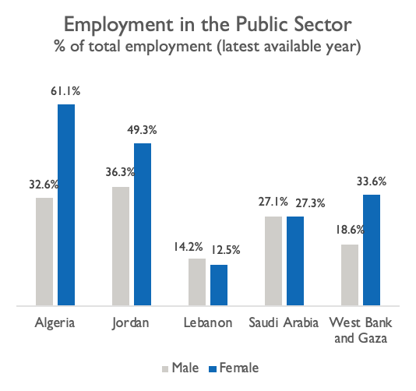
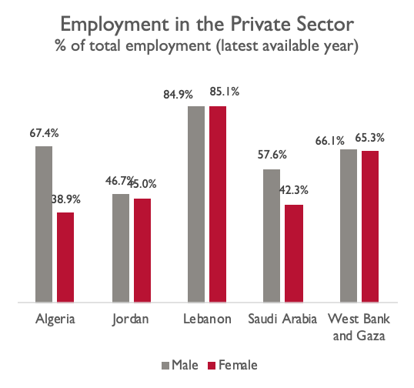
LABOR MARKET CONDITIONS WOMEN’S EMPLOYMENT IN PUBLIC/PRIVATE SECTORS
A high percentage of women in Jordan are employed in the public sector.
Notes:
The high concentration of women in the public sector and their gravitation toward it was among the factors limiting FLPF. One additional noted issue that was shared by a number of the reviewed countries was the problems that arise when the public sector constitutes an excessively large share of the labor market. Due to its regulation, the protections it offers (relatively to other avenues of private and non-formal employment), the relative stability, the public sector became a primary destination for women employment across the MENA region. However, due to its problems arising from having an overrepresented state-controlled labor market, many countries have started to diversify their sources of revenue, while also shifting significant portions of their economic sectors (especially the services sector) into the private sector. This proved to be problematic when alternative, suitable, employment opportunities are not presented in an adequate amount that offsets it. This trend seems to disproportionately affect women in cases where special consideration and programs aren’t put in place to safeguard women employment.
West Bank and Gaza situation regarding sectoral employment is unique; both the private and public sectors exist and additionally employment can take place in Israel and settlements of Israel. The share of employment between sectors in West Bank and Gaza has not changed significantly throughout the decade. The private sector accounts for the largest share of employment, at around 65.9% of total employment in 2020, compared to a share of 65.5% in 2010. The second largest share of employment is in the public sector, which has gradually declined throughout the decade, by 3 percentage points of total employment. The public sector accounted for 24% of employment in 2010 and reduced to 21% in 2020. The remaining share of employment is in Israel and its settlements at 13.1% in 2020, having increased by 2.6 percentage points from 10.5% of total employment in 2010 (PCBS, 2021).
Regarding women and men’s employment, a large majority of women are employed in the private sector, at 65.3% in 2020, followed by 33.6% in the public sector and 1.1% in Israel and settlements. The percentage of women in the public sector has increased from its 2017 rate of 29.6% whereas women’s private sector employment decreased from 69% in 2017. The share of women and men in the private sector is comparable (66.1% of men); however, a lower percentage of men are employed in the public sector (20% in 2017, 18.6% in 2020) and 15% of males work in Israeli settlements compared to the 1% of women, where they receive disproportionately higher wages (daily average of 257.9 NIS) compared to both West Bank and Gaza’s public sector (116 NIS) and private sector (98.9 NIS) (PCBS, 2022).
Data: Algeria: ONS DZ. (2019). Activity, Employment and Unemployment, May 2019 (Emploi, Chom, Mai 2019). Office National des Statistiques Algerie. Available fromhttps://www.ons.dz/spip.php?rubrique3 -https://drive.google.com/file/d/1WFZxcf1s2F_LBlUClPwt1rj-ADDemKha/view?usp=sharing
Jordan: Jordan DOS. (2021). http://www.dos.gov.jo/owa-user/owa/emp_unemp_y.show_tables1_y?lang=E&year1=2021&t_no=82 Note: Percentages for public/private are out of paid employees. 83.5% of males and 96.4% of females are paid employees (out of total employment). Percentages for female and male employment in Jordan’s public and private sectors do not total 100% due to a small number of males and females being employed in ‘Other’ sectors (including employers, own-account workers, paid trainees, and contributing family workers).
Morocco: Reliable gender aggregated data for public/private sector employment was not available.
Lebanon: CAS (2018/2019) https://docs.google.com/spreadsheets/d/1166V63HVh42yfX0ubpKsYU1lBE0MzcFo/edit#gid=245391550&range=A4:A6 Note: Percentages for female and male employment in Lebanon’s public and private sectors do not total 100% due to 2.4% of females and 0.9% of males being employed in the ‘Other’ sector.
Saudi Arabia: GASTAT. (2021).Labor market statistics Q3, 2021 https://www.stats.gov.sa/en/814 - Note: Percentages for female and male employment in Saudi’s public and private sectors do not total 100% due to 30.4% of females and 15.3% of males being employed in the ‘Other’ sector (Other: includes family workers, non-profit organizations, domestic workers, regional and international organizations). Note: Figures are for total employed population which include Saudis and Non-Saudis.
Tunisia: Reliable gender aggregated data for public/private sector employment was not available.
Turkey: Reliable gender aggregated data for public/private sector employment was not available.
West Bank and Gaza: PCBS. (2021). Women and Men in Palestine Issues and Statistics, 2021. Available from https://pcbs.gov.ps/Downloads/book2586.pdf p54.
PCBS. (2022). Average Daily Wages by Sector. https://www.pcbs.gov.ps/Portals/_Rainbow/Documents/wages-2015-2020-01e.html
Note: Percentages for female and male employment in West Bank and Gaza’s public and private sectors do not total 100% due to 1.1% of women and 15.3% of men being employed in Settlement areas, which are considered independently from the private/public sectors.

Slide 38
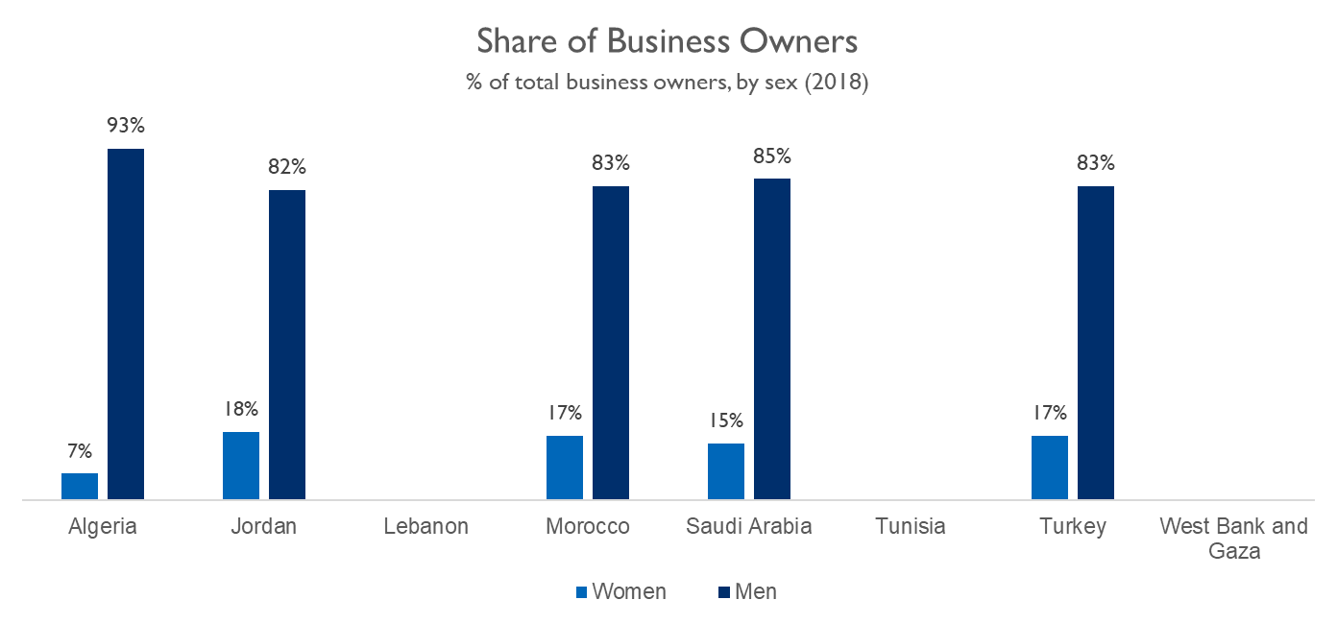
LABOR MARKET CONDITIONS WOMEN BUSINESS OWNERS
There is limited data available on women business owners, though there are large gender gaps in business ownership across the available data.
Notes:
The MENA average for women’s business ownership of formally registered small and medium-sized enterprises (SMEs) is 12-15% (IFC 2018). The data presented here includes enterprises of all sizes and shows a large disparity between the number of men and women business owners in all of the countries for which there was data available.
Sources:
International Finance Corporation. (2018). Banking on Women in Tunisia: Innovations in the Banking Industry Workshop Report. https://www.ifc.org/wps/wcm/connect/2ed82d7a-bf2a-40bf-ad22-4d54a9c22286/LR_Banking+on+Women+in+Tunisia.pdf?MOD=AJPERES&CVID=mgomCyt
World Bank Gender Data Portal -https://genderdata.worldbank.org/

Slide 39
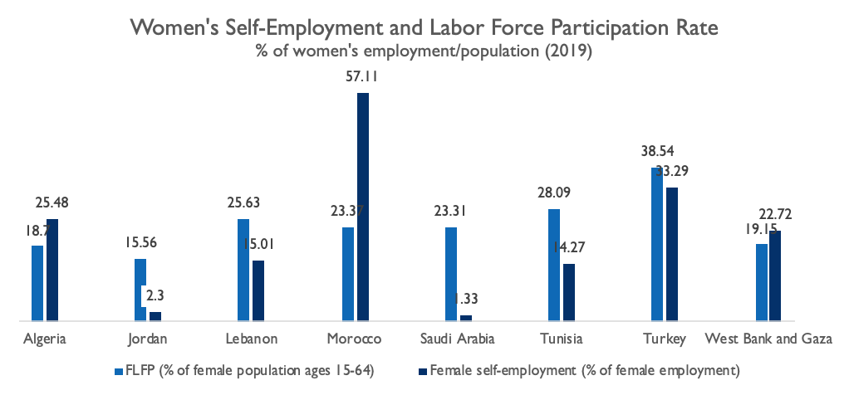
FEMALE LABOR FORCE PARTICIPATION SELF-EMPLOYED WOMEN
Countries with higher or increased levels of female labor force participation have a sizable percentage of self-employed women.
Self-employed women in Jordan account for only 2.3% of female employment.
Notes:
Unlike the data on women business owners, which is restricted to ownership of formally registered enterprises, the data on self-employed women may include women who work in the informal sector or as family laborers. The greatest female self-employment was observed in Morocco, while the countries with the smallest percentage of self-employed women were Jordan and Saudi Arabia.
Definition: Self-employed workers are those workers who, working on their own account or with one or a few partners or in cooperative, hold the type of jobs defined as a "self-employment jobs," i.e. jobs where the remuneration is directly dependent upon the profits derived from the goods and services produced. Self-employed workers include four sub-categories: employers, own-account workers, members of producers' cooperatives, and contributing family workers.
Data: FLFP figures are from the Labor force participation rate, female (% of female population ages 15-64) (modeled ILO estimate) series for the latest year available
Source: World Bank. (2022). World Bank Development Indicators. https://databank.worldbank.org/source/world-development-indicators

Slide 40
Legal, Regulatory,
and Policy Frameworks

Slide 41
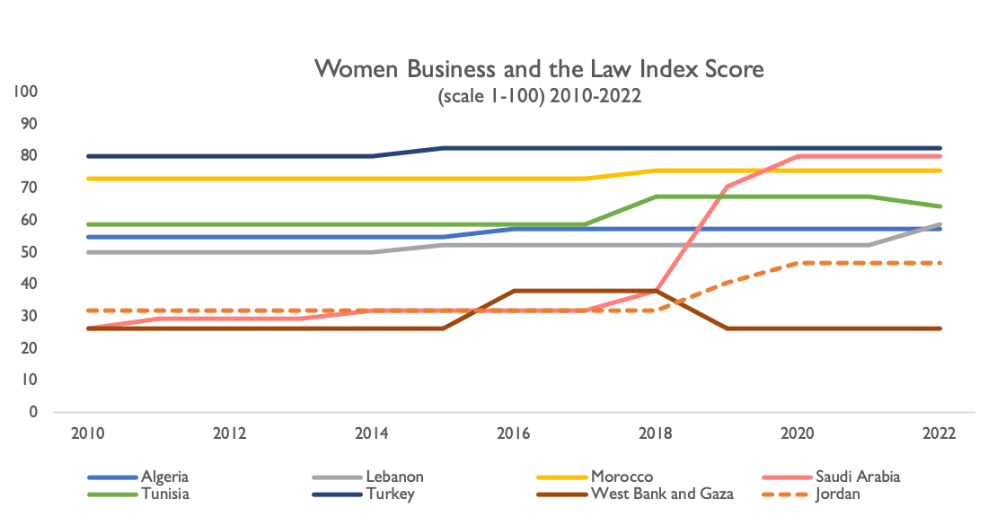
LEGAL, REGULATORY, AND POLICY FRAMEWORKS WOMEN, BUSINESS, AND THE LAW INDEX
All countries except for the West Bank and Gaza outperformed Jordan on the index.
Jordan observed an increase on the index due to its recent legislative changes.
76.5
Global Average
(2022)
53.0
Regional Average
(2022)
Notes:
The Women, Business, and Law Index ranks economies based on points scored across eight indicators in order to measure how countries have adjusted their national policies to strengthen gender equality in the labor market. The indicators include mobility, workplace, pay, marriage, parenthood, entrepreneurship, assets, and pension.
The countries obtaining the highest score were Turkey (82), followed by Morocco (75.6), Saudi Arabia (70.6) and Tunisia (67.5). The two countries which did not get a perfect score in any of the indicators were Algeria and the West Bank and Gaza – where there is great room for improvement. Jordan only received a perfect score in Entrepreneurship. While Jordan’s score in the Women, Business, and the Law (WBL) Index is improving (46.9), it is still lower than the regional average observed across the MENA (53). Over the last two years, Jordan demonstrated great improvement as its score went up from 31.9 in 2017, to 40.6 in 2020, to 46.9 in 2022.
Improvement in WBL index scores were mostly driven by Labour Law reform. Among amendments to the Labor law were the elimination of legal restrictions on women’s ability to work at night, enacting legislation that mandates equal remuneration for work of equal value, and introducing paid paternity leave for the first time. Other changes which reflected positively on Jordan’s score included removing procedural requirements that made it more difficult for women than men to apply for a passport and prohibiting gender-based discrimination in financial services. Should Jordan uphold the implementation of these new policies and legislations, it stands to reason the country’s FLFP will increase in the next decade. In fact, research has found that when gender parity is reflected in law, FLFP increased by at least 5 percentage points in the following 5 years (Gonzales et al. 2015).
Based on the Women, Business and the Law Index, all countries without exception need to consider reforms to improve legal equality for women when it comes to laws affecting women’s work after having children.
Definition: The Women, Business, and The Law Index measures the laws and regulations that affect women's economic opportunity in 190 economies. The index incorporates eight indicators structured around women's interactions with the law as they move through their careers: Mobility, Workplace, Pay, Marriage, Parenthood, Entrepreneurship, Assets, and Pension.
Sources:
World Bank. 2022. Women, Business and the Law 2022. Washington, DC: World Bank. doi:10.1596/978-1-4648-1817-2. License: Creative Commons Attribution CC BY 3.0 IGO
Gonzales, M. C., Jain-Chandra, M. S., Kochhar, M. K., & Newiak, M. M. (2015). Fair play: More equal laws boost female labor force participation. International Monetary Fund.

Slide 42
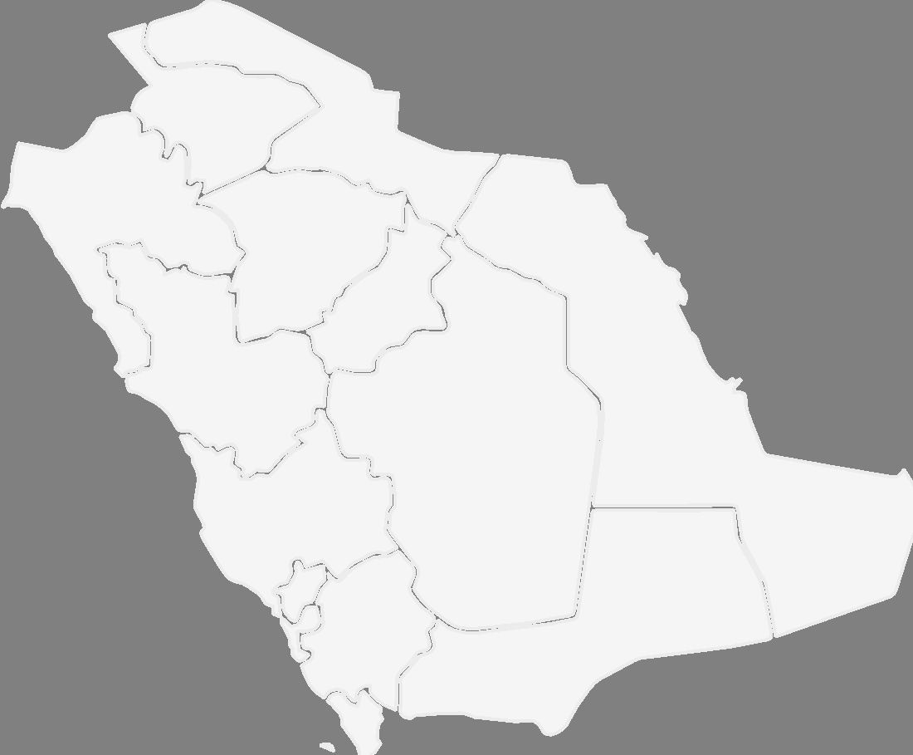
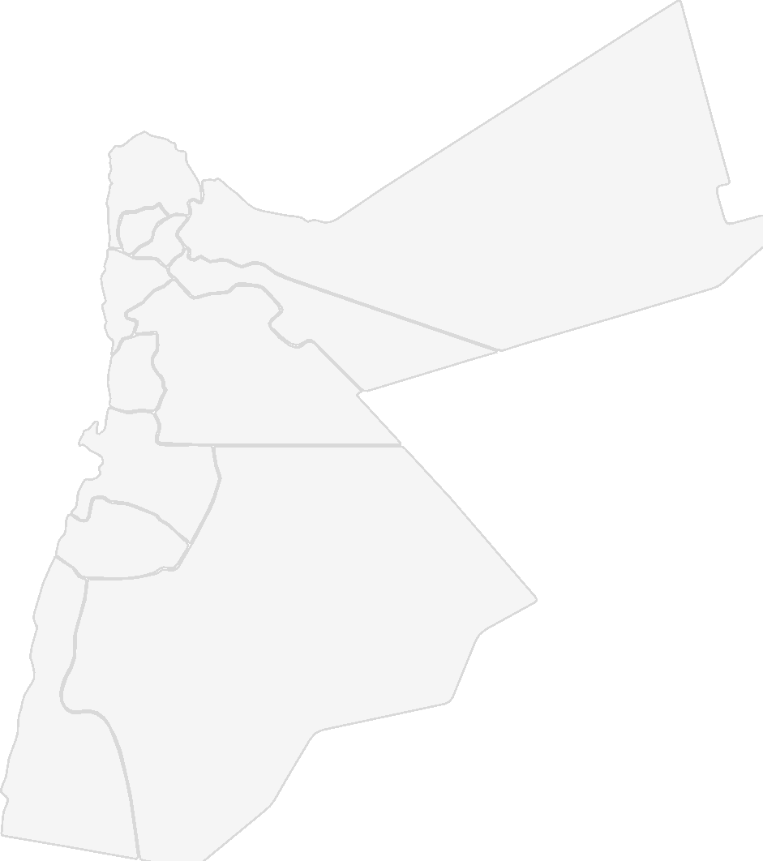
LEGAL, REGULATORY, AND POLICY FRAMEWORKS WOMEN, BUSINESS, AND THE LAW INDEX
Saudi Arabia had the largest improvement in the index given its robust changes in the following areas:
Eliminating the need for a male guardian to approve employment
Lifting ban on female driving
Criminalizing sexual harassment in the workplace
Prohibiting employers
from firing women during pregnancy or maternity leave
Jordan also made gains on the index with the following changes:
Imposing penalty on employers in the event of gender-based discrimination in wages
Mandating childcare facilities once companies surpass 15 children under the age of 5 among their (male and female) employees
Prohibiting gender-based discrimination in financial services
Notes:
Notable changes that took place between 2010 and 2022 were Saudi Arabia having the largest score improvement (from 26.3 in 2010 to 80 in 2022) and Jordan having the second-largest increase (from 28.8 to 56.9 in 2022). Saudi Arabia increased from 0 to 100 in Mobility, 25 to 100 in Workplace and Pay, 0 to 60 in Marriage, 20 to 40 in Parenthood, and 75 to 100 in Entrepreneurship, and from 50 to 100 in Pension. Meanwhile, Jordan increased from 0 to 25 in Mobility, 0 to 75 in Pay, 20 to 40 in Parenthood, 75 to 100 in Entrepreneurship, and from 50 to 75 in Pension.
In recent years, Jordan has made several reforms to support women’s entrance into the labor market, though discriminatory laws continue to deter women from entering and/or remaining in the workforce. A recent achievement is the amended Jordanian Labor Law, which not only introduced clear definitions on “wage discrimination” and “flexible work,” but also mandated equal renumeration for work of equal value with penalties in the event of gender-based wage discrimination. This is considered a step forward towards pay equity and non-discriminatory practices between women and men in the workplace. Furthermore, gender-based discrimination in financial services was prohibited and former restrictions on women’s ability to work at night were lifted. Finally, the Labor Law was amended to stipulate that any employer, where among the employees in a company there are 15 or more children under the age of 5, should provide suitable childcare in the workplace and fathers are now entitled to a paid paternity leave of three days.
Source: World Bank. 2022. Women, Business and the Law 2022. Washington, DC: World Bank. doi:10.1596/978-1-4648-1817-2. License: Creative Commons Attribution CC BY 3.0 IGO

Slide 43
Legal, Regulatory,
and Policy Frameworks
Enabling Environment

Slide 44
ENABLING ENVIRONMENT SUPPORT SERVICES FOR WOMEN
 | Breaks for breastfeeding | Paid maternity leave¹ | Dismissal of pregnant workers prohibited
Algeria | Not mandated | Full wage for 14 weeks | No
Jordan | 1 hour a day with pay for 1 year | Granted 70 days | No
Lebanon | Not mandated | Granted 70 days | Yes
Morocco | 1 hour a day with pay for 14 months | 67% of wages for 14 weeks | Yes
Saudi Arabia | 1 hour a day with pay | 50% of wages for 10 weeks | Yes
Tunisia | 1 hour a day with pay for 1 year | 67% of wages for 4 weeks | No
Turkey | 1.5 hours with pay for 1 year | 16 weeks of paid leave | Yes
West Bank and Gaza | 1 hour with pay for 1 year | Granted 70 days | No
¹ The cells highlighted in red are those paid by the government, while those in gray are paid by the employer.
Notes:
The countries assessed have various policies in place to support parenthood. However, achieving parity is not merely a question of regulation of services but proper oversight is required to ensure its implementation. While paid maternity leave supports mothers and allows them to later return to their jobs, assigning the financial responsibility to the private sector may create a preference for hiring men and disincentivize employers from hiring women (Al-Munajjed 2010). In Jordan, paternity leave has recently been introduced for the first time, which will allow fathers to take a more equal role in caregiving.
Sources:
International Labour Organization. (2021). Assessment of the Maternity Insurance in Jordan. ILO: Amman. https://www.ilo.org/wcmsp5/groups/public/---arabstates/---ro-beirut/documents/publication/wcms_776223.pdf
Jordanian National Commission for Women. (2019). Fiscal Policy, Taxation and Gender Equality in Jordan. Policy Paper, Jordan. https://www.women.jo/~women/en/node/7907.
World Bank Group (2020). Women’s Economic Participation in Iraq, Jordan and Lebanon. https://openknowledge.worldbank.org/handle/10986/34535
World Alliance for Breastfeeding Action. (2019). Parents At Work: Leave and Breastfeeding Breaks by Country. http://waba.org.my/v3/wp-content/uploads/2019/10/PAW-Chart_eng_A4.pdf
Al-Munajjed, M. (2010). Women’s Employment in Saudi Arabia: A Major Challenge, Booz & Co., New York City. https://arabdevelopmentportal.com/sites/default/files/publication/235.womens_employment_in_saudi_arabia_a_major_challenge.pdf

Slide 45
ENABLING ENVIRONMENT SUPPORT SERVICES FOR WOMEN
 | Childcare facilities | Transportation
Algeria | Neither public nor private is required to provide | Some employers provide transportation for female employees, but it is not required
Jordan | Employer mandated where there are 15 or more children under the age of 5 | The National Employment Plan (NEP) is slated to include government subsidies for transportation
Lebanon | Employers are not required to provide | Private sector employers are required to provide employees with a daily transportation allowance
Morocco | Employer mandated if more than 50 female employees | Not found
Saudi Arabia | Government mandated for companies above a certain size | Government pays 80% of the transportation cost for each trip between work and home for 24 months for workers earning less than 8000 riyals monthly
Tunisia | Neither public nor private is required to provide | 2019 initiative for authorized non-regular public transporters to transport female agricultural workers to their workplaces
Turkey | Government mandated for companies that employ more than 150 women. Private childcare is exempt from taxes for five accounting periods from launch. Childcare costs deducted from income tax if employers pays directly to facility.* | Not found
West Bank and Gaza | Not found | Not found
Notes:
The lack of childcare support and the burden of unpaid care work at home are cited as barriers to women’s economic participation in Jordan. Women’s responsibility for childcare and the inadequate infrastructure and legal and policy support available to them to help redistribute unpaid care work is considered one of the main barriers preventing women’s entry and retention in the workforce (ILO, 2021). A World Bank study (2018) that asks women about the main deterrents from the labor market also cites the lack of childcare facilities and intra-household barriers. It is highlighted that the lack of a friendly work environment to mothers with access to childcare facilities affect participation (JNCW, 2019).
The cost of paid childcare as substitutes to unpaid care work means women’s reservation wages are set higher relative to men, which contributes to their drastically lower participation rates. Average childcare costs as a share of a women’s average wage ranges from 123% for primary school graduates, to 77% for university graduates. When this is combined with historically lower wages for women, it acts as an important factor for weakening women’s labor force participation. The new amendment to the labor law will help reduce the gender pay gap but there is still a need to reduce childcare costs through public subsidized quality childcare services (JNCW, 2019).
In Jordan, research shows that lack of adequate, safe, and affordable transport presents a significant barrier to women’s participation in the labor market. Lack of safe transport options can translate into girls missing schools, women not looking for jobs far away from homes, giving up their jobs or being unable to access health or childcare services. According to a recent study undertaken by Sadaqa and Friedrich– Ebert–Stiftung in Jordan, 47% of the surveyed women reported to have turned down job opportunities due to the current state of public transportation naming sexual harassment, affordability and service coverage as one of the key barriers (World Bank 2019, SADAQA, 2018).
62.6% of 497 female public transport users surveyed stated experiencing harassment while using public transportation. Among the most frequently cited types of harassment was inappropriate stares (41.5%), followed by verbal abuse (31.5%), stalking (19.5%) and physical abuse (5.7%). As for the times during which the harassment took place, it was found that harassment was common at all times, including peak morning and evening hours. In that same study, 80.5% of the sample considered that the participation of women in the labor market can be improved through safer public transport (Aloul et al., 2018).
Women from lower socio-economic brackets are more likely to be affected by unsafe and inadequate transportation. The Jordanian Labor Market Panel Survey (2010-16) shows that women with less than a high school degree mainly use public transport to go to work and only 15.2% of those with less than a high school degree use a private car to travel (World Bank, 2020).
Sources:
Aloul et al. (2018). Gender in Public Transportation: A Perspective of Women Users of Public Transportation. A research study conducted by Sadaqa Jordan. Supported by FES (Amman office). http://library.fes.de/pdf-files/bueros/amman/15221.pdf
International Labour Organization. (2021). Assessment of the Maternity Insurance in Jordan. ILO: Amman. https://www.ilo.org/wcmsp5/groups/public/---arabstates/---ro-beirut/documents/publication/wcms_776223.pdf
Jordanian National Commission for Women. (2019). Fiscal Policy, Taxation and Gender Equality in Jordan. Policy Paper, Jordan. https://www.women.jo/~women/en/node/7907.
SADAQA. (2018). Gender in Public Transportation: A Perspective of Women Users of Public Transportation. SADAQ and Friedrich– Ebert–Stiftung. http://transportgenderobservatory.eu/wp-content/uploads/2020/06/Gender-in-Public-Transportation.pdf
World Bank. (2019). Jordan Improving Women Economic Opportunities. The World Bank: Washington. https://documents1.worldbank.org/curated/en/429441581525262376/pdf/Jordan-Improving-Women-Economic-Opportunities-Select-Entry-Points-for-Policy-Dialogue-and-Operational-Interventions.pdf
World Bank Group (2020). Women’s Economic Participation in Iraq, Jordan and Lebanon. https://openknowledge.worldbank.org/handle/10986/34535

Slide 46
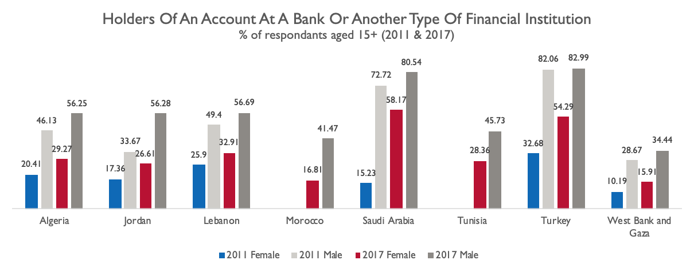
ENABLING ENVIRONMENT ACCESS TO FINANCE
All countries with available data observed increases in women’s access to finance but gender gaps remain.
Access to finance increases for countries with higher GDP.
Notes:
All of the countries for which data was available reported increases in women’s access to finance, but none has yet reached gender parity. Jordan has made progress in the last decade by introducing the right to non-discrimination based on gender in access to finance and prohibiting gender-based discrimination in financial services, which will continue to improve women’s access to credit. These changes are expected to have a positive effect on women’s entrepreneurship.
Definition: The percentage of respondents who report having an account (by themselves or together with someone else) at a bank or another type of financial institution (see definition for financial institution account https://databank.worldbank.org/metadataglossary/global-financial-development/series/GFDD.AI.05) or report personally using a mobile money service in the past 12 months (see definition for mobile money account https://databank.worldbank.org/metadataglossary/world-development-indicators/series/WP15163_4.1), female (% age 15+).
Source: World Bank Global Financial Inclusion Database (2018), available at https://databank.worldbank.org/source/global-financial-inclusion

Slide 47
Social Factors

Slide 48
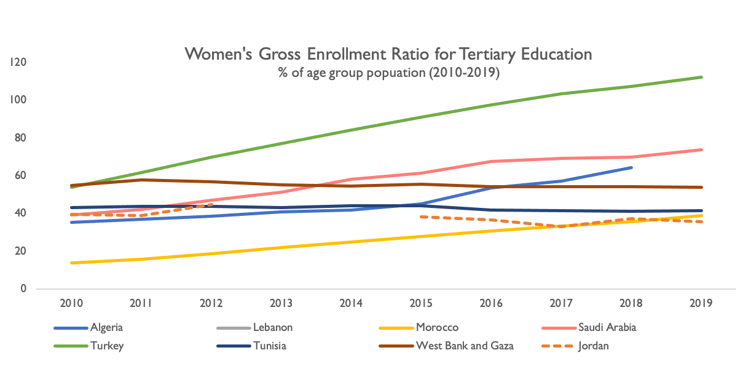
SOCIAL FACTORS FEMALE TERTIARY EDUCATION ENROLLMENT (2010-2019)
Turkey had the greatest increase in gross female enrollment ratio in tertiary education over the 2010-2019 period.
Jordan saw a decline in the female tertiary enrollment ratio, a comparable trend to West Bank and Gaza and Tunisia.
Notes:
Turkey, Saudi Arabia, Algeria, and the West Bank and Gaza all had female tertiary education enrollment over 50% by the end of the decade. Jordan saw a decline given the influx of refugees, who have lower rate of enrollment (HRW 2020).
School enrollment ratios are generated based on the population estimates from population registers, but the absence of population count in Lebanon makes this calculation difficult. Indicators of school participation derived from household surveys refer to attendance – whether children and adolescents attended school at any point during the reference school year. The net attendance rates in tertiary education for women in Lebanon are as follows: 2004 (35.9%), 2007 (43.0%), and 2018-19 (44.9%). By this measure we can see tertiary attendance in Lebanon improved by 1.9% from 2007 to 2018-19.
Definition: Gross enrollment ratio (GER) is the ratio of total enrollment, regardless of age, to the population of the age group that officially corresponds to the level of education shown. Tertiary education, whether or not an advanced research qualification, normally requires, as a minimum condition of admission, the successful completion of education at the secondary level.
Note: GER can exceed 100% due to the inclusion of over-aged and under-aged students because of early or late entrants, and grade repetition. In this case, a rigorous interpretation of GER needs additional information to assess the extent of repetition, late entrants, etc.
Sources: UNESCO Institute for Statistics (http://uis.unesco.org/). Data as of September 2021.
Turkey:
Turkstat, MONE, National Education Statistics Formal Education, 2007-2020
UNDP, CAS. (2021). The Life of Women and Men in Lebanon: A Statistical Portrait. United Nations Development Programme (UNDP) and the Central Administration of Statistics (CAS) of Lebanon. Lebanon: Beirut. Available from http://www.cas.gov.lb/images/Publications/Gender/GENDER%20REPORT.pdf
HRW, Human Rights Watch. (2020). Jordan: Secondary School Gap for Syrian Refugee Kids. Article June 26, 2020. https://www.hrw.org/news/2020/06/26/jordan-secondary-school-gap-syrian-refugee-kids

Slide 49
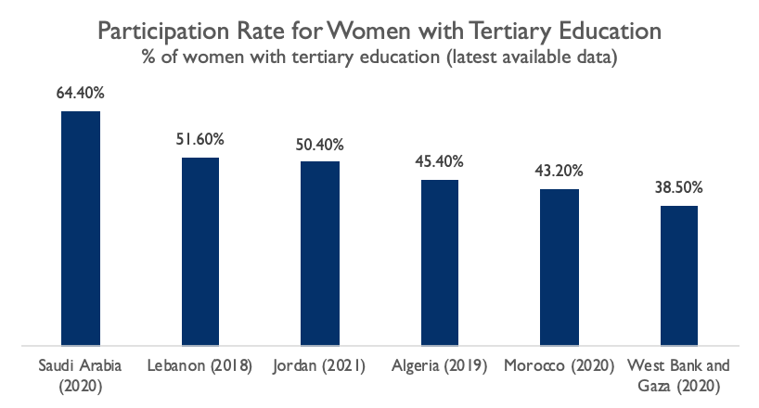
SOCIAL FACTORS FEMALE LABOR FORCE PARTICIPATION BY EDUCATION
Higher educational attainment translates into higher participation but does not necessarily result in increased employment.
Notes:
The mismatch between education and labor market demand was among the barriers to increase FLFP. Another shared issue among the countries was the inability to coordinate between the available supply of educated and skilled labor force within the country, with the labor market demand. This resulted in the phenomenon of a high representation of highly educated women who remain unemployed or discouraged from participating in the economy altogether.
High educational attainment did not necessarily result in increased employment. Though educational (even within high education) attainment is quite high amongst women in the region, and showed steady increase across the past decade, many countries couldn’t create enough skilled jobs to absorb them into relevant professions that met the countries’ labor needs. In some cases, women education is still even widely viewed as a way to improve a women’s perceived value for marriage. It does seem, however, that new generations are exhibiting a more progressive shift in opinions regarding the role of women in the home and the labor market.
Sources:
Algeria: ONS DZ. (2019). Activity, Employment and Unemployment, May 2019 (Emploi, Chom, Mai 2019). Office National des Statistiques Algerie. Available from https://www.ons.dz/spip.php?rubrique3
Jordan: DOS. (2021). Population Age 15+ Years by Economic Activity Status, Sex, Educational Level & Nationality (Percentage Distribution) – 2021. Jordan Department of Statistics. Available from http://www.dos.gov.jo/owa-user/owa/emp_unemp_y.show_tables1_y?lang=E&year1=2021&t_no=19
Lebanon: UNDP. (2021). THE LIFE OF WOMEN AND MEN IN LEBANON: A STATISTICAL PORTRAIT. United Nations Development Programme (UNDP) and the Central Administration of Statistics (CAS) of Lebanon: Beirut. Available from http://www.cas.gov.lb/images/Publications/Gender/GENDER%20REPORT.pdf
Morocco: BDS MAROC. (2020). LA FEMME MAROCAINE EN CHIFFRES. Available from https://www.hcp.ma
Saudi Arabia: GASTAT. (2020). Labor Market Statistics Q4 2020. Available from https://www.stats.gov.sa/en/814
Tunisia: Reliable gender aggregated data for participation by level of education was not available.
Turkey: Reliable gender aggregated data for participation by level of education was not available.
West Bank and Gaza: PCBS. (2021). Women and Men in Palestine Issues and Statistics, 2021. Available from https://pcbs.gov.ps/Downloads/book2586.pdf

Slide 50
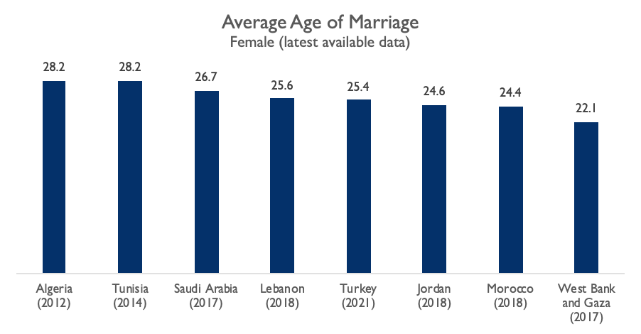
SOCIAL FACTORS AVERAGE AGE OF MARRIAGE
Algeria, Tunisia and Saudi Arabia have the highest average age of female at first marriage at 28.
Notes:
Marriage by the median age reduces women’s probability of market work by 47% in Jordan and 33% in Tunisia. Moreover, women in Jordan often leave employment at marriage, and are particularly likely to leave private sector work at marriage (Assad, Krafft and Selwaness, 2022). The average age of marriage in Jordan has been increasing over the decade, from age 20 in 2010 to age 22 in 2016 (ERF, 2018) and increasing to age 24.6 in 2018 (World Bank, 2022). Women marrying by the median age are significantly less likely to ever engage in wage employment, by 37% in Jordan, 31% in Tunisia, and 20% in Egypt. This is mostly due to a reduction in the probability of ever entering private wage work, which declines by 33% in Jordan and 21% in Tunisia (Assad, Krafft and Selwaness, 2022). The biggest average effect on overall employment is found for Jordan and is mostly due to never entering employment in the first place in anticipation of marriage (ibid).
Reconciling domestic and work responsibilities within marriage is an important factor in reducing women’s ability to engage in market work. In Jordan, married women face a high domestic workload of 28-30 hours, compared to unmarried women who are not employed engaging in 8-14 hours per week. Therefore, unmarried women’s domestic work is more easily reconciled with market work which ranges from an average of 42-48 hours in the private sector and an average of 38-40 hours in the public sector. Women who obtain government jobs tend to stay in them until retirement, but women with other types of wage employment tend to exit work at marriage (ibid).
Sources:
Algeria: Data from 2012. World Bank. (2022). World Bank Gender Data Portal - https://genderdata.worldbank.org/indicators/sp-dyn-smam/
Jordan: Jordan (JLMPS 2010,2016). ERF. (2018). Marriage and Fertility Patterns Among Jordanians and Syrian Refugees in Jordan. Available from https://erf.org.eg/app/uploads/2018/05/WP-1187_Final.pdf
Lebanon: UNDP. (2021). THE LIFE OF WOMEN AND MEN IN LEBANON: A STATISTICAL PORTRAIT. United Nations Development Programme (UNDP) and the Central Administration of Statistics (CAS) of Lebanon: Beirut. Available from http://www.cas.gov.lb/images/Publications/Gender/GENDER%20REPORT.pdf p24
Morocco: Data from 2018. World Bank. (2022). World Bank Gender Data Portal - https://genderdata.worldbank.org/indicators/sp-dyn-smam/
Saudi Arabia: Data from 2017. World Bank. (2022). World Bank Gender Data Portal - https://genderdata.worldbank.org/indicators/sp-dyn-smam/
Tunisia: Data from 2014. World Bank. (2022). World Bank Gender Data Portal - https://genderdata.worldbank.org/indicators/sp-dyn-smam/
Turkey: TURKSTAT. (2021) https://data.tuik.gov.tr/Bulten/Index?p=Women-in-Statistics-2021-45635
West Bank and Gaza: Data from 2017. World Bank. (2022). World Bank Gender Data Portal - https://genderdata.worldbank.org/indicators/sp-dyn-smam/
Additional Sources:
Assaad, R. and Krafft, C. and Selwaness, I. (2022): The Impact of Marriage on Women's Employment in the Middle East and North Africa, Feminist Economics, DOI: 10.1080/13545701.2021.2007415
ERF. (2018). Marriage and Fertility Patterns Among Jordanians and Syrian Refugees in Jordan. Available from https://erf.org.eg/app/uploads/2018/05/WP-1187_Final.pdf
World Bank. (2022). World Bank Gender Data Portal - https://genderdata.worldbank.org/indicators/sp-dyn-smam/

Slide 51
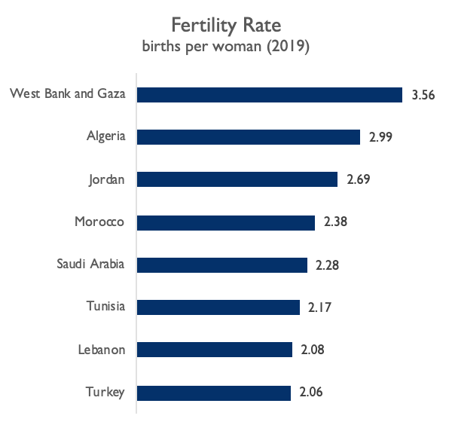
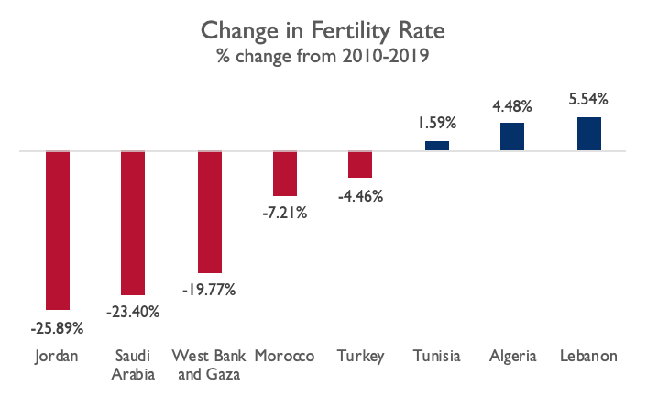
SOCIAL FACTORS FERTILITY RATES (2010-2019)
Jordan, along with several countries that had high increases in FLFP, observed decreases in fertility rates.
Notes:
Countries with the highest increase in FLFP, in addition to Jordan, also saw significant decreases in fertility rates over the same time period: Jordan (-25.89%), Saudi Arabia (-23.4%), West Bank and Gaza (-19.77%), and Turkey (-7.03%).
Of the cases selected, only Tunisia, Algeria and Lebanon saw fertility rates increase over the decade.
Definition: Total fertility rate represents the number of children that would be born to a woman if she were to live to the end of her childbearing years and bear children in accordance with age-specific fertility rates of the specified year, in this case of 2019. Fertility rate change is the difference in percentage points between 2010 and 2019.
Sources:
United Nations Population Division. World Population Prospects: 2019 Revision.
Census reports and other statistical publications from national statistical offices.
Eurostat: Demographic Statistics.
United Nations Statistical Division. Population and Vital Statistics Report (various years).
U.S. Census Bureau: International Database.
Secretariat of the Pacific Community: Statistics and Demography Programme.

Slide 52
SOCIAL FACTORS NORMS AND BELIEFS
One common barrier across all countries was having strong social norms that deeply entrenched patriarchal notions of gender roles such as:
Restricting women to the domestic sphere
“Feminized” occupations
Education to improve perceived value for marriage
Preference for public sector
Wage gaps
In Jordan, social norms and beliefs remain critical to women’s participation in the labor market. The following norms are observed:
Married women are less likely to be working
Men are considered the ultimate decision-makers in households
Discrimination in hiring
Notes:
Jordan's social norms and beliefs remain critical to women’s participation in the labor market. The World Bank (2018) found while there was support for FLFP, this support came with important caveats. 96% of male and female respondents were in agreement with women working, but this figure slightly decreased if work is outside the home (80%) or if those working were married (72%). There was a further decrease if work was in a mixed-sex environment (38%) or if work required women to return home after 5 pm (26%). Given that many jobs – particularly in the private sector – involve a mixed-sex environment and working hours until 4 and 5 pm, these views could severely constrain the options women can realistically consider when looking for suitable work.
Norms and beliefs regarding women’s role in society also influence the willingness of employers to hire women. Research shows that some employers resist hiring women or paying them the same wages as men. Some women report that they are still asked about their marital status and plans to have children during job interviews.
While over 60% of non-working women would like to work, both male and female respondents agreed that men are the ultimate decision-makers in the household – influencing whether women decide to accept a job or not.
Other binding constraints for women include availability and affordability of childcare, flexibility in work arrangements, hiring and wage discrimination, transportation, and scarcity of attractive job opportunities.
Sources:
Jordan Department of Statistics. (2020) Employment and Unemployment Data. http://www.dos.gov.jo/owa-user/owa/emp_unemp_y.show_tables1_y?lang=E&year1=2020&t_no=20
Winkler, Hernan Jorge; Gonzalez, Alvaro S..2019. Jobs Diagnostic Jordan. (English). Issue no. 18; Jobs Series Washington, D.C.: World Bank Group. https://openknowledge.worldbank.org/bitstream/handle/10986/32751/143662.pdf?sequence=5&isAllowed=y

Slide 53
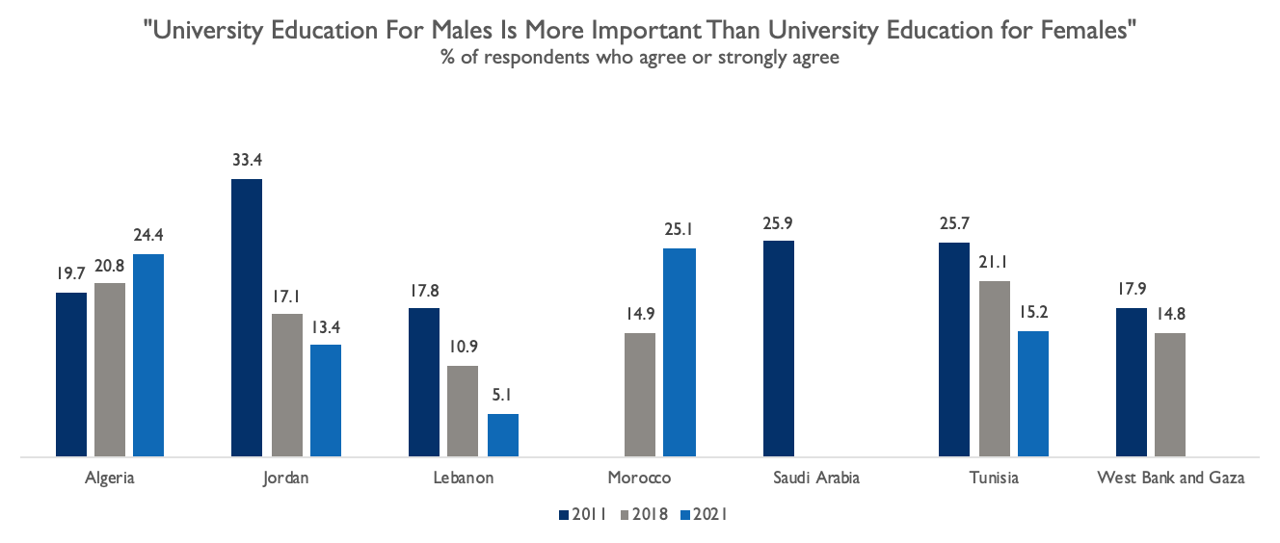
SOCIAL FACTORS NORMS AND BELIEFS
Discriminatory beliefs regarding education decreased in Jordan over the last decade.
Notes:
Percentage of respondents who agreed that university education for males was more important than university education for females decreased significantly between 2011 and 2021 in Jordan and Lebanon.
Though Lebanon faces restrictive social norms as it relates to women’s economic participation, it is changing with younger generations. Younger age groups in Lebanon generally have more egalitarian views of women’s economic participation and 15-24-year-olds are almost twice as likely as 40-69-year-olds to find women’s working for pay as fulfilling as primary caretaking roles and responsibilities at home. In fact, women aged 15-44 are twice as likely to participate in the labor force as women aged 45-64. Across age groups, 79% of men and 86% of women believe that married women should have the same right to have a career as their husbands.
Source: Arab Barometer. Wave II-2011, Wave V-2018, Wave VI-2021. https://www.arabbarometer.org/

Slide 54
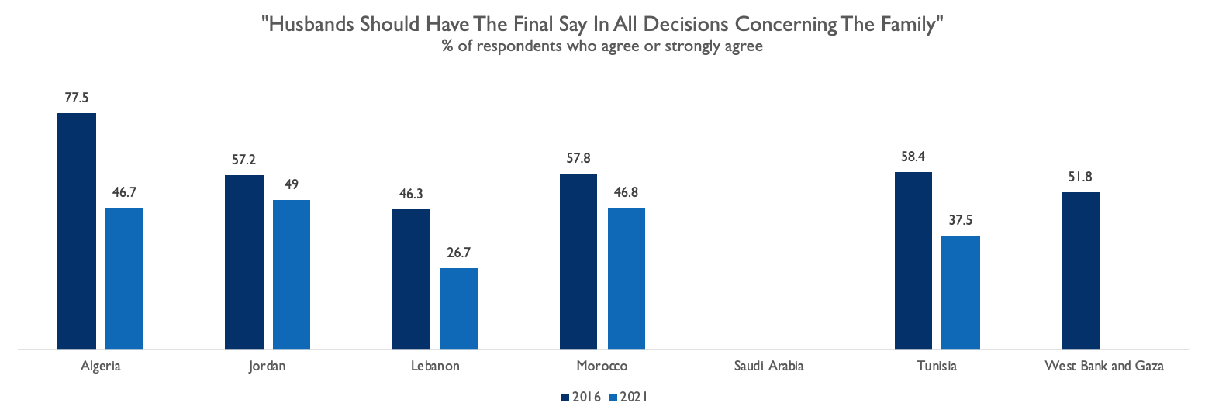
SOCIAL FACTORS NORMS AND BELIEFS
Views on whether husbands should have the final say in family decisions changed in only five years, decreasing in Jordan.
Notes:
Likewise, view on whether husbands should have the final say in all decisions concerning the family changed in only five years in, decreasing in all countries with available data, including Jordan.
Source: Arab Barometer. Wave IV-2016, Wave VI-2021. https://www.arabbarometer.org/

Slide 55
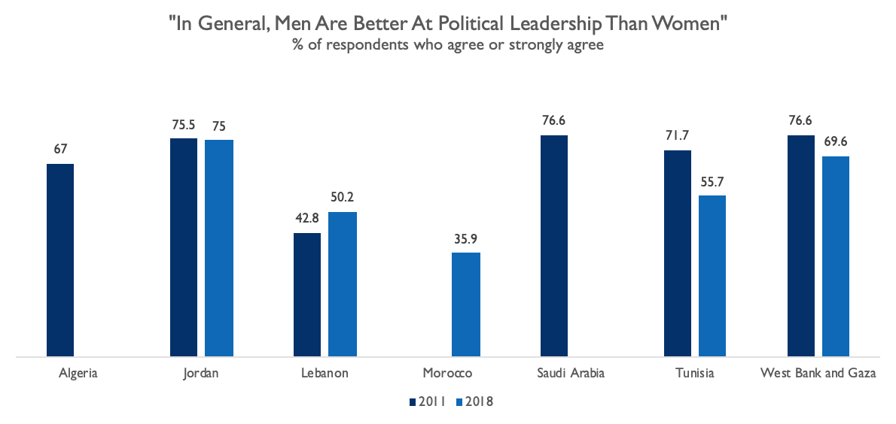
SOCIAL FACTORS NORMS AND BELIEFS
A large percentage of respondents in Jordan hold discriminatory views regarding women’s and men’s political leadership. These views have not changed from 2011-2018 (most recent data).
Notes:
Despite changes to beliefs around women in education and more gender equal beliefs around family decision-making, a large percentage of respondents in each country assessed hold discriminatory views regarding women and men’s political leadership.
Source: Arab Barometer. Wave II-2011, Wave V-2018, Wave VI-2021. https://www.arabbarometer.org/

Slide 56
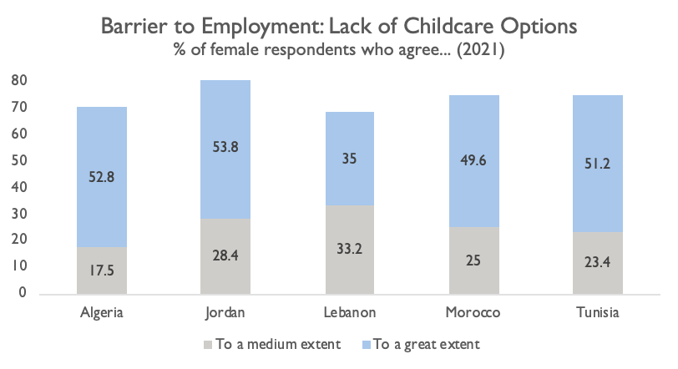
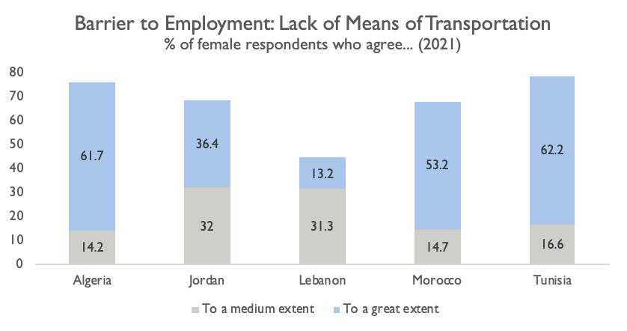
SOCIAL FACTORS NORMS AND BELIEFS
Jordan has the highest percentage of women (82.2%) who identify lack of childcare options as a barrier to employment to a great or medium extent.
68.4% of women in Jordan also identify lack of means of transportation as a barrier to employment to a great or medium extent.
Notes:
When asked in 2021 about barriers to economic participation, Jordan had the highest percentage of women who identify lack of childcare options among the assessed countries.
Source: Arab Barometer Wave VI-2021. https://www.arabbarometer.org/

Slide 57
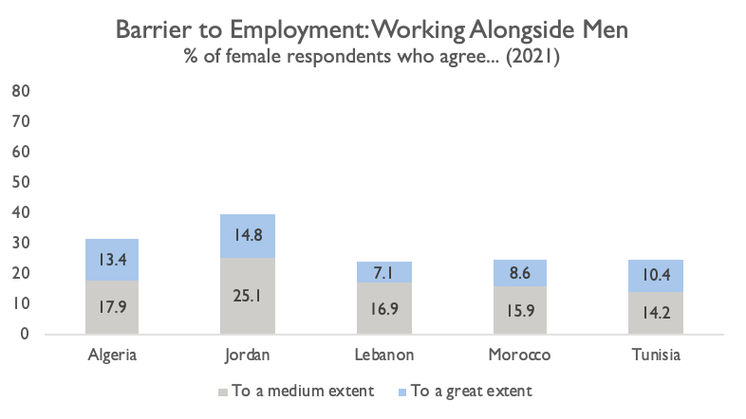
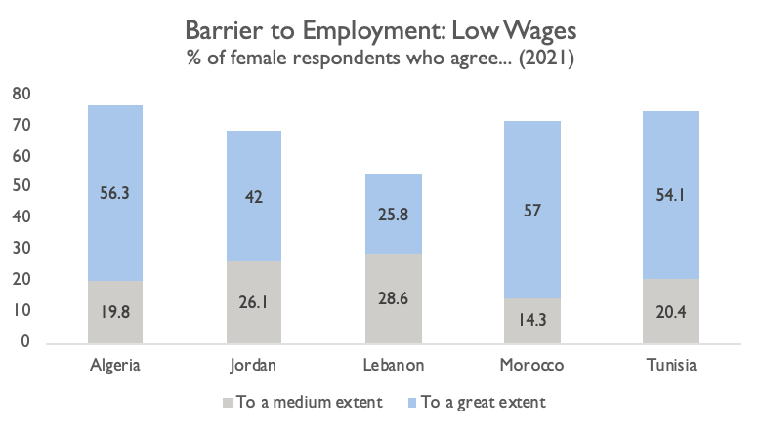
SOCIAL FACTORS NORMS AND BELIEFS
Jordan also has the highest percentage of women (39.9%) who identify working alongside men as a barrier to employment to a great or medium extent.
68.1% of women in Jordan identify low wages as a barrier to employment to a great or medium extent.
Notes:
Jordan had the highest percentage of women (39.9%) who identify working alongside men as a barrier to employment to a great or medium extent among the assessed countries. In Saudi Arabia, where similar cultural norms regarding gender-segregated workspaces, companies were required to invest in upfront costs like gendered facilities to meet their recruitment quotas for women (Alfarran, Pyke, and Stanton 2018).
Sources:
Arab Barometer Wave VI-2021. https://www.arabbarometer.org/
Alfarran, A., Pyke, J., & Stanton, P. (2018). Institutional barriers to women’s employment in Saudi Arabia. Equality, Diversity and Inclusion: An International Journal.

Slide 58
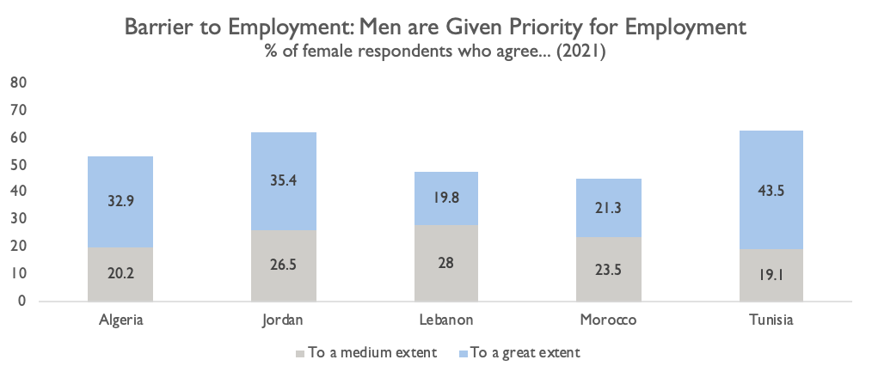
SOCIAL FACTORS NORMS AND BELIEFS
The percentage of women in Jordan who identify men being given priority for employment as a barrier to their employment to a medium or great extent is high at 61.9%
Notes:
Nearly two-thirds of the Jordanian women surveyed in the Arab Barometer reported men being given priority for employment as a barrier for their own employment.
Source: Arab Barometer Wave VI-2021. https://www.arabbarometer.org/

Slide 59
Interventions
Notes:
Saudi Arabia and Turkey, two of the countries with the highest increase in FLFP, implemented nationwide strategies and programs implemented to deliberately increase FLFP. In the case of Saudi Arabia, increasing women’s participation was a stated and deliberate goal of their Saudi Arabia Vision 2030 Strategy (WTO, 2021). They had also set a goal to create one million additional jobs specifically for women (Ibid). Turkey also set up programs which ensured that female employment is expanded within their national economic strategies. Programs paying wages and social security premiums were introduced. In July 2008, the country implemented a scheme by which employers of newly hired women were exempted from paying their social security contributions in a way that would be phased over five years (Dildar, 2020).
Other countries that exhibited smaller increases in FLFP also implemented strategies albeit smaller in scale. An example of this is Algeria’s ANGEM which oversaw the offering of microcredit loans to youth and benefited women to a much larger degree than men. Offering loans to finance at-home activities, purchase of raw materials, or small business-starting material proved to be highly effective in resolving Algeria’s problem with unemployment of young women as a specific category. Women entrepreneurship, in the case of Algeria, proved to be an important alternative for employment in other facets of the economy (Benzidane and Boudraf, 2020). West Bank and Gaza and Tunisia also exhibited improvements in the way they incorporated women-specific objectives in their overall economic strategies, this was done by improving legislation surrounding women’s employment environments, as well as promoting entrepreneurship and small-business ownership amongst youth and women.
Sources:
World Trade Organization. (2021). Vision 2030, an economic diversification strategy and women’s economic empowerment, available at https://www.wto.org/english/tratop_e/womenandtrade_e/230621_saudi_arabia.pdf
Dildar, Y. (2020). Targeting women’s employment: Do employment subsidies work? Evidence from Turkey. Review of Radical Political Economics, 52(1), 5-25.
Benzidane, Y. and Boudraf, D. (2020). Woman Entrepreneurship, Economic Perspectives and Challenges. Case of Angem of Mostagnem- Algeria. Algerian Scientific Journal Platform, 11 (1), 607-628. Available from https://www.asjp.cerist.dz/en/article/141835

Slide 60
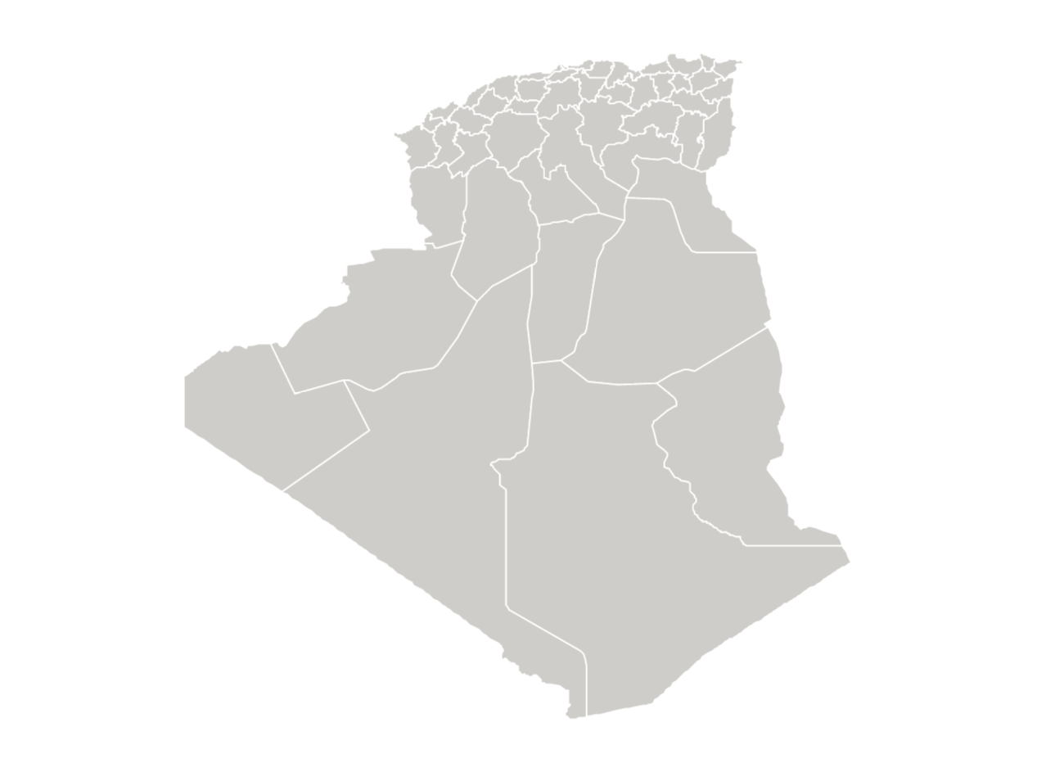
INTERVENTIONS
ALGERIA
Government provided interest-free financing to entrepreneurs, with a focus on women including:
At-home activities
Purchase of raw materials
Small business-starting material
State-funded social security contributions reduced and/or exempted employer costs for new hires.
Action Plan reduced corporate income taxes for job creators.
Notes:
Algeria witnessed a steady, but modest increase in FLFP over the last decade, increasing from 3.1% in 2010 to 17.01% in 2019. This was in part due to the government’s efforts to diversify the economy away from the petroleum industry, which opened opportunities for women. Since women are disproportionately employed in the services sector (72.5% percent of employed women in this sector in the past ten years), growth of the services sector played an important factor in increasing FLFP rates.
The Algerian government has funded various programs to support entrepreneurship through tax exemptions, hiring subsidies, government-backed credit guarantees to start-ups, and microcredit for poor households. One of the most successful has been the National Agency for Management of Microcredit (ANGEM), which was established in 2003. It offers microcredit and interest-free loans to finance entrepreneurship, with a focus on women including at-home activities, purchase of raw materials, or small business-starting material. ANGEM has granted 51,237 loans to women compared to 28,294 for men in the past 3 years and consequently, women’s entrepreneurship has become a new pillar of the economy (Benzidane and Boudraf, 2020).
Another notable government effort was the Action Plan for Promoting Employment and Combating Unemployment launched in 2008. The Action Plan reduced or exempted social security contributions for employers and the state funded the differential contribution. It also reduced income tax and taxes on corporate profits for 4 years and extended exemptions on corporate profit taxes to 5 years for companies creating 50 to 100 jobs and up to 7 years for those creating more than 100 jobs. Souag and Assaad (2017) found the plan to be successful in reducing the probability that workers are employed informally.
Sources:
Benzidane, Y. and Boudraf, D. (2020). Woman Entrepreneurship, Economic Perspectives and Challenges. Case of Angem of Mostagnem- Algeria. Algerian Scientific Journal Platform, 11 (1), 607-628. Available from https://www.asjp.cerist.dz/en/article/141835
Souag, A. and Assaad, R. (2017). The Impact of the Action Plan for Promoting Employment and Combating Unemployment on Employment Informality In Algeria. IZA DP No. 10966, IZA Institute of Labor Economics. Available from https://ftp.iza.org/dp10966.pdf

Slide 61
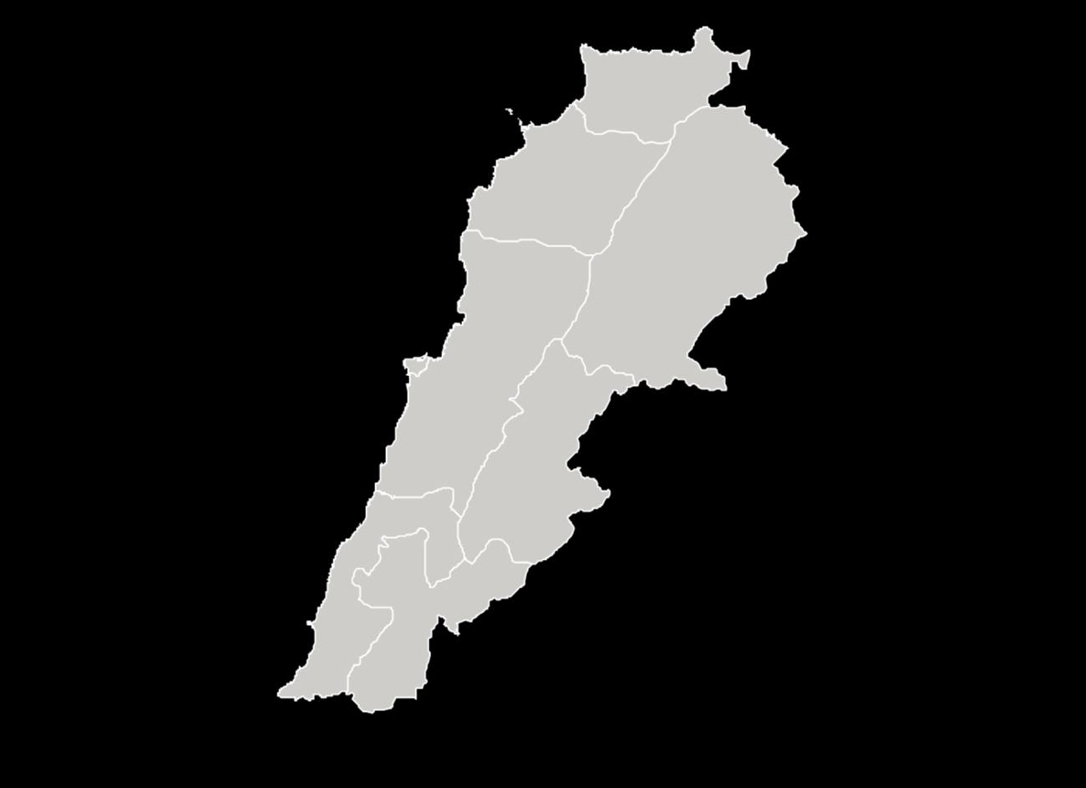
INTERVENTIONS
LEBANON
The Government of Lebanon set a target of a 5% increase in FLFP by 2025 and adopted the Women’s Economic Empowerment Action Plan as a roadmap to achieve this goal.
No major interventions beyond the amendments of legislation and development of the strategy.
Notes:
Lebanon witnessed the lowest increase of FLFP among the selected countries, at less than 1%. This low rate of FLFP rate growth is owed in part to the prolonged period of economic contraction and insufficient job creation it experienced over the course of the past decade.
Similar to other studied countries, women in Lebanon are primarily concentrated in the services sector and the public sector. Entrepreneurship rates for women remain low compared to men with only 17% of women being self-employed in contrast to 43% of men.
Lebanon prioritizes gender equality as a development goal. In the last 20 years, it has adopted laws, national strategies, and action plans which contribute to eliminating gender inequalities and advancing women’s rights and women’s empowerment. The Government of Lebanon set a target of a 5% increase in FLFP by 2025. The World Bank-IFC initiative, the Mashreq Gender Facility (MGF) (World Bank, 2020), is supporting these efforts by supporting action plan development and sharing research and public dialogue across Jordan, Lebanon, and Iraq. The country also developed the National Strategy for Women (2011 – 2021) and the National Strategy for Gender Equality (2017 – 2030).
Source: World Bank Group. (2020). Women’s Economic Participation in Iraq, Jordan, and Lebanon. https://openknowledge.worldbank.org/handle/10986/34535

Slide 62
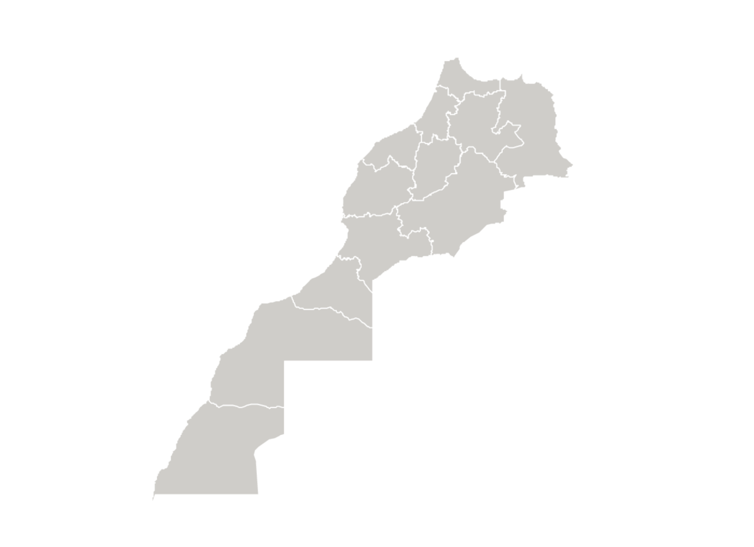
INTERVENTIONS
MOROCCO
Programs to encourage banks to provide loans to female entrepreneurs.
Allocation of funds to technical and vocational education and training to prepare young Moroccans to meet the demands of the labor market, including construction of 12 vocational training centers across country to prepare for work in industry, management, tourism and hospitality, agriculture, fisheries, agro-industry, and handcrafts
In 2015, the National Agency for the Promotion of Employment and Skills (ANAPEC) launched its Vision 2020 in order to extend its scope of action to job seekers without qualifications.
Three active programs in place: Idmaj (wage subsidies for unemployed graduates); Te'chil (formation of the young); and Moukawalati (promoting entrepreneurship through training and financial assistance).
Notes:
Morocco experienced a drop-in FLFP in the past decade, from 32% in 2006 to 23.4% in 2019. The key group that explains low FLFP in Morocco is married educated women in urban areas. This group is not likely to participate mainly because of marriage and because they have an education level matching sectors that are not growing. Morocco noted a significant drop in the share of the public sector in the labor market that has not been offset with an adequate number of new jobs created in alternative sectors that women would normally work in.
It appears that Moroccan women may solely be entering the job market out of necessity. Economic growth has not been labor-intensive, has generated few jobs, and has not been in female-friendly sectors, resulting in weak demand for women, especially urban educated women with secondary education. When men and women compete for scarce jobs, men may have priority access because of employers’ and households’ preference.
Although education levels have been improving, one-third of the population still suffers from illiteracy. The apparent lack of employability for those with postsecondary and tertiary education also raises concerns about the quality of education as this skills mismatch decreases returns from investment in education.
The Ministry of Labor and Professional Integration has launched two versions of the program, “Min Ajliki” (2013 and 2017-2021) to encourage banks to provide loans to female entrepreneurs. From 2013 to 2015, the Fund provided loans totaling 81.5 million Dirham to 236 enterprises and created employment for 762 people. The Government has also recently allocated US$378 million towards technical and vocational education and training to prepare young Moroccans to meet the demands of the labor market. In 2020, Morocco announced the Cities of Trades and Skills initiative, which entails the construction of 12 vocational training centers across various regions and to offer multi-sectoral vocational training to 34,000 participants in industry, management, tourism and hospitality, agriculture, fisheries, agro-industry, and handcrafts. These are all part and parcel of broader strategies to improve the economy and stimulate employment; the main three are: youth integration, to improve training and integrate young people into the labor market through internships or skills matching; strengthening employment and productivity; and promotion of micro-enterprises, through funding.
Sources:
Bargain, O., & Lo Bue, M. C. (2021). The economic gains of closing the employment gender gap: Evidence from Morocco (No. 2021/79). WIDER Working Paper.
Lopez-Acevedo, G., Devoto, F., Morales, M., & Roche Rodriguez, J. (2021). Trends and determinants of female labor force participation in Morocco: An initial exploratory analysis
UN Women. National review of the implementation of the Beijing Declaration and Platform for Action, after 25 years – Kingdom of Morocco. https://www.unwomen.org/sites/default/files/Headquarters/Attachments/Sections/CSW/64/National-reviews/Morocco_en.pdf

Slide 63
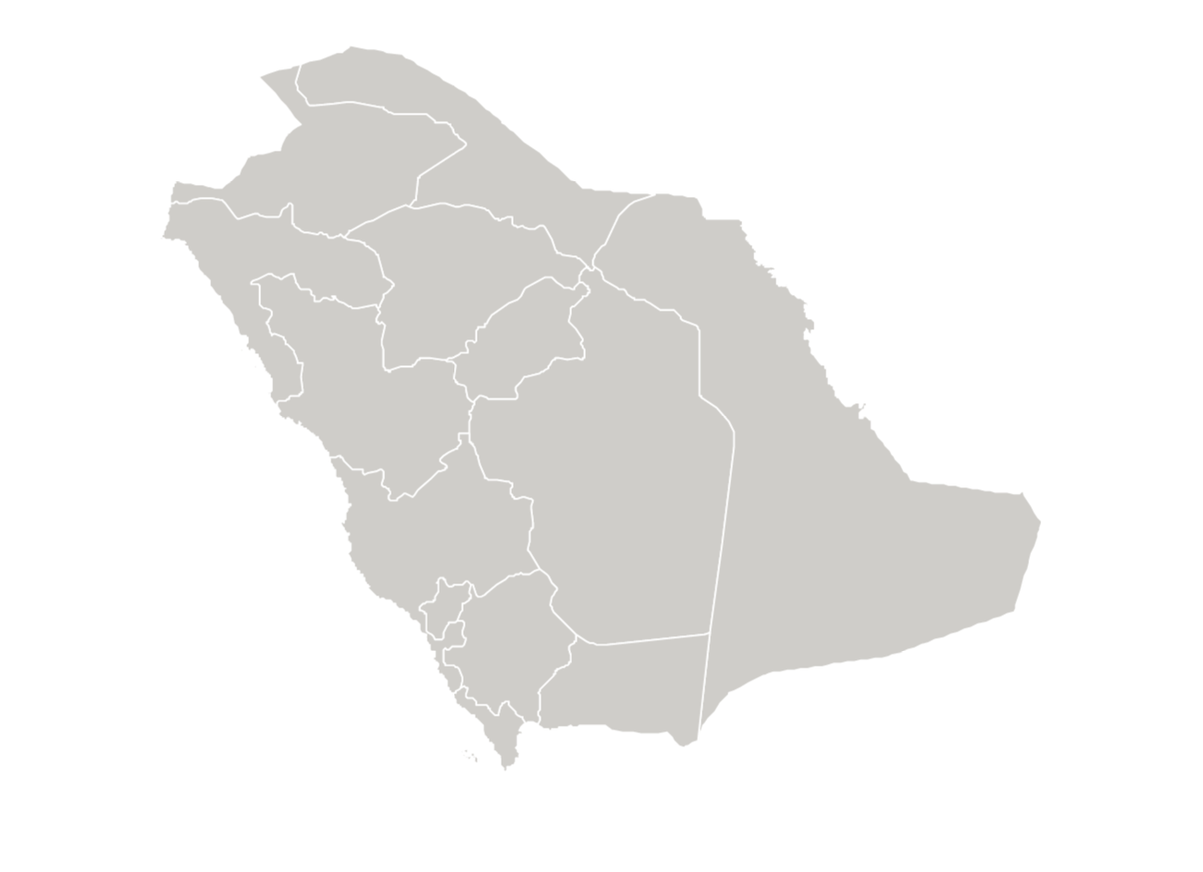
INTERVENTIONS
SAUDI ARABIA
In 2011, launched the Nitaqat market program, which included quotas that guaranteed the inclusion of women across different sectors; provided incentives for compliance and penalties for non-compliance.
In 2016, Saudi Vision was implemented to increase women’s labor force participation to 30% by 2030; increase employment in the private sector; and create 1 million additional jobs for women.
Legislative changes lowered barriers for women’s entry into the workforce.
In 2016 established the Small and Medium Enterprises General Authority to support self-employment, entrepreneurship, and innovation.
Government launched the “Qurrah” online portal to connect families to childcare centers, with subsidies.
“Wusool” program covers 80% of transportation cost between work and home.
“Riyada” initiative focused on entrepreneurship and incubating small and emerging projects.
Notes:
Saudi Arabia had one of the greatest increases in FLFP over the decade, from 19.20% in 2010 to 23.31% in 2019 (using modeled ILO estimates for ages 15-64). The 2020 FLFP (using modeled ILO estimates for ages 15+) was 32% but KSA government-reported statistics show even higher rates of 2020 FLFP (33.2%).
Such drastic increase could be primarily attributed to large-scale government initiatives that aimed to expand the private sector’s share of the economy, diversify its economy away from a petroleum-based one, expand the participation of Saudi nationals in the labor market, and make deliberate efforts to increase women’s participation in the economy. One such effort is the Nitaqat labor market program, which was launched in 2011 and introduced quotas that guaranteed the inclusion of women across different sectors of the labor market. It included both incentives for compliances and penalties for non-compliance. The program includes incentives aimed at increasing the rate in which private companies hired local female employees, such as counting the hiring of 2 Saudi women as equivalent to the hiring of 1 Saudi man, and requires employers to invest in upfront costs like gendered facilities to meet their quotas. This quota policy nearly tripled the female share of Saudis working in the private sector from 10% to 27% between 2011 and 2015.
The Saudi Vision 2030 was launched in 2016 with the goals of increasing women’s labor force participation to 30% by 2030, to increase employment in the private sector, and to create 1 million additional jobs for women. Other legislative changes that have been introduced in order to reach this FLFP goal include eliminating the need for a male guardian to obtain a job, lifting the ban on female driving, criminalizing sexual harassment in public and private sector employment, mandating care and childcare facilities to companies above a certain size, and prohibiting employers from firing women during pregnancy or while on maternity leave. All of these legislative changes have lowered barriers for women’s entry into the workforce.
Furthermore, the Small and Medium Enterprises General Authority was established in 2016 to support self-employment, entrepreneurship, and innovation. Other initiatives supported by the Saudi government include the “Qurrah” online portal to connect families to childcare centers with subsidies and the “Wusool” program, which covers 80% of transportation cost between work and home for women in the private sector.
Sources:
GSTAT. 2022. https://www.stats.gov.sa/en
Miller, C., Peck, J., & Seflek, M. (2020). Missing women, integration costs, and big push policies in the Saudi labor market. American Economic Journal: Applied Economics.
Saudi Vision 2030. https://www.vision2030.gov.sa/
Williams, S., Qiu, W., Al-awwad, Z., & Alfayez, A. (2019). Commuting for women in Saudi Arabia: Metro to driving-Options to support women employment. Journal of Transport Geography, 77, 126-138.

Slide 64
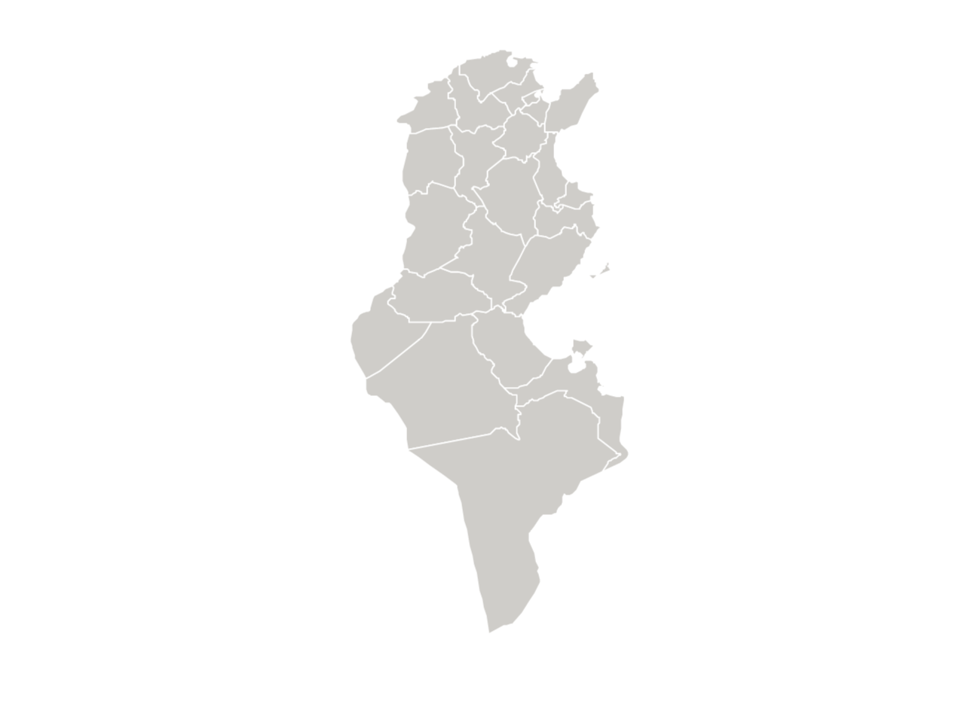
INTERVENTIONS
TUNISIA
Following the 2011 revolution, new legislation and programs were introduced to stimulate employment.
A public sector employment scheme offered jobs to people above the age of 35. It contributed to minor improvement of female unemployment, but also contributed to a bloated public sector.
Government provided vocational training programs to young job seekers matching their skills to labor market needs and encouraged private companies to recruit first-time job seekers by contributing to their salary.
Government and UN-funded training programs targeted women’s entrepreneurship.
Notes:
Tunisia observed a modest increase in FLFP of 1.17% in the last decade. Following the 2011 revolution, new legislation and programs were introduced to stimulate employment. One employment scheme offered jobs in the public sector to people above the age of 35, and while this contributed to minor improvement of female unemployment, it also contributed to a bloated public sector. This dependence on the state as the primary destination for employment is problematic in the way it discourages entrepreneurship and distorts the demand for education toward skills that are best suited for success in the public sector, which in turn worsens the skills mismatch faced by the private sector.
Other programs like the Employability Improvement Cheque and the Employment Support Cheque offered vocational training to young job seekers matching their needs with those relating to labor market needs, as well as encouraging private companies to recruit first-time job seekers by contributing to their salaries. Moreover, the Ministry of Women, Family, and Children (MFFE) and UN Women have organized training programs on women’s entrepreneurship as part of the National Plan for Female Entrepreneurship.
Source: Bass, H. H., Kappel, R., & Wohlmuth, K. (2016). Starting Points for a National Employment Strategy for Tunisia.

Slide 65
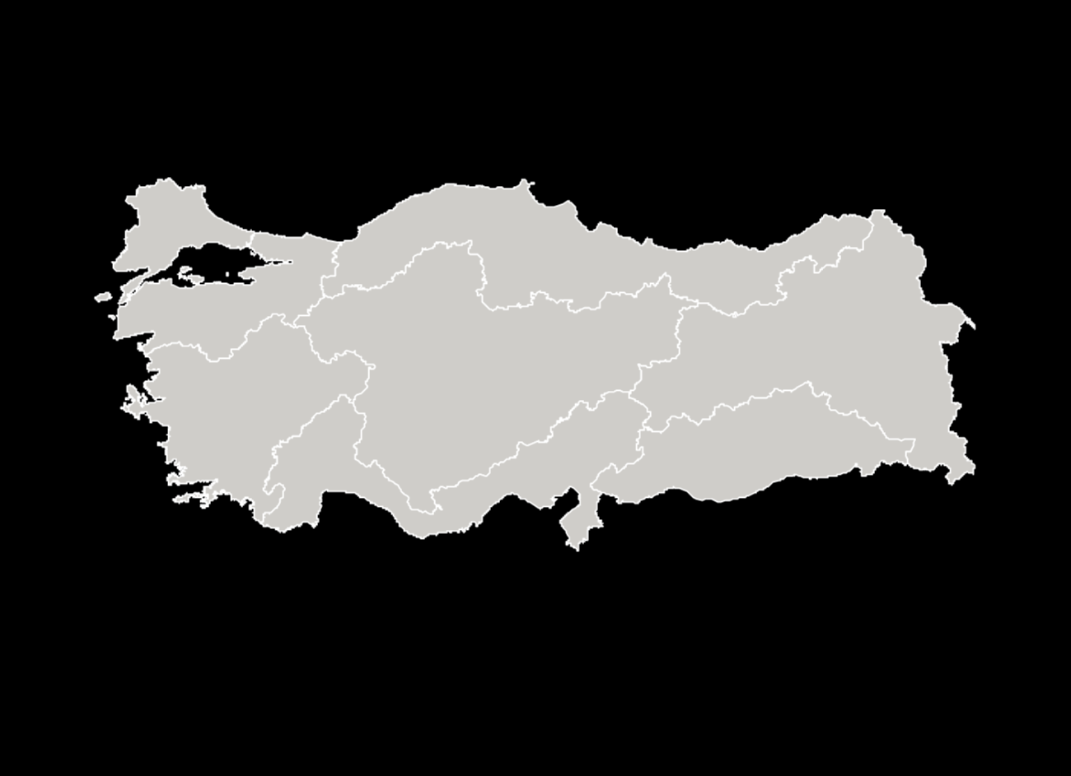
INTERVENTIONS
TURKEY
In 2008, passed a targeted subsidy scheme that included exemptions for employers to pay social security contributions for hired women (above the age of 18) and young men (18-29 years old).
In 2016, passed progressive maternity leave policy with salary partially paid by employers and partially paid for by unemployment fund.
A Ministry of Family, Labour, and Social Services program paid grandmothers for watching grandchildren, giving mothers the opportunity to work.
The Turkish Employment Agency provides childcare support for women who attend vocational training workshops and on-the-job training through active labor force programs.
Focused on flexible work to encourage women’s participation in the labor market, especially among mothers.
Notes:
Turkey experienced the largest increase in FLFP over the decade among our selected countries. FLFP in Turkey was 38.54% in 2019, which was an 8.95 percentage point increase from its rate of 29.59% in 2010. This increase took place after a long period of decreasing FLFP that coincided with a sectoral shift away from agriculture, where many women were employed as ”contributing” family workers. It is important to note that in Turkish statistics, unpaid family workers are counted as employed (Tansel 2017).
The increase in women’s employment largely took place through the expansion of the service sector. The percentage of women working in the service sector rose from 50.0% in 2014 to 60.4% in 2020.
Notable social changes that took place were an increased focus placed on women’s education and increased public acceptance of new family dynamics that have space for two breadwinners in the family. According to Toksöz (2012), the government’s employment strategy for women in Turkey relies on increasing their participation without neglecting their care responsibilities at home and therefore, flexible forms of employment are promoted for women. An example of this was the 9th Development Plan for 2007 to 2013, which underlined that flexible work should be popularized to encourage women’s participation in the labor market.
Law No. 5763, passed in 2008, created a targeted subsidy scheme that included exemptions for employers to pay social security contributions for hired women (above the age of 18) and young men (18-29 years old). The exemption would be phased out and gradually decreased over the course of five years. Studies found that these subsidies increased the employment probability of women (Dildar 2020).
Sources:
Tansel, A. (2001). Economic development and female labor force participation in Turkey: time-series evidence and cross-province estimates. ERF.
Dildar, Y. (2020). Targeting women’s employment: Do employment subsidies work? Evidence from Turkey. Review of Radical Political Economics, 52(1), 5-25.
Toksöz , G. (2012). The State of Female Labor in the Impasse of Neoliberal Market and Patriarchal Family and Society. Gender and Society in Turkey: The Impact of Neo-liberal Policies, Political Islam and EU Accession, London/New York: IB Tairus.

Slide 66
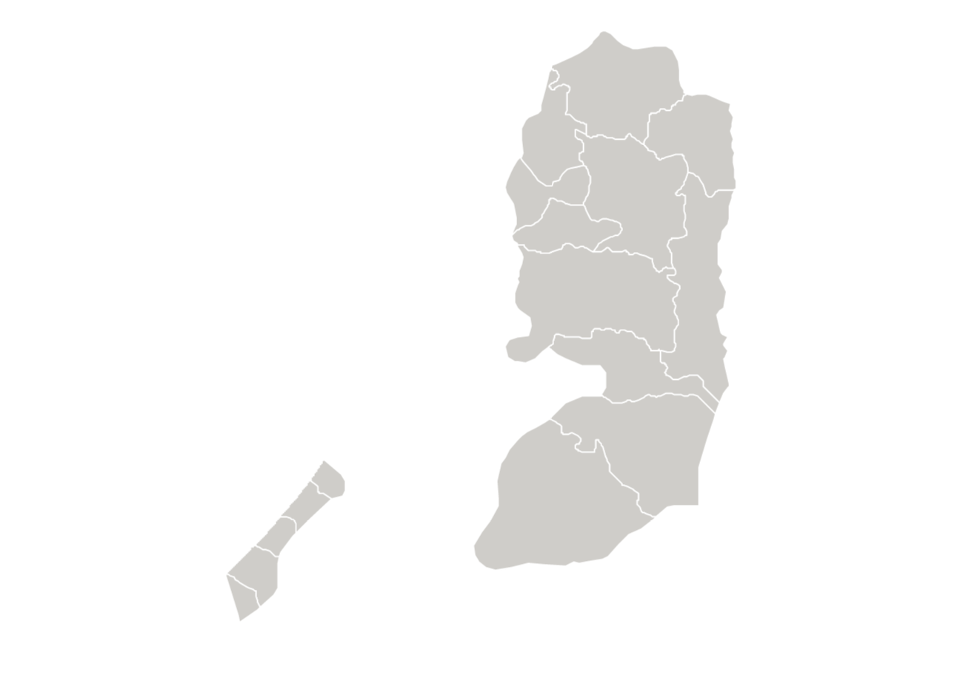
INTERVENTIONS
WEST BANK AND GAZA
Government provides vocational guidance and employment counseling, guidance on self-employment and small enterprise creation, job search, and work permits for working in the 1948 territory.
Public-private support to implement active labor market policies such as business start-up loans, business incubation and acceleration.
Private sector employment incentives like wage subsidies to employers.
Strategic Plan for Combating Violence against Women (VAW) 2011 - 2019
Notes:
A variety of programs have been introduced to stimulate the economy in the West Bank and Gaza including: the Labour Sector Strategy of 2020-2022, National Employment Strategy of 2021-2025, National Strategy for Entrepreneurship and Empowerment Sector of 2020-2022, and the second Palestinian Decent Work Programme 2018-2022. The Ministry of Labour (MoL) provides employment services through its employment offices (16 in the West Bank and 5 in Gaza). Eight of the West Bank offices offer vocational guidance and employment counseling, guidance on self-employment and small enterprise creation, job search, and work permits for working in the 1948 territory.
The Palestinian Fund for Employment and Social Protection (PFESP) is a semi-independent, autonomous body that implements active labor market policies such as business start-up loans, business incubation and acceleration, and private sector employment incentives like wage subsidies to employers.
The National Strategic Plan for Combating Violence against Women was prepared by the Ministry of Women’s Affairs (MoWA) in cooperation with UN WOMEN (United Nations Development Fund for Women - UNIFEM). This Plan responds to the United Nation’s (UN) third Millennium Development Goal (MDG), which calls for gender equality and women’s empowerment in the occupied Palestinian territory. The VAW National Strategy is considered one of the MDG program's outcomes and calls for ending gender-based violence through intervention at three levels: prevention, protection and law enforcement.
Sources:
ETF. (2021). PALESTINE* EDUCATION, TRAINING AND EMPLOYMENT DEVELOPMENTS 2021. European Training Foundation. Available from https://www.etf.europa.eu/sites/default/files/document/CFI_Palestine_2021.pdf
Hodali, A. (2018). Palestinian Women Empowerment in Rural Areas: 35 years of achievements in collaboration with PARC and rural women. Agricultural Development Association – PARC Palestinian American Research Centre. Available fro, https://www.ciheam.org/uploads/attachments/918/WL40_2Palestinian_women.pdf
International Labour Organisation (ILO). (2020). The situation of workers of the occupied Arab territories Report of the Director-General, Appendix 2020. International Labour Office, Geneva. Available from http://search.ilo.org/wcmsp5/groups/public/---ed_norm/---relconf/documents/meetingdocument/wcms_745966.pdf

Slide 67
Key Findings & Lessons Learned

Slide 68
KEY FINDINGS FEMALE LABOR FORCE PARTICIPATION
The most significant increases in FLFP over the decade (2010 - 2019) were: Turkey (8.98%), West Bank and Gaza (4.78%), and Saudi Arabia (4.11%) (current: 12.9%); with the West Bank and Gaza starting from a very low rate.
West Bank and Gaza’s FLFP rate masks the reality of skyrocketing female unemployment (~40%).
The only country in the assessment to have a decrease in FLFP rate in the past decade was Morocco (-3.97%), in addition to Jordan (-.67).
Female labor force participation in Jordan has been persistently low.

Slide 69
KEY FINDINGS ECONOMY AND ECONOMIC FACTORS
The countries exhibiting the most FLFP improvement were also the countries with the highest GDP/capita (Saudi Arabia and Turkey).
Diversification in sectors and setting explicit objectives to include women in new sectors were factors that helped increase FLFP (Saudi Arabia and Turkey).
In several countries, women’s employment increased through the expansion of the service sector (West Bank and Gaza, Algeria, Turkey).
Countries with increases in FLFP has female tertiary enrollment over 50% (Turkey, Saudi, West Bank and Gaza, Algeria), though the mismatch between education and labor market demand was among the barriers to increase FLFP.
The high concentration of women in the public sector and their preference toward it was among the factors limiting FLPF.
Notes:
The countries exhibiting the most FLFP improvement were also the countries with the highest GDP/capita. Saudi Arabia and Turkey’s large economy played a major role, in part at least, in their ability to expand women’s participation in the labor force. They were able to provide financial stimuli and incentives to increase women’s employment.
Diversification in sectors and setting explicit objectives to include women in new sectors were factors that helped increase FLFP. Saudi Arabia has been making strides to wean themselves off their dependence on oil revenues, while Turkey started placing more emphasis on the services sector instead of the agriculture and industry sectors.
Several countries were unable to coordinate between the available supply of educated and skilled labor force within the country with labor market demand. This resulted in the phenomenon of a high representation of highly educated women who remain unemployed or discouraged from participating in the economy altogether.
The public sector became a primary destination for women employment across the MENA region due to its regulation, the protections it offers (compared to private and informal employment), and the relative stability. However, as countries have started to diversify their sources of revenue and shifted significant portions of their economic sectors to the private sectors, alternative suitable employment opportunities have not presented themselves in an adequate amount to offset this shift.

Slide 70
KEY FINDINGS LEGAL, REGULATORY, AND POLICY FRAMEWORKS
Saudi Arabia and Jordan saw significant improvements on the Women, Business, and Law index. Should Jordan uphold the implementation of these new policies and legislations, it stands to reason the country’s FLFP will increase in the next decade.
Legislative changes challenged cultural norms though social and cultural norms remain a barrier.
Changing laws does not always equate to enforcement (Jordan).
Notes:
In Saudi Arabia, legislative changes challenged cultural norms though social and cultural norms remain a barrier.
In Turkey, specific laws were introduced that aim to improve women’s employment by exempting employers from paying the social security contributions for newly hired women for the first year, this was found to increase women’s formal employment. Women above the age of 30 experienced a marked boost in their employment probability due to social security subsidies.
In Algeria, amendments to the Algerian Penal Code were made in 2015 which established penalties for those convicted of gender-based-violence, whether it is physical, verbal, or psychological in nature and whether it happens in private or in public. Since 2016, a new article of the constitution extended gender equality into business matters. Article 36 of the constitution states that ‘The State shall work towards promoting equity in terms of opportunities between men and women in the job market. The State shall encourage the promotion of women to positions of responsibility in public institutions and administrations, as well as in the enterprises.’ These measures were followed by increased female labor force participation.

Slide 71
KEY FINDINGS SOCIAL FACTORS
Social norms restrict women to the domestic sphere and impact women’s choices in the labor market across all of the assessment countries.
Women vastly prefer the public sector due to wages and benefits (West Bank and Gaza, Jordan, Algeria, Lebanon, KSA).
There is an employment bias against women and marriage due to employers perceiving women as less productive after marriage and less favorable due to maternity benefits and daycare responsibilities for employing women, and thus employers prefer to employ men (Turkey, Morocco, Jordan).
High educational attainment did not necessarily result in increased employment.
The most successful countries were able to integrate countermeasures into their national policies to ensure incentive is provided to shift women’s roles into new domains.
Notes:
There is still emphasis placed on women’s roles as caregivers rather than potential participants in the economy and providers for the household. There is a prevalent trend in which men’s employment is considered as prioritized over that of women’s and such opinions are shared by both men and women.
Often considered as needing more protection, rather than ensuring protection measures are in place to offer safe standards of work environments, women are rather relegated to occupations and professions that are deemed safer and more “feminized. In some countries, there are laws in place that prohibit women from working at night or in certain conditions
Although women’s educational attainment has steadily increased over the past decade, many countries couldn’t create enough skilled jobs to absorb them into relevant professions that met the countries’ labor needs. In some cases, women’s education is still viewed widely as a way to improve a women’s perceived value for marriage. It does seem, however, that new generations are exhibiting a more progressive shift in opinions regarding the role of women in the home and the labor market.

Slide 72
KEY FINDINGS INTERVENTIONS
National strategies aimed at increasing job creation in general and FLFP and significantly changing laws to support women in the workforce are beneficial (KSA, Turkey, Algeria, Lebanon, West Bank & Gaza)
Other countries that exhibited smaller increases in FLFP also implemented strategies, albeit smaller in scale (Algeria, Tunisia, West Bank & Gaza).
Notes:
In Saudi Arabia, which is characterized by having rigid social norms, and in Turkey, where such norms are more prevalent among rural communities, large scale government initiatives and legal reforms played a role in improving FLFP. It is notable that such government initiatives did not only come in the shape of strategies, rather included mandated quotas, incentives for compliance and penalties for non-compliance to ensure increasing FLFP. Tunisia and Morocco on the other hand, which have relatively high WBL index scores compared to Jordan, Lebanon and the West Bank and Gaza for example – reflecting a level of equality in legislation – government initiatives were not strong enough to increase FLFP.
Saudi Arabia Vision 2030 Strategy had set a goal to increase FLFP to 30% and create 1 million additional jobs specifically for women. Turkey implemented a scheme in 2008 by which employers of newly hired women were exempted from paying their social security contributions in a way that would be phased over five years
Algeria’s ANGEM oversaw the offering of microcredit loans to youth and benefited women to a much larger degree than men. Offering loans to finance at-home activities, purchase of raw materials, or small business-starting material proved to be highly effective in resolving Algeria’s problem with unemployment of young women as a specific category and made women’s entrepreneurship a new pillar of the economy (Benzidane and Boudraf 2020).
Dismissal of pregnant workers is not prohibited in Algeria, Tunisia, and the West Bank and Gaza.
Sources: Benzidane, Y. and Boudraf, D. (2020). Woman Entrepreneurship, Economic Perspectives and Challenges. Case of Angem of Mostagnem- Algeria. Algerian Scientific Journal Platform, 11 (1), 607-628. Available from https://www.asjp.cerist.dz/en/article/141835

Slide 73
Barriers to FLFP in Jordan
Notes:
Jordan presents a somewhat perplexing case when it comes to the rates of FLFP over the past decade. Though Jordan exhibited certain signs of improvement with regards to its overall economic conditions including GDP increase, a decrease in fertility rate, and relatively high levels of educational enrolment and attainment for women (as women make up 53% of university graduates), it still has one of the lowest FLFP rates in MENA and is considered the country with the third lowest FLFP rate in the world.
A defining characteristic of Jordan over the past decade is its rapid and high rate of population growth attributed to previously high fertility rates, migrant labor, and the hosting of a high number of refugees eligible to work. Though the labor market is growing, it is still unable to supply the adequate number of jobs required on an annual basis. In 2018, the Jordanian economy generated around 50,000 new jobs annually, during a time when around 200,000 new jobs were needed in order to absorb new entrants into the labor market each year (JNCW, 2019).
Another factor that affects the country’s low economic growth is the large and growing public debt resulting from low-income tax collection and increased public spending. Increased public spending is largely due to increased demand for social welfare pertaining to high population growth and unemployment rates (JNCW, 2019).
Source: Jordanian National Commission for Women. (2019). Fiscal Policy, Taxation and Gender Equality in Jordan. Policy Paper, Jordan. https://www.women.jo/~women/en/node/7907.

Slide 74
BARRIERS TO FLFP IN JORDAN ECONOMY AND ECONOMIC FACTORS
Economic growth has not translated into increased employment for women despite studies that link economic development to female labor force participation rates, suggesting economic growth in Jordan by itself is not sufficient to enhance female labor force participation.
Insufficient growth in female-friendly sectors and public sector preference is a barrier to women entering the labor market as the sector’s ability to absorb female employment is shrinking.
Disconnect between the skills females acquire and those demanded by employers.
Notes:
Economic growth has not translated into increased employment for women despite studies that link economic development to female labor force participation rates, suggesting economic growth in Jordan by itself is not sufficient to enhance female labor force participation.
There is insufficient growth in female-friendly sectors and public sector preference is a barrier to women entering the labor market as the sector’s ability to absorb female employment is shrinking. In addition, there is a disconnect between the skills females acquire and those demanded by employers.

Slide 75
BARRIERS TO FLFP IN JORDAN LEGAL, REGULATORY, AND POLICY FRAMEWORKS
Despite legal reform efforts, there are still discriminatory laws and regulations in place that deter women from entering and/or remaining in the workforce.
There are no applicable provisions against non-discrimination in employment based on gender.
There is no legislation on a safe and appropriate work environment including preventing sexual harassment in the workplace
Notes:
Despite legal reform efforts, there are still discriminatory laws and regulations in place that deter women from entering and/or remaining in the workforce. It is also important to note that while legislation undergoes reform, the actual implementation of policy and regulations and their enforcement remains a pressing concern and priority for women to access their rights.
For example, Article 61 of the Personal Status Law states that a woman requires the permission of her husband to work outside the marital home. If she does so without his consent, she loses her right to financial maintenance. There are no applicable provisions against non-discrimination in employment based on sex. There is no legislation on a safe and appropriate work environment, including preventing sexual harassment in the workplace and no criminal penalties or civil remedies for sexual harassment in employment. And Article 69 of the Labor Law imposes legal restrictions on women’s employment in occupations considered hazardous, or occupations that pose health risks, such as mining, shipping and docking work, exposure to lead, etc.
Sources:
Better Work. (2018). Jordan – Gender Strategy 2019-2022. ILO: Geneva. Available from https://betterwork.org/wp-content/uploads/2020/01/Jordan-Gender-Strategy.pdf
United Nations. (2020). Meta-Analysis on Women’s Participation in the Labour Force in Jordan. United Nations: Amman. Available from https://jordan.unwomen.org/en/digital-library/publications/2020/meta-analysis-on-womens-participation-in-the-labour-force-in-jordan
WANA Institute. (2014). The Status of Legal Empowerment in Jordan. WANA Institute: Amman. Available from http://wanainstitute.org/sites/default/files/publications/StatusOfLegalEmpowermentInJordan_WANA_2014.pdf
World Bank. (2018). Hashemite Kingdom of Jordan: Understanding How Gender Norms in MNA Impact Female Employment Outcomes. World Bank: Washington DC. Available from https://documents1.worldbank.org/curated/en/859411541448063088/pdf/ACS25170-PUBLIC-FULL-REPORT-Jordan-Social-Norms-June-1-2018-with-titlepg.pdf
World Bank. (2020). State of the Women in the Mashreq Flagship: Women’s economic participation in Iraq, Jordan and Lebanon. World Bank. Available from https://www.worldbank.org/en/country/lebanon/publication/state-of-the-mashreq-women
World Bank. (2020). Women, Business and The Law 2020. World Bank: Washington DC. Available from https://openknowledge.worldbank.org/bitstream/handle/10986/32639/9781464815324.pdf

Slide 76
BARRIERS TO FLFP IN JORDAN SOCIAL FACTORS
Jordan's social norms and beliefs remain critical to women’s participation in the labor market.
While over 60% of non-working women would like to work, both male and female respondents agreed that men are the ultimate decision-makers in the household – influencing whether women decide to accept a job or not.
Other binding constraints for women include availability and affordability of childcare, flexibility in work arrangements, hiring and wage discrimination, and lack of adequate transportation system.
Notes:
Jordan's social norms and beliefs remain critical to women’s participation in the labor market. The World Bank (2018) found while there was support for FLFP, this support came with important caveats. 96% of male and female respondents were in agreement with women working, but this figure slightly decreased if work is outside the home (80%) or if those working were married (72%). There was a further decrease if work was in a mixed-sex environment (38%) or if work required women to return home after 5 pm (26%). Given that many jobs – particularly in the private sector – involve a mixed-sex environment and working hours until 4 and 5 pm, these views could severely constrain the options women can realistically consider when looking for suitable work.
Norms and beliefs regarding women’s role in society also influence the willingness of employers to hire women. Research shows that some employers resist hiring women or paying them the same wages as men. Some women report that they are still asked about their marital status and plans to have children during job interviews.
While over 60% of non-working women would like to work, both male and female respondents agreed that men are the ultimate decision-makers in the household – influencing whether women decide to accept a job or not.
Other binding constraints for women include availability and affordability of childcare, flexibility in work arrangements, hiring and wage discrimination, transportation, and scarcity of attractive job opportunities.
Transportation: Research shows that lack of adequate, safe, and affordable transport presents a significant barrier to women’s participation in the labor market.
Childcare and unpaid work: Women’s responsibility for childcare and the inadequate infrastructure, legal and policy support available to them to help redistribute unpaid care work is considered one of the main barriers preventing women’s entry and retention in the workforce. The cost of paid childcare as substitutes to unpaid care work means women’s reservation wages are set higher relative to men, which contributes to their drastically lower participation rates. Though the Labor Law stipulates suitable childcare in the workplace under certain conditions, there is a lack of enforcement and non-compliance. In addition, 98% of businesses in Jordan are small-to-medium-sized companies. Two-thirds of them have fewer than 19 employees and are not bound by the law. The cost of setting up and running on-site childcare can also be cost-prohibitive for smaller companies.
Sources:
Better Work. (2018). Jordan – Gender Strategy 2019-2022. ILO: Geneva. Available from https://betterwork.org/wp-content/uploads/2020/01/Jordan-Gender-Strategy.pdf
United Nations. (2020). Meta-Analysis on Women’s Participation in the Labour Force in Jordan. United Nations: Amman. Available from https://jordan.unwomen.org/en/digital-library/publications/2020/meta-analysis-on-womens-participation-in-the-labour-force-in-jordan
WANA Institute. (2014). The Status of Legal Empowerment in Jordan. WANA Institute: Amman. Available from http://wanainstitute.org/sites/default/files/publications/StatusOfLegalEmpowermentInJordan_WANA_2014.pdf
World Bank. (2018). Hashemite Kingdom of Jordan: Understanding How Gender Norms in MNA Impact Female Employment Outcomes. World Bank: Washington DC. Available from https://documents1.worldbank.org/curated/en/859411541448063088/pdf/ACS25170-PUBLIC-FULL-REPORT-Jordan-Social-Norms-June-1-2018-with-titlepg.pdf
World Bank. (2020). State of the Women in the Mashreq Flagship: Women’s economic participation in Iraq, Jordan and Lebanon. World Bank. Available from https://www.worldbank.org/en/country/lebanon/publication/state-of-the-mashreq-women
World Bank. (2020). Women, Business and The Law 2020. World Bank: Washington DC. Available fromhttps://openknowledge.worldbank.org/bitstream/handle/10986/32639/9781464815324.pdf

Slide 77
Recommendations for Jordan

Slide 78
RECOMMENDATIONS ADAPTING FINDINGS TO JORDAN
Expanding into the service sector might prove to be beneficial for enhancing overall economic growth in Jordan and FLFP.
Women are disproportionately represented in the service sector.
Saudi Arabia and Lebanon’s service sectors grew by more than 10% over the decade.
Turkey and the West Bank and Gaza saw increases in women’s employment primarily in the service sector.
Jordan can leverage digital technologies to promote entrepreneurship and women’s employment in the information and communication technology (ICT) sector, especially location-independent and time-flexible services at a large scale. Examples include call centers, e-commerce, and other business services.
Notes:
Expanding into the services sector might prove to be beneficial to enhancing overall economic growth in Jordan. This proved to be useful in the case of countries like Turkey, Algeria, and Saudi Arabia. Worth noting, is the direct benefit from expanding the services sector would have on women specifically. As it currently encompasses 81% of all female employment in Jordan. Contrast to a number of the countries included in this study that can rely on a wealth of natural resources to supplement their national revenues (including Saudi Arabia and Algeria which can rely on revenue of petroleum-based exports), Jordan is a relatively natural resource-poor country.
Jordan has already been implementing structural changes that include a shift into the services sector which currently comprises 59% of the GDP.

Slide 79
RECOMMENDATIONS ADAPTING FINDINGS TO JORDAN
Advance large-scale national programs and strategies that deliberately target FLFP
Turkey implemented a large-scale targeted scheme that subsidized the social security contributions for newly hired women and young men. This increased the female share of formal employment.
Saudi Arabia launched the major labor market program Nitaqat, that in addition to quotas, included incentives for hiring women (hiring 1 Saudi woman was considered equivalent to hiring 2 men) and enforced penalties for non-compliance.
Provide incentives for childcare support beyond the requirement imposed on companies, such as paying to grandmothers to look after their grandchildren. (Turkey)
Regulate flexible hours work for women having children under the age of 4. (Turkey)
Provide incentives to childcare institutions to enhance quality and reduce costs.
Notes:
Moreover, further national programs and strategies that deliberately target FLFP will prove to be very effective. Turkey and Saudi Arabia both had large scale efforts and government-backed strategies that deliberately gave focus to increased FLFP. Both countries set target for the number of jobs that would be created for women specifically during a set duration. They also invested in increasing appetite for women employment by subsidizing a certain number of wages or social security premiums for newly hired women entering the labor force.
Though Jordan may lack the financial capacity to fund programs on such a scale, they can still follow the model of other country strategies like that of Algeria’s ANGEM that dedicated microloans and microcredit to women. Such efforts, with measures to protect women from failure and legal consequences, could prove to be highly effective in encouraging female entrepreneurship and female job ownership in the country.
In Jordan’s case, one potential approach is to offer subsidies to select sectors specifically for women employment with the goal of expanding their participation specifically within them.

Slide 80
RECOMMENDATIONS ADAPTING FINDINGS TO JORDAN
Overcome social norms and beliefs that limit the type of employment opportunities women seek and expectations around women as homemaker and caregiver.
The Abraham Path Initiative in West Bank and Gaza addresses the challenge of occupational segregation in the eco-tourism industry by exploring how to create culturally acceptable opportunities for community women to break into tour-guiding which is a lucrative business dominated by men. The project carried a gender analysis of how the communities benefited from the trainings carried out and the number of jobs generated.
Encourage female graduates in more innovative STEM (science, technology, engineering, and mathematics) fields.
In West Bank and Gaza, new partnership programs between tertiary institutes and the private sector, are underway.
Notes:
However, perhaps the most important factor for Jordan to overcome is that of social norms and beliefs. Social norms and beliefs are a compounding factor that affect female employment in a multi-faceted manner. Such perceptions affect the fields of study women consider and they also limit the type of employment opportunities they would seek (healthcare and education). Moreover, due to the vastly held belief that unpaid care responsibilities are the responsibility of a woman, women in Jordan often leave employment at marriage and are particularly likely to leave private sector employment at marriage.
Source: The World Bank. (2018). Second Country Gender Action Plan (C-GAP II) for Palestinian Territories (FY2018-2021). https://documents1.worldbank.org/curated/en/446441520342346745/pdf/123946-WP-P160288-PUBLIC-Country-Gender-Action-Plan-II-for-Palestinian-Territories-Final-002.pdf

Slide 81
RECOMMENDATIONS ADAPTING FINDINGS TO JORDAN
Expand vocational training and technical education beyond “feminine” fields. (Morocco)
Expand women’s entrepreneurial role in the economy by providing greater access to financing. (Algeria, Tunisia)
Algerian program offers interest-free loans to primarily female entrepreneurs.
Improve transportation and mobility to increase women’s access to work.
Tunisia launched an initiative to transport female agricultural workers to their workplaces.
Wusool Program in Saudi Arabia provides a transportation subsidy for low-wage women working in the private sector.
Private sector employers in Lebanon are required to provide daily transport allowances.
Notes:
The country would also benefit from expanding women’s entrepreneurial role in the economy. Initiatives and programs like offering microcredit and loans to women provided a new avenue for women to participate in the economy by promoting entrepreneurship within young women in Algeria. Placing further emphasis and expanding similar programs in Jordan could prove to beneficial as well.

Slide 82
RECOMMENDATIONS ADAPTING FINDINGS TO JORDAN
Expand the private sector and ensure it is an acceptable alternative to the public sector for women, especially married women. (Turkey, Saudi Arabia)
Further extension of social protections and career stability, into the private sector could increase women’s participation in the sector as a whole.
Promote additional legal safeguards and legislative amendments to facilitate further integration of women into the labor force.
Explicitly include women in goals for inclusive growth across the following sectors: tourism, technology, entrepreneurship, logistics and infrastructure, and high-skilled professional services.
Strengthen monitoring, learning, and evaluation practices to gather better evidence on impact of current interventions.
Notes:
Expanding the private sector and ensuring it is an acceptable alternative to the public sector for women, especially married women. One possible direction Jordan can look towards is that of Turkey in that regards. The country’s employment strategy for women relies on increasing their participation without neglecting their care responsibilities at home and therefore, Turkey did this by promoting flexible forms of employment for women.
Further extension of social protections, and career stability, into the private sector could increase women’s participation in the sector as a whole. Though making up large portion of the labor market, the public sector is still limited in terms of its capacity to absorb the large number of those interested in working within it. The waiting time for these jobs can sometimes be years. Furthermore, as mentioned earlier, having an overrepresented public sector within the labor market could prove to be problematic for the overall growth of the economy, and can often prove to be a hindrance for the development of the private sector, and discourages entrepreneurship. As such, provided they ensure the private sector is able to provide the same benefits as public sector employment does for women, proceeding with increasing the private sector’s share of the labor market will prove to be beneficial for enhanced women’s participation in the labor force.

Slide 83
Recommendations for Future Research

Slide 84
RECOMMENDATIONS FOR FUTURE RESEARCH
To revisit this study in the future to evaluate the impact of recently implemented programs and laws in Jordan on women’s economic participation.
To conduct a similar study with countries in other regions that have experienced an increase in FLFP over 5% over the last decade.
To more frequently conduct household socioeconomic surveys, with more gender-disaggregated data, especially around digital economy, informal economy, and micro-entrepreneurship.

Slide 85
Questions
WOMEN’S ECONOMIC PARTICIPATION ASSESSMENT

Slide 86
APPENDIX

Slide 87
Key Terms

Slide 88
KEY TERMS
Female labor force participation (FLFP) rate: the percentage of women aged 15 and older who are active in the labor force (International Labour Organization)
GDP per capita: gross domestic product divided by population, measures a country’s economic output per person in USD (The World Bank)
International migrant stock: the number of people born in a country other than that in which they live, including refugees (United Nations Population Division)
Fertility rate: the average number of children born to women during their reproductive years (United Nations Population Division)
Gross enrollment ratio: number of students enrolled in a given level of education, regardless of age, expressed as a percentage of the official school-age population corresponding to the same level of education. For the tertiary level, the population used is the 5-year age group starting from the official secondary school graduation age (UNESCO Institute for Statistics)

Slide 89
Case Selection

Slide 90
CASE SELECTION METHODOLOGY
To identify countries that are most comparable to Jordan but exhibit greater degrees of women’s economic participation or offer learning opportunities for Jordan, the assessment team considered:
Country has a rate of women’s economic participation that is higher than that of Jordan
Experienced an increase in women economic participation (2010 – 2019/2020 depending on availability of data)
Similar level of economic prosperity with Jordan measured by GDP per capita, or similar level a decade ago
Similarity in population characteristics in terms of sex and age distribution with Jordan
Similarity with Jordan in terms of share of migrant workers to the employed population
Has increased its score on the Global Gender Gap index in the last decade

Slide 91
COUNTRY LIST
Included an abridged version of the World Bank MENA list
Excluding countries in red
Including Turkey given proximity and similarities to MENA
Jordan + 15 countries
Algeria | Jordan | Qatar
Bahrain | Kuwait | Saudi Arabia*
Djibouti | Lebanon | Syrian Arab Republic
Egypt, Arab Rep. | Libya | Tunisia
Iran, Islamic Rep. | Malta | United Arab Emirates
Iraq | Morocco | West Bank and Gaza
Israel | Oman | Yemen, Rep.
Turkey
*One case study that may not necessarily be comparable to Jordan, Saudi Arabia, was specifically requested by the Mission during the in-brief support meeting.
Notes:
List of countries evaluated against the selection criteria.

Slide 92
PROPOSED COUNTRIES
– Data not available
* Requested country
~ With caveats
 | Algeria | Bahrain | Egypt | Iraq | Kuwait | Lebanon | Libya | Morocco | Oman | Qatar | Saudi Arabia | Tunisia | Turkey | UAE | West Bank & Gaza
Country has a rate of women’s economic participation that is higher than that of Jordan | 1 | 1 | 1 |  | 1 | 1 | 1 | 1 | 1 | 1 | 1 | 1 | 1 | 1 | 1
Country experienced an increase in women’s economic participation in last decade | 1 | 1 |  |  | 1 | 1~ | 1~ |  | 1 | 1 | 1 | 1 | 1 | 1 | 1
Similar level of economic prosperity with Jordan measured by GDP per capita, or similar level a decade ago | 1 |  | 1 | 1 |  | 1 | 1 | 1 |  |  |  | 1 | 1 |  | 1
Similarity in population characteristics in terms of sex and age distribution with Jordan | 1 |  | 1 | 1 |  | 1 | 1 | 1 |  |  |  | 1 | 1 |  | 1
Similarity with Jordan in terms of share of migrant workers to the employed population |  |  |  |  |  | 1 |  |  | 1 |  | 1
Has increased its score on the Global Gender Gap index in the last decade | 1 | 1 | 1 | – | 1 |  | – | 1 | 1 | 1 | 1 | 1 | 1 | 1 | -
Total | 5 | 3 | 4 | 2 | 3 | 5~ | 4~ | 4 | 4 | 3 | 4* | 5 | 5 |  | 4
Notes:
Our primary selection criteria focused on FLFP rates higher than Jordan and increases in women’s economic participation over the last decade. Algeria, Tunisia, and Turkey all met five parts of the selection criteria and were proposed by the assessment team. West Bank and Gaza met four of the selection criteria but was also proposed by the assessment team for inclusion in the in-depth study given their increase in women’s participation over the last decade. Lebanon and Libya both have less than a 1% increase in women’s labor force participation rates over the last decade and lost ground in comparison to their male peers; however, Lebanon was requested by the USAID team for its similarities to Jordan and its already higher FLFP rates. Morocco was also added by the USAID team because it is a country often used as a comparison to Jordan. Finally, Saudi Arabia was requested by the USAID team.

Slide 93
Research Constraints

Slide 94
RESEARCH CONSTRAINTS
Household socioeconomic surveys are infrequent.
Lack of gender-disaggregated data.
Difficult to find data on informal labor force participation and migrant workers.
Some countries do not have up to date national statistics.

Slide 95
Additional Data for Consideration

Slide 96
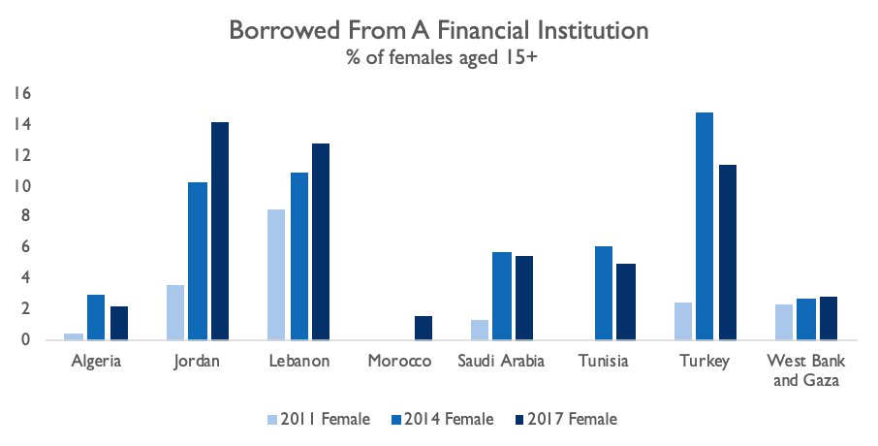
FEMALE LABOR FORCE PARTICIPATION ACCESS TO FINANCE
Women in Jordan have seen increased access to finance, with an increased percentage of women who have borrowed from a financial institution throughout the decade. Since 2011, the rate has surpassed many of its regional peers.
Notes:
Definition: The percentage of respondents who report borrowing any money from a bank or another type of financial institution in the past 12 months, female (% age 15+).
Source: World Bank Global Financial Inclusion Database (2018), available at https://databank.worldbank.org/source/global-financial-inclusion

Slide 97
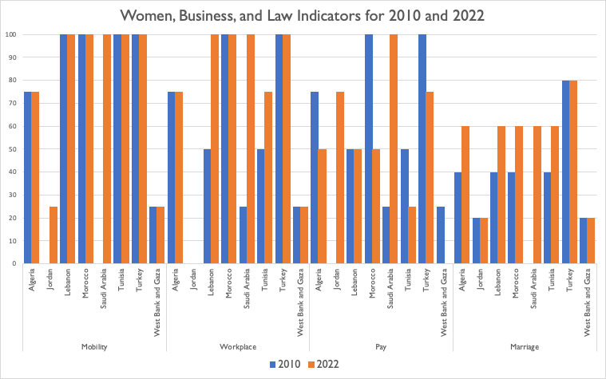
WOMEN, BUSINESS, AND THE LAW INDEX
SCORES
Jordan saw increases in Mobility (0 to 25) and Pay (0 to 75) but saw no changes in Workplace (0) or Marriage (25)
Notes:
Jordan has a score of 0 in Workplace because the Personal Status Law No. 15/2019, Art. 61 requires women to get a job with permission from her husband, does not prohibit discrimination in employment based on sex, has not yet enacted legislation protecting women from sexual harassment in employment nor adopted criminal or civil penalties for sexual harassment in employment. Moreover, Labor Law No. 8, Art. 69 does not allow women to work in industrial jobs the same way as men.
Definition: The Women, Business, and The Law Index measures the laws and regulations that affect women's economic opportunity in 190 economies. The index incorporates eight indicators structured around women's interactions with the law as they move through their careers: Mobility, Workplace, Pay, Marriage, Parenthood, Entrepreneurship, Assets, and Pension.
Source: World Bank. 2022. Women, Business and the Law 2022. Washington, DC: World Bank. doi:10.1596/978-1-4648-1817-2. License: Creative Commons Attribution CC BY 3.0 IGO

Slide 98
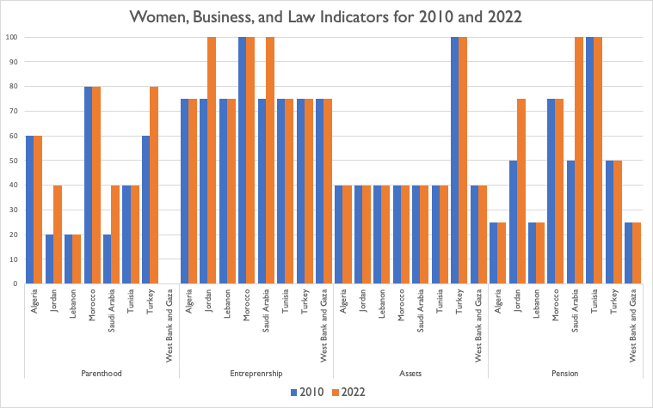
WOMEN, BUSINESS, AND THE LAW INDEX
SCORES
Jordan improved its score on Parenthood (25 to 40), Entrepreneurship (75 to 100), and Pension (50 to 75) but maintained its score for Assets (40)
Notes:
Definition: The Women, Business, and The Law Index measures the laws and regulations that affect women's economic opportunity in 190 economies. The index incorporates eight indicators structured around women's interactions with the law as they move through their careers: Mobility, Workplace, Pay, Marriage, Parenthood, Entrepreneurship, Assets, and Pension.
Source: World Bank. 2022. Women, Business and the Law 2022. Washington, DC: World Bank. doi:10.1596/978-1-4648-1817-2. License: Creative Commons Attribution CC BY 3.0 IGO

Slide 99
WOMEN, BUSINESS, AND THE LAW INDEX MOBILITY
MOBILITY |  | Can a woman apply for a passport in the same way as a man? | Can a woman travel outside the country in the same way as a man? | Can a woman travel outside her home in the same way as a man? | Can a woman choose where to live in the same way as a man?
Algeria | 75 | No | Yes | Yes | Yes
Jordan | 25 | Yes | No | No | No
Lebanon | 100 | Yes | Yes | Yes | Yes
Morocco | 100 | Yes | Yes | Yes | Yes
Saudi Arabia | 100 | Yes | Yes | Yes | Yes
Tunisia | 100 | Yes | Yes | Yes | Yes
Turkey | 100 | Yes | Yes | Yes | Yes
WB & Gaza | 25 | Yes | No | No | No
Notes:
Definition: The Women, Business, and The Law Index measures the laws and regulations that affect women's economic opportunity in 190 economies. The index incorporates eight indicators structured around women's interactions with the law as they move through their careers: Mobility, Workplace, Pay, Marriage, Parenthood, Entrepreneurship, Assets, and Pension.
Source: World Bank. 2022. Women, Business and the Law 2022. Washington, DC: World Bank. doi:10.1596/978-1-4648-1817-2. License: Creative Commons Attribution CC BY 3.0 IGO

Slide 100
WOMEN, BUSINESS, AND THE LAW INDEX WORKPLACE
WORKPLACE |  | Can a woman get a job in the same way as a man? | Does the law prohibit discrimination in employment based on gender? | Is there legislation on sexual harassment in employment? | Are there criminal penalties or civil remedies for sexual harassment in employment?
Algeria | 75 | Yes | No | Yes | Yes
Jordan | 0 | No | No | No | No
Lebanon | 100 | Yes | Yes | Yes | Yes
Morocco | 100 | Yes | Yes | Yes | Yes
Saudi Arabia | 100 | Yes | Yes | Yes | Yes
Tunisia | 75 | Yes | Yes | Yes | Yes
Turkey | 100 | Yes | Yes | Yes | Yes
WB & Gaza | 25 | No | Yes | No | No
Notes:
Definition: The Women, Business, and The Law Index measures the laws and regulations that affect women's economic opportunity in 190 economies. The index incorporates eight indicators structured around women's interactions with the law as they move through their careers: Mobility, Workplace, Pay, Marriage, Parenthood, Entrepreneurship, Assets, and Pension.
Source: World Bank. 2022. Women, Business and the Law 2022. Washington, DC: World Bank. doi:10.1596/978-1-4648-1817-2. License: Creative Commons Attribution CC BY 3.0 IGO

Slide 101
WOMEN, BUSINESS, AND THE LAW INDEX PAY
PAY |  | Does the law mandate equal remuneration for work of equal value? | Can a woman work at night in the same way as a man? | Can a woman work in a job deemed dangerous in the same way as a man? | Can a woman work in an industrial job in the same way as a man?
Algeria | 50 | Yes | No | No | Yes
Jordan | 75 | Yes | Yes | Yes | No
Lebanon | 50 | No | Yes | Yes | No
Morocco | 50 | Yes | Yes | No | No
Saudi Arabia | 100 | Yes | Yes | Yes | Yes
Tunisia | 25 | No | No | Yes | No
Turkey | 75 | Yes | Yes | Yes | No
WB & Gaza | 0 | No | No | No | No
Notes:
Definition: The Women, Business, and The Law Index measures the laws and regulations that affect women's economic opportunity in 190 economies. The index incorporates eight indicators structured around women's interactions with the law as they move through their careers: Mobility, Workplace, Pay, Marriage, Parenthood, Entrepreneurship, Assets, and Pension.
Source: World Bank. 2022. Women, Business and the Law 2022. Washington, DC: World Bank. doi:10.1596/978-1-4648-1817-2. License: Creative Commons Attribution CC BY 3.0 IGO

Slide 102
WOMEN, BUSINESS, AND THE LAW INDEX MARRIAGE
MARRIAGE |  | Is there no legal provision that requires a married woman to obey her husband? | Can a woman be head of household in the same way as a man? | Is there legislation specifically addressing domestic violence? | Can a woman obtain a judgment of divorce in the same way as a man? | Does a woman have the same rights to remarry as a man?
Algeria | 60 | Yes | Yes | Yes | No | No
Jordan | 20 | No | No | Yes | No | No
Lebanon | 60 | Yes | Yes | Yes | No | No
Morocco | 60 | Yes | Yes | Yes | No | No
Saudi Arabia | 60 | Yes | Yes | Yes | No | No
Tunisia | 60 | Yes | No | Yes | Yes | No
Turkey | 80 | Yes | Yes | Yes | Yes | No
WB & Gaza | 20 | No | Yes | No | No | No
Notes:
Definition: The Women, Business, and The Law Index measures the laws and regulations that affect women's economic opportunity in 190 economies. The index incorporates eight indicators structured around women's interactions with the law as they move through their careers: Mobility, Workplace, Pay, Marriage, Parenthood, Entrepreneurship, Assets, and Pension.
Source: World Bank. 2022. Women, Business and the Law 2022. Washington, DC: World Bank. doi:10.1596/978-1-4648-1817-2. License: Creative Commons Attribution CC BY 3.0 IGO

Slide 103
WOMEN, BUSINESS, AND THE LAW INDEX PARENTHOOD
PARENTHOOD |  | Is paid leave of at least 14 weeks available to mothers? | Length of paid maternity leave | Does the government administer 100% of maternity leave benefits? | Is there paid leave available to fathers? | Length of paid paternity leave | Is there paid parental leave? | Shared days | Days for the mother | Days for the father | Is dismissal of pregnant workers prohibited?
Algeria | 60 | Yes | 98 | Yes | Yes | 3 | No | 0 | 0 | 0 | No
Jordan | 40 | No | 70 | Yes | Yes | 3 | No | 0 | 0 | 0 | No
Lebanon | 20 | No | 70 | No | No | 0 | No | 0 | 0 | 0 | Yes
Morocco | 80 | Yes | 98 | Yes | Yes | 3 | No | 0 | 0 | 0 | Yes
Saudi Arabia | 40 | No | 70 | No | Yes | 3 | No | 0 | 0 | 0 | Yes
Tunisia | 40 | No | 30 | Yes | Yes | 1 | No | 0 | 0 | 0 | No
Turkey | 80 | Yes | 112 | Yes | Yes | 7 | No | 0 | 0 | 0 | Yes
WB & Gaza | 0 | No | 70 | No | No | 0 | No | 0 | 0 | 0 | No
Notes:
Definition: The Women, Business, and The Law Index measures the laws and regulations that affect women's economic opportunity in 190 economies. The index incorporates eight indicators structured around women's interactions with the law as they move through their careers: Mobility, Workplace, Pay, Marriage, Parenthood, Entrepreneurship, Assets, and Pension.
Source: World Bank. 2022. Women, Business and the Law 2022. Washington, DC: World Bank. doi:10.1596/978-1-4648-1817-2. License: Creative Commons Attribution CC BY 3.0 IGO

Slide 104
WOMEN, BUSINESS, AND THE LAW INDEX ENTREPRENEURSHIP
ENTREPRENEURSHIP |  | Can a woman sign a contract in the same way as a man? | Can a woman register a business in the same way as a man? | Can a woman open a bank account in the same way as a man? | Does the law prohibit discrimination in access to credit based on gender?
Algeria | 75 | Yes | Yes | Yes | No
Jordan | 100 | Yes | Yes | Yes | Yes
Lebanon | 75 | Yes | Yes | Yes | No
Morocco | 100 | Yes | Yes | Yes | Yes
Saudi Arabia | 100 | Yes | Yes | Yes | Yes
Tunisia | 75 | Yes | Yes | Yes | No
Turkey | 75 | Yes | Yes | Yes | No
WB & Gaza | 75 | Yes | Yes | Yes | No
Notes:
Definition: The Women, Business, and The Law Index measures the laws and regulations that affect women's economic opportunity in 190 economies. The index incorporates eight indicators structured around women's interactions with the law as they move through their careers: Mobility, Workplace, Pay, Marriage, Parenthood, Entrepreneurship, Assets, and Pension.
Source: World Bank. 2022. Women, Business and the Law 2022. Washington, DC: World Bank. doi:10.1596/978-1-4648-1817-2. License: Creative Commons Attribution CC BY 3.0 IGO

Slide 105
WOMEN, BUSINESS, AND THE LAW INDEX ASSETS
ASSETS |  | Do men and women have equal ownership rights to immovable property? | Do sons and daughters have equal rights to inherit assets from their parents? | Do male and female surviving spouses have equal rights to inherit assets? | Does the law grant spouses equal administrative authority over assets during marriage? | Does the law provide for the valuation of nonmonetary contributions?
Algeria | 40 | Yes | No | No | Yes | No
Jordan | 40 | Yes | No | No | Yes | No
Lebanon | 40 | Yes | No | No | Yes | No
Morocco | 40 | Yes | No | No | Yes | No
Saudi Arabia | 40 | Yes | No | No | Yes | No
Tunisia | 40 | Yes | No | No | Yes | No
Turkey | 100 | Yes | Yes | Yes | Yes | Yes
WB & Gaza | 40 | Yes | No | No | Yes | No
Notes:
Definition: The Women, Business, and The Law Index measures the laws and regulations that affect women's economic opportunity in 190 economies. The index incorporates eight indicators structured around women's interactions with the law as they move through their careers: Mobility, Workplace, Pay, Marriage, Parenthood, Entrepreneurship, Assets, and Pension.
Source: World Bank. 2022. Women, Business and the Law 2022. Washington, DC: World Bank. doi:10.1596/978-1-4648-1817-2. License: Creative Commons Attribution CC BY 3.0 IGO

Slide 106
WOMEN, BUSINESS, AND THE LAW INDEX PENSION
PENSION |  | Is the age at which men and women can retire with full pension benefits the same? | Is the age at which men and women can retire with partial pension benefits the same? | Is the mandatory retirement age for men and women the same? | Are periods of absence due to childcare accounted for in pension benefits?
Algeria | 25 | No | No | No | Yes
Jordan | 75 | No | Yes | Yes | Yes
Lebanon | 25 | No | No | Yes | No
Morocco | 75 | Yes | Yes | Yes | No
Saudi Arabia | 100 | Yes | Yes | Yes | Yes
Tunisia | 100 | Yes | Yes | Yes | Yes
Turkey | 50 | No | Yes | Yes | No
WB & Gaza | 25 | No | No | Yes | No
Notes:
Definition: The Women, Business, and The Law Index measures the laws and regulations that affect women's economic opportunity in 190 economies. The index incorporates eight indicators structured around women's interactions with the law as they move through their careers: Mobility, Workplace, Pay, Marriage, Parenthood, Entrepreneurship, Assets, and Pension.
Source: World Bank. 2022. Women, Business and the Law 2022. Washington, DC: World Bank. doi:10.1596/978-1-4648-1817-2. License: Creative Commons Attribution CC BY 3.0 IGO

Slide 107
LEGAL, REGULATORY, AND POLICY FRAMEWORKS LEGISLATIVE SYSTEMS
Algeria | Presidential republic with a bicameral Parliament
Jordan | Parliamentary constitutional monarchy with a bicameral National Assembly (Senate and House of Representatives)
Lebanon | Parliamentary republic with a unicameral National Assembly
Morocco | Parliamentary constitutional monarchy with a bicameral Parliament
Saudi Arabia | Absolute monarchy with a unicameral Consultative Council
Tunisia | Parliamentary republic with a unicameral Assembly of the Representatives of the People
Turkey | Presidential republic with a unicameral Grand National Assembly of Turkey
West Bank and Gaza | Separately administered Palestinian territories. The Palestinian Legislative Council is the unicameral legislature of the Palestinian Authority
Notes:
Source: Central Intelligence Agency. (2016). The World Factbook. Retrieved from http://cia.gov/the-world-factbook/countries/

Slide 108
ENTREPRENEURSHIP
TOTAL EARLY-STAGE ENTREPRENEURIAL ACTIVITY (TEA)
Jordan’s female TEA was 6.75% of the adult population while the male TEA was 11.43% (2019).
The gender gap became smaller since 2017 but still in the lower quartile.
Notes:
Jordan greatly improved its female-to-male TEA ratio, which was 0.26 in 2017 but reached 0.59 in 2019.
Definition: Percentage of female 18-64 population who are either a nascent entrepreneur or owner-manager of a 'new business', divided by the equivalent percentage for their male counterparts
Source: Global Entrepreneurship Monitor (GEM), most recent figures available at https://www.gemconsortium.org/data

