Slide 1
WATER AUDIT AND EVALUATION OF IRRIGATION SYSTEMS FROM THE WELL TO THE FIELD
WATER INNOVATION TECHNOLOGIES
Ensure most efficient use of water
Khalil Ammar, Henda Mahmoudi, Zied Hammami
24 June, MS Teams platform, ICBA, Dubai, UAE
Field coordinators: Eng. Ayman Abukeshek¹ and Osama Al Zyoud

Slide 2
Evaluation of irrigation system efficiency in Azraq and Mafraq
WATER AUDIT AND EVALUATION OF IRRIGATION SYSTEMS
WIT-ICBA team conducted a survey including:
A farm baseline questionnaire with sections related to audit team and farm information, farming system, farm economics, financing, business profile;
Farm level water audit of irrigation systems including sections on wells, pumps hardware and basin, water requirements and demand, irrigation system suppliers and water saving awareness;
Water audit at the management block level for the major crop grown in each farm.
Irrigation pick season and basin usage

Slide 3
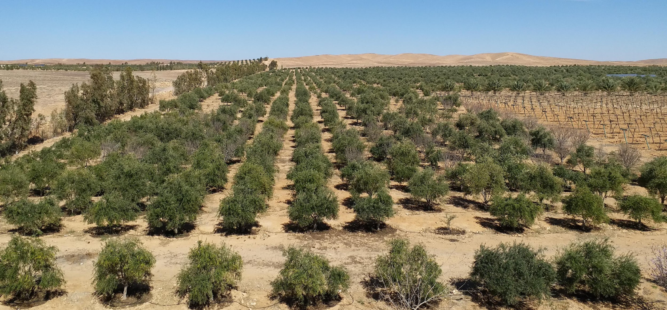
WATER AUDIT AND EVALUATION OF IRRIGATION SYSTEMS
Olives and stone fruits are dominating the irrigated agriculture in Jordan highlands of Azraq and Mafraq and constitute the essential customers group for suppliers and embedded extension services

Slide 4
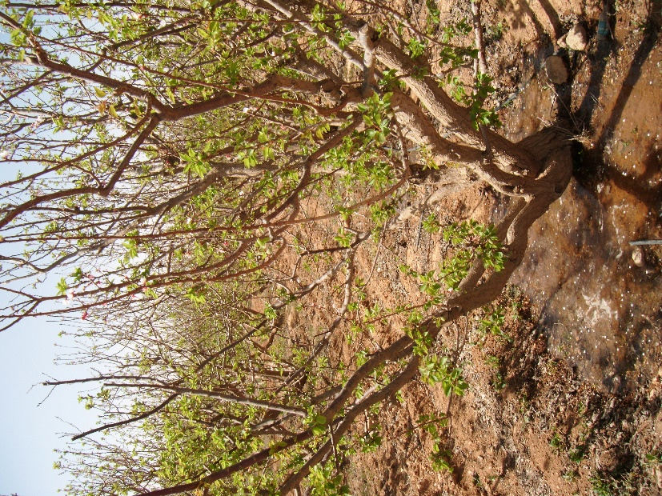
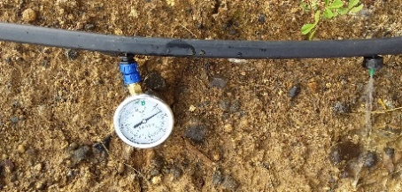
WATER AUDIT AND EVALUATION OF IRRIGATION SYSTEMS
Irrigation system performance
Irrigation system are not customized for each crop type.
Irrigation system sizing is not based on the calculation of the irrigation dose.
Visual soil over-saturation.
Notes:
Based on the data collected

Slide 5
Goal of auditing
WATER AUDIT AND EVALUATION OF IRRIGATION SYSTEMS
Identify, quantify and verify water losses and costs.
Identify water resource efficiency.
Ensure most efficient use of water in agriculture.

Slide 6
WATER AUDIT AND EVALUATION OF IRRIGATION SYSTEMS
Why to conduct water audit
On-Farm water audit is a tool to overcome shortage, leakage, and losses in the irrigation system.
It consists of collecting and recording information that provide overall status of the farm.
Keeping accurate and up-to-date records throughout the year will help during the auditing process.

Slide 7
WATER AUDIT AND EVALUATION OF IRRIGATION SYSTEMS
Field sampling to evaluate irrigation network
Water use history for the farm being audited.
Seasonal Irrigation scheduling applied at the farm.
Daily challenges.
Measurements (flow rate, pressure, salinity) in specific block for each major crop (olives, stone fruits, grapes).

Slide 8
WATER AUDIT AND EVALUATION OF IRRIGATION SYSTEMS
Step 1: History of farm water use
Farm water use.
Area of the farm/ plot.
The agricultural practices.
Date of plantation.
Flowering, fruiting.
Previous years yield.
Type and brand of irrigation material used.
Notes:
It necessary to have an idea about the history of the

Slide 9
Step 2: Introduction about water audit
Communicate with the farmer.
Build trust with him.
Brief him about the importance of the auditing task and the benefits that he will gain in terms of improvement of crop production.
Notes:
The first step during farm field visit is to

Slide 10
Tips
Some important tips and selling points, that need to be considered when visiting new farms, are summarized below:
Brief the farmer about the project in a very simple way.
Never mention the saving of water as the main objective of the project.
Try to assess the farm status productivity and irrigation efficiency.
Make a quick basic calculation of cost-benefit.
Highlight in a very simplified way the positive impact considering crop water requirement.
Notes:
The basic kit includes the following items:
Pressure Gauge
Stopwatch
Graduated cylinder
Container
Portable TDS meter
Water audit form

Slide 11
Tips
Inform about the outstanding Jordanian suppliers’ having adequate irrigation hardware.
What precaution should be taken into-consideration about using PC dripper.
Highlight that WST will reduce their electricity bills.
WST will reduce labors costs.
WST will conserve more nutrients.
WST will reduce water-borne diseases.
Notes:
The basic kit includes the following items:
Pressure Gauge
Stopwatch
Graduated cylinder
Container
Portable TDS meter
Water audit form

Slide 12
Step 4: Seasonal irrigation scheduling applied at the farm
Current seasonal irrigation scheduling applied at the farm.
How many times is irrigating or how long.
Notes:
It is very important to know the

Slide 13
Step 5: Daily challenges at the farm
Farm daily challenges and evaluate the status of the farm by descripting the problems that are directly affecting the performance of the irrigation system.
Provide the right solutions/ recommendations to the farmers.
Notes:
Report about the

Slide 14
STEP 6: MEASUREMENTS
WATER AUDIT AND EVALUATION OF IRRIGATION SYSTEMS
Dimensions and GPS coordinates.
Characteristics will be reported in the auditing forms: date of installation.
lateral pipe diameter and thickness.
number of drip lines per planting row.
distance between emitters.
GPS coordinates of the sampling points, the flow rate, the pressure.
Notes:
It necessary to have an idea about the history of the

Slide 15
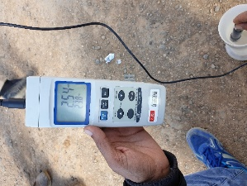
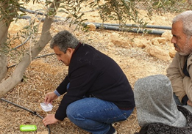
Required tools, Water audit kit
Notes:
The basic kit includes the following items:
Pressure Gauge
Stopwatch
Graduated cylinder
Container
Portable TDS meter
Water audit form

Slide 16
STEP 6: MEASUREMENTS
WATER AUDIT AND EVALUATION OF IRRIGATION SYSTEMS
Soil analysis as well as water sampling to get clear idea about all factors that affect the performance of the irrigation.
The soil samples are collected from the root zone at different points and depths in the audited area.
Notes:
It necessary to have an idea about the history of the

Slide 17
STEP 6: MEASUREMENTS
WATER AUDIT AND EVALUATION OF IRRIGATION SYSTEMS
Calculation of uniformity
measure of the average sample of dripper flow in one pipeline, divided by the average of all dripper flow in the plot.
A higher distribution uniformity indicates a better performing irrigation system.
If all the plot samples are equal, the distribution uniformity is 100%.
but generally a value greater than 70% is considered acceptable.
Notes:
It necessary to have an idea about the history of the

Slide 18
WIT-ICBA water audit forms
WATER AUDIT
Water saving technology efficiency
Date of Visit
Farmer name
Farmer telephone number
Respondent name
General investigation of the farm
Wells
Wells pumps
Basin
Booster pump
Filters
Mainlines
Submains
Laterals
Crop status
Crop productivity
Fruit quality
Notes:
The basic kit includes the following items:
Pressure Gauge
Stopwatch
Graduated cylinder
Container
Portable TDS meter
Water audit form

Slide 19
Water audit
Crop parameters
Variable | Conventional system | Implemented system
GPS- latitude (y-value) [range 31.700000 - 32.400000]:
GPS- longitude (y-value) [range 31.700000 - 32.400000]:
Crop specie
Variety
Date of plantation or tree age
Date of end-of dormancy
Flowering date
Maturity date
Harvest date
Yield of record (maximum obtained)
Yield at the previous season
Yield at actual season (at harvest)
Tree canopy total diameter
Tree maximum height
Tree root depth as estimated by the farmer
Distance between planting rows
Distance between trees on the same row
Pipe diameter of the main line (in inch)
Pipe diameter of the sub-main line (in inch)
Plot length
Plot width
Irrigation sector area (in dunam)
Date of Installation [use format: YYYY-MM-DD]:
Lateral pipe diameter (in inch)
Thickness of the lateral pipe (mm)
Number of drip lines per planting row
Brand of irrigation line/emitters
Emitter commercial name
Distance between emitters on the same line (cm)
Nominal flow rate of emitter (liter per hour)
Functioning pressure(bar)
Number of emitters per tree
Average width of the wetting front on the irrigation line (cm)
اسم المزارع.......................................................موقع المزرعه يتم اخذ احداثيات القطعة بواسطة جهاز الاحداثيات (مبدئيا بالهاتف) في حالة زيارتها: خط العرض: …….. خط الطول ………
اسئلة للمزارعين
خصائص المزرعة وخاصة القطعة التي تم تركيب النظام الجديد فيها (اطلب من المزارعين ، إن أمكن ، أن يلتقط صور نظام الري والنبات والخط الجانبي (الخط والنقطات)
نوع المحصول محور النقاش
صنف المحصول محور النقاش
مرحلة نمو المحصول محور النقاش
اسئلة عامة
هل لديك ملاحظات عامة سلبية اوايجابية فيما يتعلق بالشبكة المحسنة
هل لديك ملاحظات سلبية اوايجابية بخصوص الشركة المزودة لانظمة الري الجديدة
كيف هي الحالة العامة للبئر ومضخة البئر
كيف هي الحالة العامة للحوض و مضخته
هل هناك فلاتر ضمن شبكة الري و النوع ان وجد ( الي/ يدوي)
كيف هي الحالة العامة للفلاتر
هل يتم التنظيف الدوري للفلاتر و ماهية المدة
كيف هي حالة شبكة الري: الخطوط الرئيسية والفرعية
نوع النقاطات عددها لكل شجرة
كيف هي الحالة العامة للنقاطات:
جدولة الري الفعلية: عدد أيام الري في الأسبوع ........... عدد ساعات الري يوميا ...........
اذا امكن للمزارع اثناء عملية الري الروتينية ان يقوم بحساب مائي للنقاطات بواسطة قياس التدفق للنقاطات باستعمال اي وعاء متاح و معلوم الكمية (كقارورة مياه نصف لتر) مع اخذ الوقت الكافي لملئها
سعة الوعاء المستعمل: .......
الوقت اللازم لملئ الوعاء: ........
في حالة زيارة المزرعة يجب ان أمكن اخذ قراءات الضغط وقياس التدفق للنقاطات باستخدام الاداوات المعتمدة، ثم السؤال عن
حالة المحاصيل: ....................................................................................
إنتاجية المحاصيل: ..................................................................................
جودة الفاكهه: .......................................................................................
ملاحظات عامة
.................................................................................................................................................................................................................................................................................................................................

Slide 20
ON-FARM WATER AUDIT
Video
WATER AUDIT AND EVALUATION OF IRRIGATION SYSTEMS

Slide 21
Design of drip Irrigation System

Slide 22
Generally, drip irrigation is the best system to apply of water directly near the root zone of plants with minimum water and energy loss. However, a water audit should be carried out regularly to ensure that this objective is achieved.
Heterogeneity
water audit
Farm audit
Solution
Over irrigation
Energy cost high
Situation
Audit
Reaction

Slide 23
Irrigation hardware
The water audit aims to check the functionality of all the systems, focusing on the distribution network and mainly the drippers
laterals mainly
Filtration and fertilizer unit
Basin
Submains
bye pass arrangement
Well pump
water audit
Mainlines
Booster pump
Well
water audit
water audit
water audit
water audit
Distribution network
Head control unit

Slide 24
Measurements | Implemented plot
GPS-latitude (y-value) [range 31.700000 - 32.400000]: | 31.8499136
GPS-longitude (x-value) [range 36.000000 - 37.200000] | 36.9909001
Emitter Flow rate measured (L/hour)
#1 on a beginning of the first line | 16.2
#2 on the first quarter of a central line | 16.3
#3 on the middle of a central line | 16.8
#4 at the end of the last line
Pressure measured (bar)
#1 (main)
#2 (sub-main)
#3 (central lateral) | 0.5
Water salinity measurement (ppm)
#1 on a beginning of the first line | 1750
#2 on the middle of a central line | 1750
#3 at the end of the last line
Water pH | 7.2
31.8499136
36.9909001
24.2
25.3
24.8
1
1750
1750
7.2
After intervention
Emitter Flow lower than expected

Slide 25
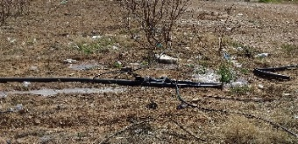
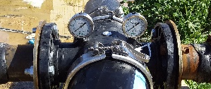
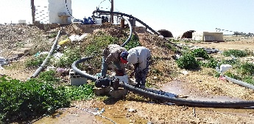
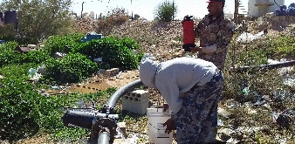
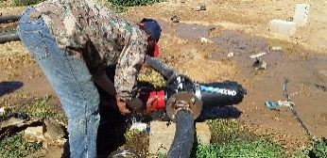
Leakage was a serious problem, causing a pressure drop in the system and loss of water.
1
2
Filter cleaning

Slide 26
Using low
flow emitters
Filters are an indispensable component to avoid the risk drippers clogging
The sand filter could be used where the organic matter content of the water is high.
Therefore, a disk filter should be installed, and it is instrumental in the filtration of organic material and algae.
Farmers can use acid to reduce chemical and physical clogging plus the chlorine to avoid biological clogging as well as other available and confirmed products.

Slide 27
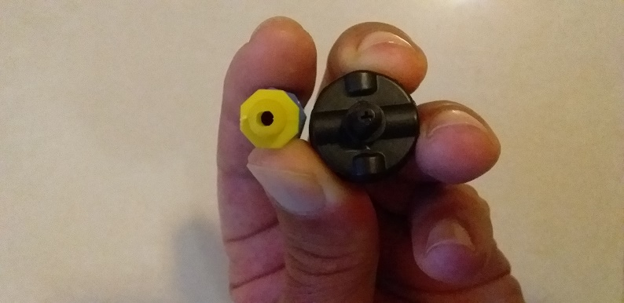
Filtration system needs to be designed, according to:
iron, sulfur
Algae
bloom
Minerals
limestone
Suspend Solids
≤
salts
Size
+ Water currents and winds
+ Open basins
Filtered water
According to the size of the holes and drippers that each system has

Slide 28
If the water audit show that irrigation system design should be adjusted
For example after shafting from high to low flow , No-PC to PC
Water audit result
Field layout
Crop water requirement
Hydraulic design of the system
Pump horsepower specification
Applying the required volume of water uniformly to all the tress in the field requires designing the system to maintain desired hydraulic pressure in the pipe network.
Notes:
The required information to redesign the drip irrigation system are summarized as the following:

Slide 29
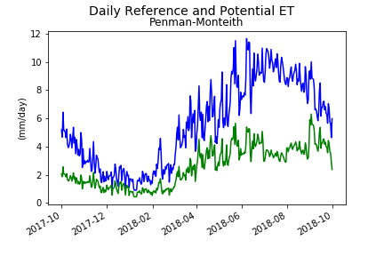
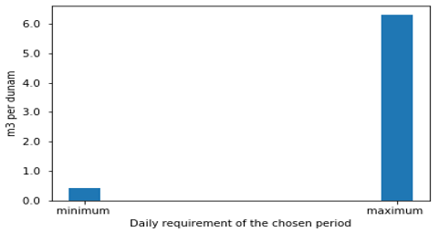
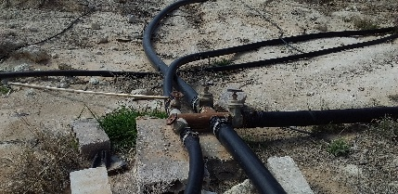
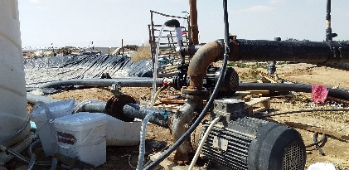
The usual steps for designing a drip-irrigation system from scratch or when enough flexibility is possible for redesign are:
maximum water requirement per day per unit surface.
Step 1
Emitter design
Step 2
Determine flow per lateral, sub-main, and mainlines
Step 3
Determine the total system capacity to meet the maximum irrigation crop requirement.
Step 4
Size laterals, submains, and mainlines.
Step 5
Determine the pump size needed.
Step 6

Slide 30
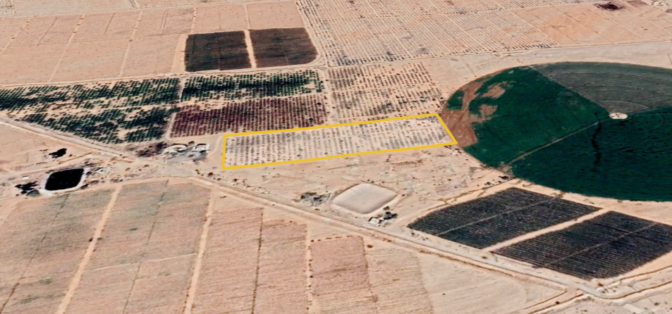
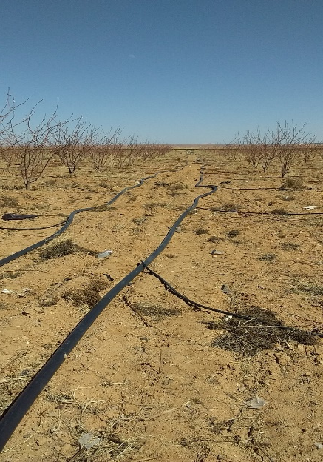
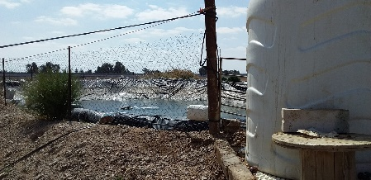
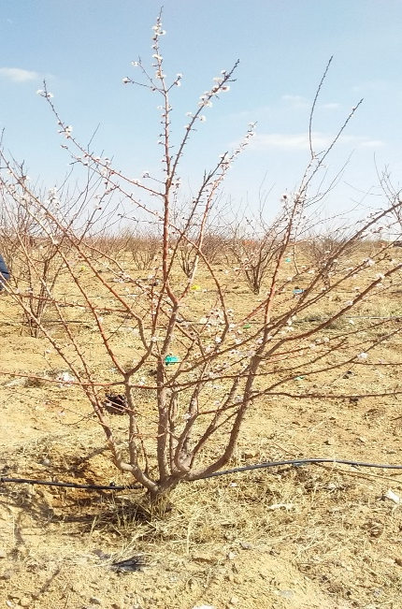
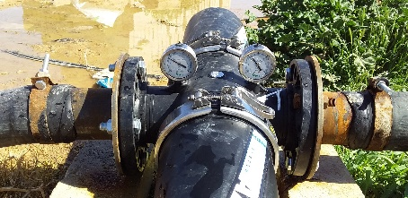
Example:
This is a real example, with some tweaks to simplify it. Design a drip irrigation system for an Apricot orchard of 17 du area.
laterals mainly : 20 mm
Submains
2 inch
Mainlines
5 inches
Basin 1600 m3
Booster pump m3/h
One well … m; Well pump ….m3/h

Slide 31
Soil and water analysis
Parameters | Apricot
Distance between planting rows | 6
Distance between trees on the same row | 4
Plot length | 220
Plot width | 70
Irrigation sector area du | 17
Date of Installation | 2020
Lateral pipe diameter (in inch) | 20
The thickness of the lateral pipe (mm) | 1.5
Number of drip lines per planting row | 1
Brand of irrigation line/emitters | 1
Emitter commercial name
Distance between emitters on the same line (cm) | 400
the flow rate of an emitter (liter per hour) | 24
Functioning pressure(bar) | 1
Number of emitters per tree | 1
The average width of the wetting front on the irrigation line (cm) | 60
Parameters
Water source | well
Water salinity | 1750 ppm
Water pH | 7.2
Soil texture | Loam
Clay | 14.6%
Silt | 45.4%
Sand | 40%
Soil salinity | 1.8 dS/m
Land slope | 0.20%

Slide 32
Step 1: Estimation of maximum water requirement
Evapotranspiration of the crop (ET) = ET₀ x Crop coefficient
= 9 * 0.75= 6.75 mm/day
Volume of water to be applied= Area covered by each tree x Wetting fraction x ET
= (6x4) x 0.50 x 6.75 = 81 l/day.

Slide 33
WIT project plan to use sensors system (plant and soil) to adjust and customize Crop Coefficient

Slide 34
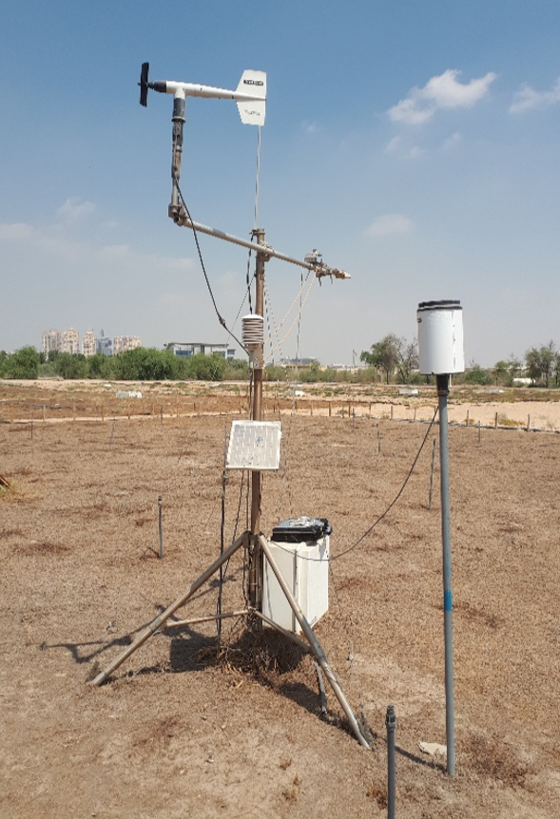
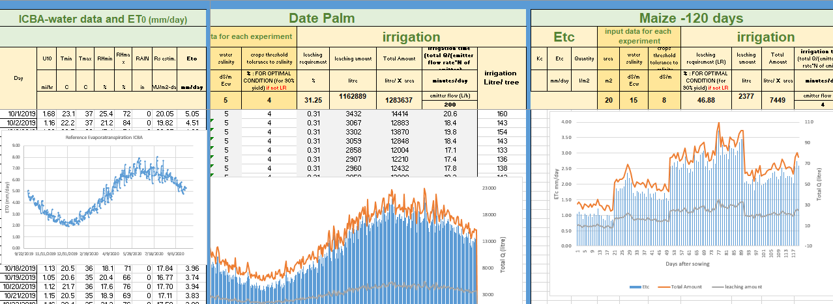
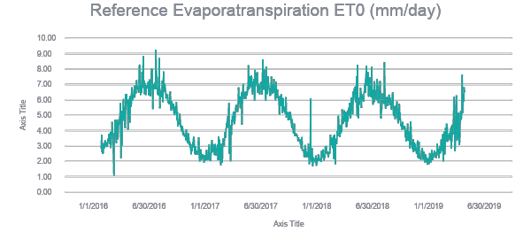
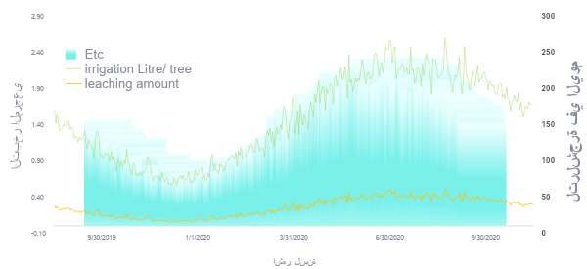
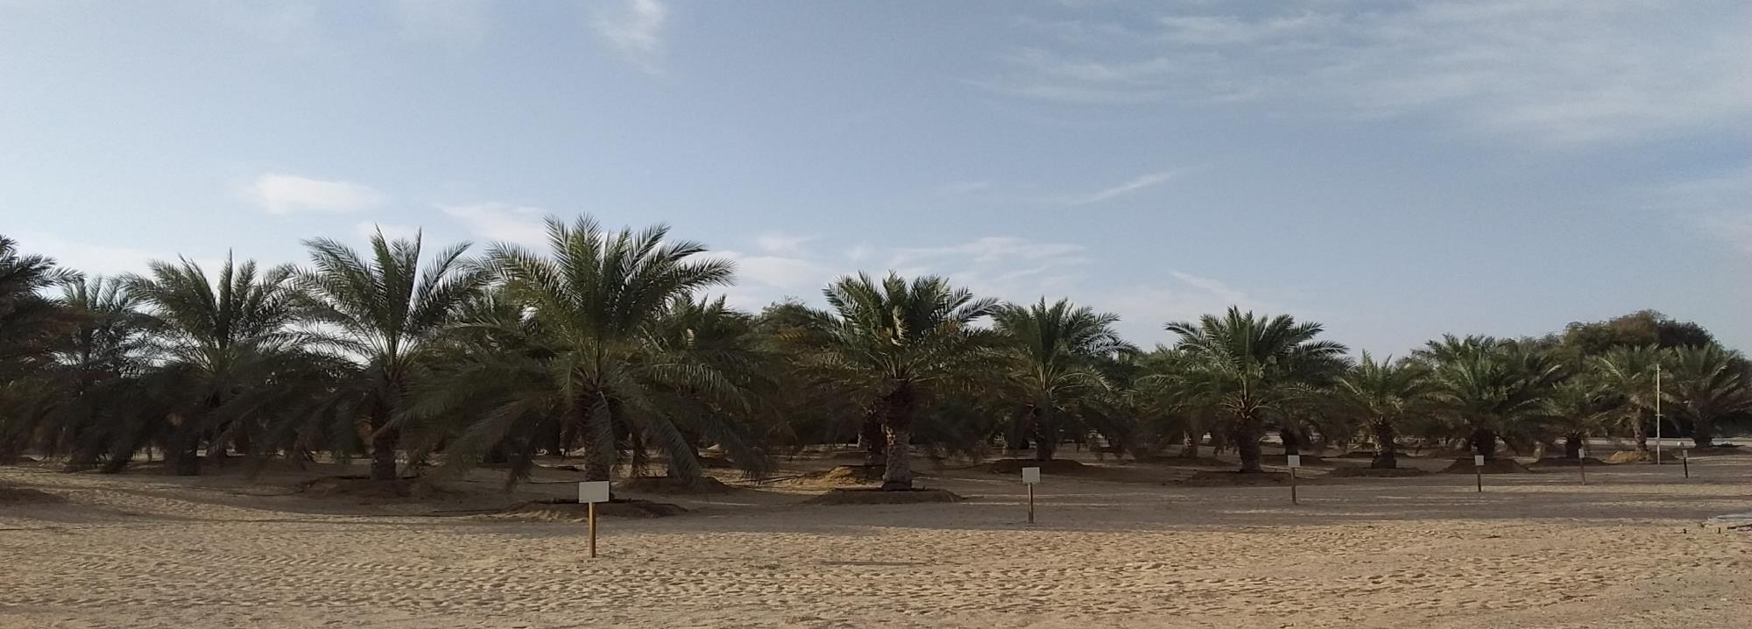
Studies done by ICBA have shown that advanced irrigation technologies such as studies of estimating actual ET and customize Kc for many crops using plant ground sensory systems for several crops. One of these achievements was Date palm irrigation monitoring.
Estimation reference evapotranspiration (ET) Using daily weather data
Weather data
Irrigation
Estimation of irrigation dose and irrigation time

Slide 35
Step 1: Estimation of maximum water requirement
Where: A= irrigated area; Y: Depleted moisture;
FC: Field capacity; Wp: Wilting point;
D: Effective root zone depth and
P: Wetting fraction.,
Ea efficiency of the irrigation,
With; Ea= Ks* EU
Where:
Ks is volume of irrigation water stored in the root zone by volume of irrigation water delivered to the farm or field it can be 1 for sand soil, 0.9 for loam soil and 0.95 for clay soil.
EU: homogeneity of the dripper flow rate.

Slide 36
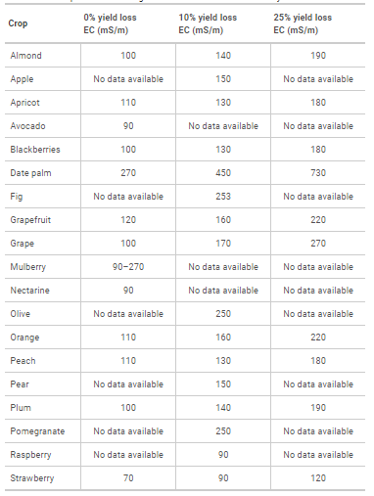
Fruit crop tolerance to irrigation with saline water with loamy soil
Where:
ECw : salinity of the applied irrigation water in dS/m
ECe: average soil salinity tolerated by the crop as measured on a soil saturation extract to obtain acceptable yield (for example only 10% of yield reduction)

Slide 37
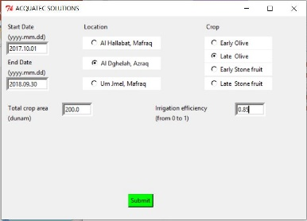
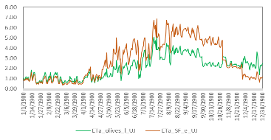
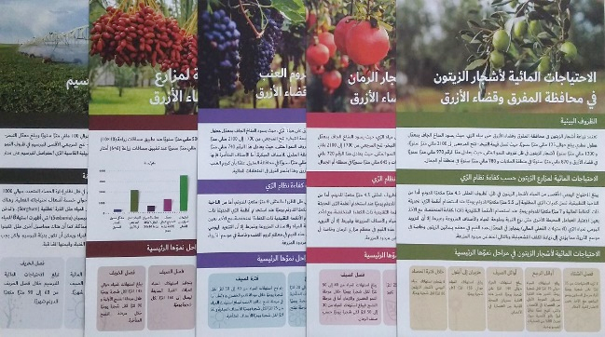
Irritec program provided during the Training of Oct 7th, 2019, to determine the maximum crop water requirements can be used, including the impact of the irrigation efficiency. The result shows that the maximum daily crop water requirements in mm/day can reach 6.
The brochures developed by WIT project can be used to estimate the maximum irrigation water requirements, 6.5 m³/day/dunum.
On average, the current daily dose at the farm level is higher than these values considered for the peak season for irrigation sector sizing.
However, we should be careful to design a new system that delivers less than the requirement.

Slide 38
Step 2: Emitters and irrigation time should be selected according to:
Soil texture and crop root zone system.
the peak demand irrigation season
Assuming two emitters of 24 l/h, placed on each tree are sufficient to wet the crop's effective root zone.
Total quantity provided in one hour = 24 x 2 = 48 l/h
Irrigation time = 81/48 = 1 h 40 minutes
However, Depending on the preference of the farmer or the field technician, it is possible to maintain the irrigation time at 3 hours, then the irrigation time = 3 h, with the number of drippers of one.

Slide 39
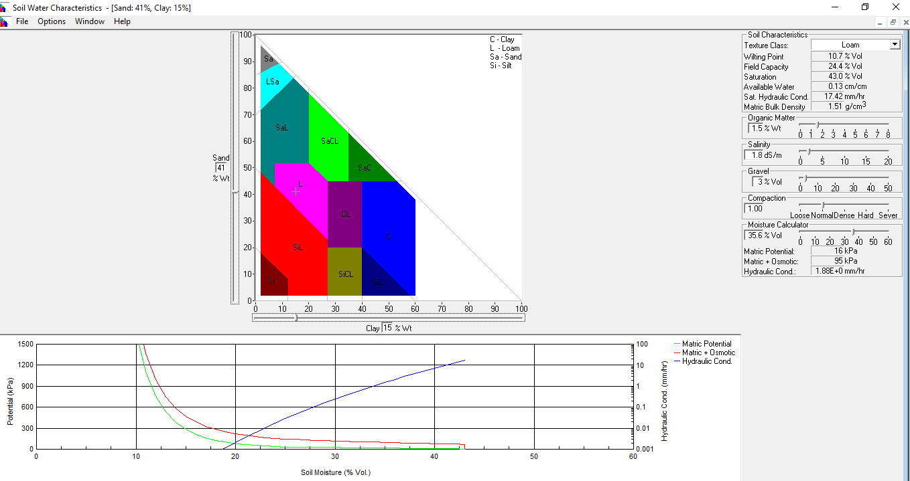
However, the best option for 3 hours of irrigation and according to soil hydrologic characteristics, to wet the effective root zone of the trees, without losing water, the ideal number of PC emitters per tree could be 3 to 4 with a flow rate of 8 l/h. Low flow emitter can help keep water and fertilizer in the roots zone and avoid profound percolation loss.
https://www.ars.usda.gov/research/software/download/?softwareid=492&modecode=80-42-05-10%20?#downloadForm

Slide 40
Example
Purpose of irrigation Maintain soil water content within a target range, to eliminate water stress.
43%
Saturation التشبع
193.5 mm
24.4%
Field capacity السعة الحقلية
47.2 mm
90 cm
14 mm
Total available
الكمية الكلية المتوفرة
50% available متوفر
Stress point نقطة الجهد
10.7%
20.7 mm
Wilting point نقطة الذبول
50 cm

Slide 41
Step 3 & Step 4: Discharge through each lateral & Determination of the number of sectors

Slide 42
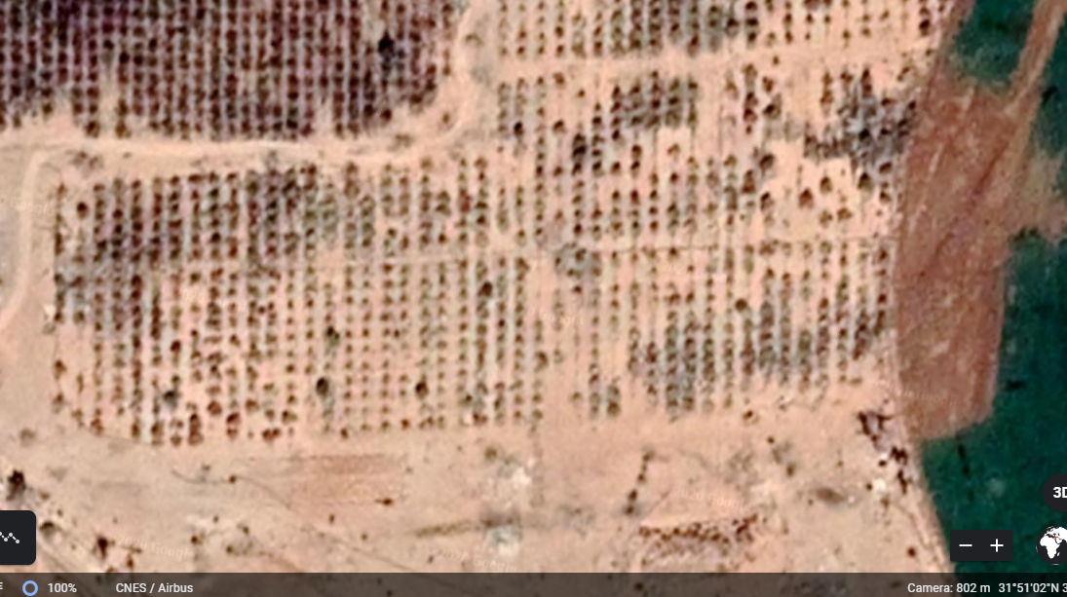
Scenario 1:
830 trees with one dripper/tree
Total discharge = 830*24= 20 m3/h
The laterals are extended on both sides of the sub mains.
Assuming the pump discharge = 7 l/s = 25000 l/h
Mainlines
laterals mainly
Submains
The number of drippers that can be operated by each manifold = 25,000 /24 = 1040
So, theatrically only one manifold or submains can supply water to all the laterals at a time.
Therefore, the length of the lateral will be the reason for the right decision according to the drippers' technical specifications.

Slide 43
The determination of the number of plots (manifolds) and then the discharge capacity through each lateral depend first on the source of water, mainly the pump capacity. If there is a possibility to change the pump or it’s horsepower of the pump is sufficient, only the technical specifications of the drippers should be taken into consideration, as well as the next design steps, size of lateral, submain and mainline, respectively.

Slide 44
Scenario 2:
number of laterals/plot ~ 23 laterals
Max discharge per plot
Plot 1= 126*24= 3024 l/h
Plot 2= 231*24= 5544 l/h
Plot 3= 231*24= 5544 l/h
Plot 4= 242*24= 5808 l/h
Total discharge= 19920 l/h ~20 m³
Therefore, the length of sub-mains and lateral will be 100 m, 35 m each respectively.
Mainlines
laterals mainly
Submains
It depends on Pump Horsepower and the drippers' technical specifications.

Slide 45
Scenario 3:
number of laterals/plot ~ 23 laterals
Max discharge per plot
Plot 1= 357*24= 8568 l/h
Plot 2= 231*24= 5544 l/h
Plot 3= 242*24= 5808 l/h
Total discharge= 19920 l/h ~20 m³
Therefore, the length of lateral in plot 1 will be 66 m.
Mainlines
laterals mainly
Submains
It depends on Pump Horsepower and the drippers' technical specifications.

Slide 46
Scenario 4:
number of laterals/plot ~ 23 laterals
Max discharge per plot
Plot 1= 357*24= 8568 l/h
Plot 2= 473*24= 11350 l/h
Total discharge= 19920 l/h ~20 m³
Therefore, the length of lateral in plot 1 will be 66 and 70 m each respectively.
Mainlines
laterals mainly
Submains
It depends on Pump Horsepower and the drippers' technical specifications.

Slide 47
Step 5, Step 6 & Step 7: Size of lateral, Size of submain & Size of the mainline
Once the delivered quantity of water in each plot is known, then size of the lateral, submain and mainline can be chosen based on the Hazen-Williams equation, and it will be possible to check the feasibility of each scenario. The Hazen-Williams equation determines the relation of the water flow in a pipe with the physical properties (pipe materiel, the C value, inside diameter, pipe length) of the pipe in the aims to determine the pressure drop or friction loss in pipes. There is many available software's or a simple excel sheet that can help estimate the total head loss in a pipe. For example, the calculation Excel sheets that can be downloaded from the following link
https://www.mepwork.com/2018/02/hazen-williams-calculator.html;
http://epanet.de/
https://www.lmnoeng.com/hazenwilliams.php

Slide 48
With:
∆H = the head loss in the pipe, m
K = Constant, 1.21 x 1010
Q = the flow rate in the pipe, l/sec
C = the friction coefficient for the continuous section of the pipe and depends on the pipe material.
D = the inside diameter, mm
L = the length of pipe, m
F = the outlet factor

Slide 49
Step 8: Determining the horsepower of the pump
In the case of starting the design from zero, the pump characteristics should take into consideration the water requirement and the loss estimated previously. If the pump existed before the redesign, like in most cases, this last step would be the first parameter to calculate before any redesigning processes.

Slide 50
Our advice is to replace low grade laterals enclosing high flow rate emitters with pressure compensating low flow emitters and Customized Filter system.

Slide 51
WATER INNOVATION TECHNOLOGIES
WATER AUDIT AND EVALUATION OF IRRIGATION SYSTEMS FROM THE WELL TO THE FIELD

