Slide 1
Community of Practice “Capacity Building Interventions: How do we know what difference we are making?” Organizational Development Eman Hadweh Senior Team Leader – Capacity Development USAIC Civic Initiatives Support Program June 5, 2018

Slide 2
Capacity Development
UNDP Definition:
“The process through which individuals, organizations and societies obtain, strengthen and maintain the capabilities to set and achieve their own development objectives over time.”
Not limited to trainings, but builds a longer term partnership with organizations and provides capacity assessment, capacity development planning and mentoring support.

Slide 3
Capacity Building Principles
Capacity cannot be understood without reference to the wider system that surrounds any organization
Capacity involves complexity
Interrelationships are central to performance
Continuous process whereby results can appear years after
* Organizational Capacity Development Measurement – USAID Paper

Slide 4
USAID CIS CD Philosophy
Organizational Management
Basics of Financial Management
Procurement Fundamentals
Organizational M&E Foundations
Strategic Planning
Good Governance
Capable Organizations
More Programs Responding to Community Needs
More Programs Implemented Efficiently & Effectively
More Effective Development
Project Design & Management
Project Design & Proposal Writing
Budgeting for Proposals
Organizational M&E Foundations
Effective Strategic Communication for Development Projects
Cross-Cutting &
Technical Topics
Introduction to Advocacy
Gender Perspective & Research
Qualitative Research Methodologies
Inclusion 101: Advancing Disability Rights
Training of Trainers in Dialogue Education

Slide 5
CB Interventions Under USAID CIS
Year I (2013-14) | Year II (2014-15) | Year III (2015-16) |  |  | Year IV (2016-17) |  | Year V (2017-18)
Institutional Strengthening Fund
Institutional Capacity Assessments and Post Assessments (ICAT/IDA)
Internal Strengthening for Change I: National outreach to CBOs on basics of management, institutional assessments, strategic planning, etc. |  |  |  | ISC II: Follow-on Subcontract to ISC Subs to issue grant to 20 ISC CBO graduates for support to implement their strategic plans and provide follow-on capacity development and mentoring
Demand-Driven Open Courses: Project Design & Proposal Writing, Budgeting for Proposals, M&E, Communications, Advocacy, etc. |  |  |  |  |  | PDPW PRO: Certification of ISOs on Project Design and Proposal Writing training content and delivery
 |  |  | Societies Empowerment Fund: two-phased grants aiming at a holistic organizational change approach
 |  |  |  | CSO Partners in Training Excellence: Certification of governorate-level CSOs in training systems, training management, training content design and delivery
 |  |  |  | Financial Sustainability Support/MANGO: Training delivery and mentoring to CSOs on financial management, financial sustainability planning, etc.
Ongoing Mentoring to CSOs: Strategic Planning Support; End of Project Evaluations; 10% Capacity Building Line Item in Grants
 |  |  |  | Fundamentals of CSO Sustainability: strategic planning, good governance, and financial management and financial sustainability panning.

Slide 6
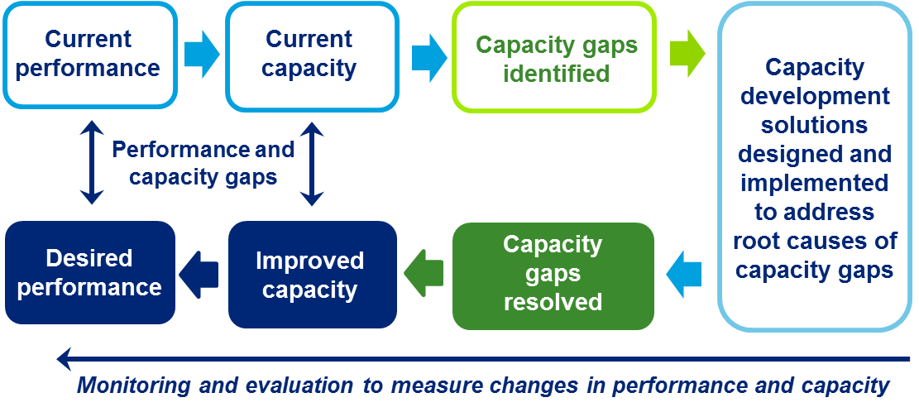
Measuring OD (Deloitte Example)

Slide 7
Our M&E Philosophy for Capacity Development
Impact
REFLECT
PLAN
ACT
M&E is embedded in the design of programs, is continuous and utilizes multiple tools. Openness of technical team for soliciting feedback and making modifications for better results.

Slide 8
Capacity Building Tracker
Totals (Open Courses - SEF - ISC - ISC II – SEF – CTEP - MANGO)
Number of Trainings Delivered to Date: | 240
Number of Trained Individuals (non-unique): | 4,148
Number of Trained Individuals (unique): | 3,208
Number of Trained Organizations (non-unique): | 2,026
Number of Trained Organizations (unique): | 1,423
Institutional Capacity Assessment Tool (ICATs)
Number of ICATs Completed (co-signed): | 66
Institutional Development Assessment Tool (IDA)
Number of IDAs completed: | 66
Internal Strengthening for Change: | 207

Slide 9
How do we know if we are making a difference?
Scope and approach of ‘evaluations’ are based on:
Project scope
Timeline
Nature of intervention
Value added, etc.
Type of intended results (results framework)

Slide 10
Internal Strengthening for Change (ISC – 1.3 USD Million)

Slide 11
ISC – “How do we know we are making a difference“?
Internal Evaluation of Toolkit Training (phone interviews and FGs) – resulted in additional component (mentoring) – openness
IDA pre and post assessment results
End of project evaluation – external (performance, qualitative, with some evidence)
Spectrum of Change

Slide 12
Spectrum of Change
Area/ Spectrum of Change | Awareness | Development and Acquisition of Tools | Application of Learning/use of tools | Continued use and sustainability
Strategic Planning
Good governance
M&E

Slide 13
Societies Empowerment Fund - SEF
Grant Structure | Activities/Deliverables | Timeframe
Phase I: Foundational Structure | Grantee will: Undertake an Institutional Assessment Participate in an Impact Assessment of its programs Prepare a Strategic Plan Define an Institutional Capacity Development Plan and initiate the plan Build capacities and systems to ensure integration of cross-cutting themes into its policies and programs | up to 8 months as per the progress of the grantee
Phase II: Program Implementation & Capacity Development* | Grantee will: Implement programs according to strategic plan Continue with Institutional and Technical Capacity Building and Integration of Cross Cutting Themes | All grant activities must end by June 30, 2018

Slide 14
Societies Empowerment Fund (SEF)
6 strategic plans produced in a participatory approach
Phase I grants to 6 organizations, and phase II grants to 4 organization
Societies Empowerment Fund SEF
Number of Trainings Delivered: | 10
Number of Trained Individuals (non-unique): | 121
Number of Trained Individuals (unique): | 46
Number of Trained Organizations (non-unique): | 34
Number of Trained Organizations(unique): | 6

Slide 15
SEF – How do we know we are making a difference?
No external evaluation
Tools: ICAT pre and post, PAT, GG, and the spectrum of change
Internal reflections sessions by technical experts, followed by reflection sessions with organizations, complemented by qualitative data collection from organizations by a third party company
Spectrum of Change

Slide 16
Open Courses – How do we know we are making a difference?
CIS-DIRECT Open Course Delivery
Number of Trainings Delivered to Date | 49
Number of Trained Individuals (non-unique) | 838
Number of Trained Individuals (unique) | 627
Number of Trained Organizations (non-unique) | 543
Number of Trained Organizations (unique) | 297
47 of the 297 CSOs attended 3 or more courses!!
15 orgs (4-5 training topics)
32 orgs (3 courses)

Slide 17
Open Courses – How do we know we are making a difference?
Internal evaluation using analysis of pre-post tests, mentoring plans, telephone surveys and focus groups discussion.
Choosing the sample
Assessing different levels of Kirkpatrick’s
How we used findings (i.e. feeding into PDPW PRO)

Slide 18
Strengthening CSOs’ Training Capacity
CSO Partners in Training Excellence (CTEP)
PDPW PRO
Mango Financial Management TOT
Dialogue Education TOT

Slide 19
Metrics & Tools
Institutional Capacity Assessment Tool (ICAT) & Capacity Development Plan (CDP)
Institutional Development Assessment Tool (IDA) & Institutional Improvement Plan (IIP)
Training Standards Review (assess organizational capacity in managing training delivery)
Strategic Plan Progress Assessment Tool
Spectrum of Change

Slide 20
 | IDA | ICAT | ICAT Inclusion
Type | Facilitated Self-Assessment | Facilitated Self Assessment with 3rd Party Verification | Facilitated Self Assessment with 3rd Party Verification
Used for | Small, medium CSOs | Medium, Large CSOs | DRI Grants (with ICAT/IDA)
Time Required | 2 days (1 assessment, 1 plan and report) | 1 month (2 day facilitation, 1-2 days verification, planning, and report writing) | 1.5 – 2 working days (extra to ICAT assessment session)
Areas of assessment | 4 (Management Systems, Financial Resources, External Relations, Programs/ Services Delivery) | 7 (Governance, Amin, HR mgmt., Financial mgmt. Project mgmt., M&E, Org. mgmt. & sustainability) | 7 (HR & Mgmt., Program/ Project Development, Comms. & Marketing, Info accessibility, Physical accessibility, Inclusive Budgeting, Strategy & Policies)
Attendees | All board, general assembly reps, all staff, some volunteers | Selection of staff and board according to section + anonymous survey to all | A selection of staff and board
Outputs | Institutional Improvement Plan | Capacity Development Action Plan & Assessment Report | Inclusion Action Plan and Assessment Report

Slide 21
Challenges
Leadership buy-in
Staff turnovers
Volunteer based organizations
CD is a continuous long term process

Slide 22
Tips and Recommendations
Identify performance indicators from the beginning
Identify useful tools
Be open to soliciting feedback
Ensure qualitative feedback from beneficiaries

Slide 23
THANK YOU!
Eman Hadweh Sa’id
USAID Civic Initiatives Support Program
emanhadweh@fhi360.org

